Slide 1
The born loser- bartter
BY 1ST MEDICAL UNIT
HOD $ CHIEF : PROF.DR.M.NATARAJAN MD
ASST PROF : DR.PALANIKUMARAN MD D.DIAB
DR.VASANTHAKALYANI MD DCP
DR.SURESHKUMAR MD
PRESENTOR: DR.RAGUPATHI.L (2ND YR PG)

Slide 2
CHIEF COMPLAINTS
A 41 year old male came with chief complaints of difficulty in using both lower limbs for 1 week.

Slide 3
HOPI
Patient was apparently normal before 1 week, then he noticed difficulty in using both legs,
Inscidious onset
Progressive nature, initially in the form of frequent tripping and then progressed to difficulty in walking & getting up from squatting posture
Not associated with numbness
No aggrevating or relieving factors
H/O difficulty in climbing stairs +
H/O difficulty in gripping chappals +
No h/o difficulty in combing hairs
No h/o difficulty in rolling over bed
No h/o urinary incontinence
No h/o difficulty in buttoning and unbuttoning
No h/o disturbance in smell

Slide 4
No h/o visual disturbance
No h/o diplopia, drooping of eyelids
No h/o difficulty in chewing food
No h/o deviation of angle of mouth/ drooling of saliva
No h/o loss of taste
No h/o hearing disturbance/ vertigo/ tinnitus
No h/o difficulty in swallowing/ nasal regurgitation of foods
No h/o difficulty in turning head side to side
No h/o slurred speech/ difficulty in mixing food inside mouth
No h/o band like sensation over torso
No h/o sensory disturbance
No h/o giddiness/ swaying while walking
No h/o urinary incontinance

Slide 5
Able to feel bladder sensation & he is able to control the stream and no h/o dribbling of urine
No h/o constipation/ diarrhea/ fecal incontinence
No h/o fever
No h/o breathlessness
No h/o sorethroat/ cough
No h/o altered sensorium/ seizures
No h/o trauma/ back pain
No h/o recent vaccinations/ skin rash

Slide 6
Past h/o
He is a K/c/o- T2DM * 6 months on Inj. Human Mixtard 12-0-10
H/o Native treatment for diabetes one month back for 10 days.
K/c/o- CAD * 4 months on T. ASA 75mg od, T. atorvastatin 20mg HS, T.Furosemide 40mg od, T. alprazolam 0.5mg HS. ( Not taken drugs for last 7 days)
K/c/o- Renal failure * 4 months
N/k/c/o- HTN/TB/BA/CVA/Thyroid disease/Epilepsy
No h/o similar illness in the past

Slide 7
Personal h/o
He takes mixed diet
Normal bowel & bladder habits
Normal sleep pattern
Not a known alcoholic or smoker
Family H/O : No significant family history

Slide 8
gpe
On examination he was
Moderately built and nourished
Conscious
Oriented
No pallor/ icterus/ pedal edema/ cyanosis/ clubbing/ lymphadenopathy
No external markers of TB/HIV/Malignancy
No neurocutaneous markers
Height - 155 cm
Weight - 52kg
BMI - 21.6

Slide 9
vitals
BP – 100/60 mmHg, measured in left arm in sitting posture
Pulse: 74/min, Regular in rhythm, normal volume, no specific character, no Radio-radial/ Radio-femoral delay, character of vessel normal
SpO2- 99% RA

Slide 10
Cns examination
Conscious & co-operative
Oriented to time/place/person
Immediate, remote & recent memory- intact
Speech – Normal
Cranial nerve examination – No abnormality detected

Slide 11
Motor system
 |  | RIGHT | LEFT
BULK | MID ARM | 26 CM | 26 CM
 | MID FOREARM | 22 CM | 22 CM
 | MID THIGH | 58 CM | 58 CM
 | MID CALF | 34 CM | 34 CM
TONE | UPPER LIMB | NORMAL | NORMAL
 | LOWER LIMB | DECREASED | DECREASED
POWER | UPPER LIMB | 5/5 | 5/5
 | LOWER LIMB | 2/5 | 2/5
DEEP TENDON REFLEX | UPPER LIMB | BJ - ABSENT TJ - ABSENT SJ - ABSENT | BJ - ABSENT TJ - ABSENT SJ - ABSENT
 | LOWER LIMB | KJ – ABSENT AJ - ABSENT | KJ – ABSENT AJ - ABSENT
PLANTAR REFLEX |  | FLEXOR | FLEXOR

Slide 12
Sensory system
Able to perceive Touch, Pain, Temperature on both sides of body
Vibration and Joint position sense intact
Cortical sensations - normal

Slide 13
No cerebellar signs
No neck stiffness
Skull and spine – no deformity/ swelling
OTHER SYSTEMS:
CVS – S1S2 +, no murmur
RS- B/L AE +, NVBS
P/A – Soft, no organomegaly

Slide 15
investigations
 | 5/8/24 | 6/8/24 | 7/8/24 | 8/8/24 | 9/8/24
TC | 9600
HB | 11.9
HCT | 39.1
PLT | 2.14
UREA | 60 | 43 |  |  | 59
CREATININE | 2.3 | 2.2 |  |  | 2.1
SODIUM | 139 |  | 131 | 138 | 128
POTASSIUM | 2.1 | 2.6 | 2.9 | 4.0 | 4.1
MAGNESIUM | LOW |  | 1.5
RBS | 349

Slide 16
ABG
PH | 7.47 | 7.50
PCO2 | 41 | 31
Pa02 | 92 | 112
Na | 122 | 126
K | 2.4 | 2.6
HCO3 | 29.2 | 27.3
Sr. Ca – 8.9mg/dL
Sr. PO4- 3.4mg/dL
Sr. Albumin- 3.7gm/dL
Fundus - Normal at present
Echo - Hypokinesia AW
EF - 40%

Slide 17
urinalysis
Urine albumin- nil
Urine sugar - ++
Urine acetone- negative
Urine Chloride- 132.0mEq/L ( 55 - 125 )
Urine Calcium – 4.7mg/dL
Urine creatinine – 14mg/dL
Urine Ca/Cr -0.33
Urine Na | 49.3 | 36.1
Urine K | 22.6 | 19.3

Slide 18
Usg abdomen & pelvis

Slide 19
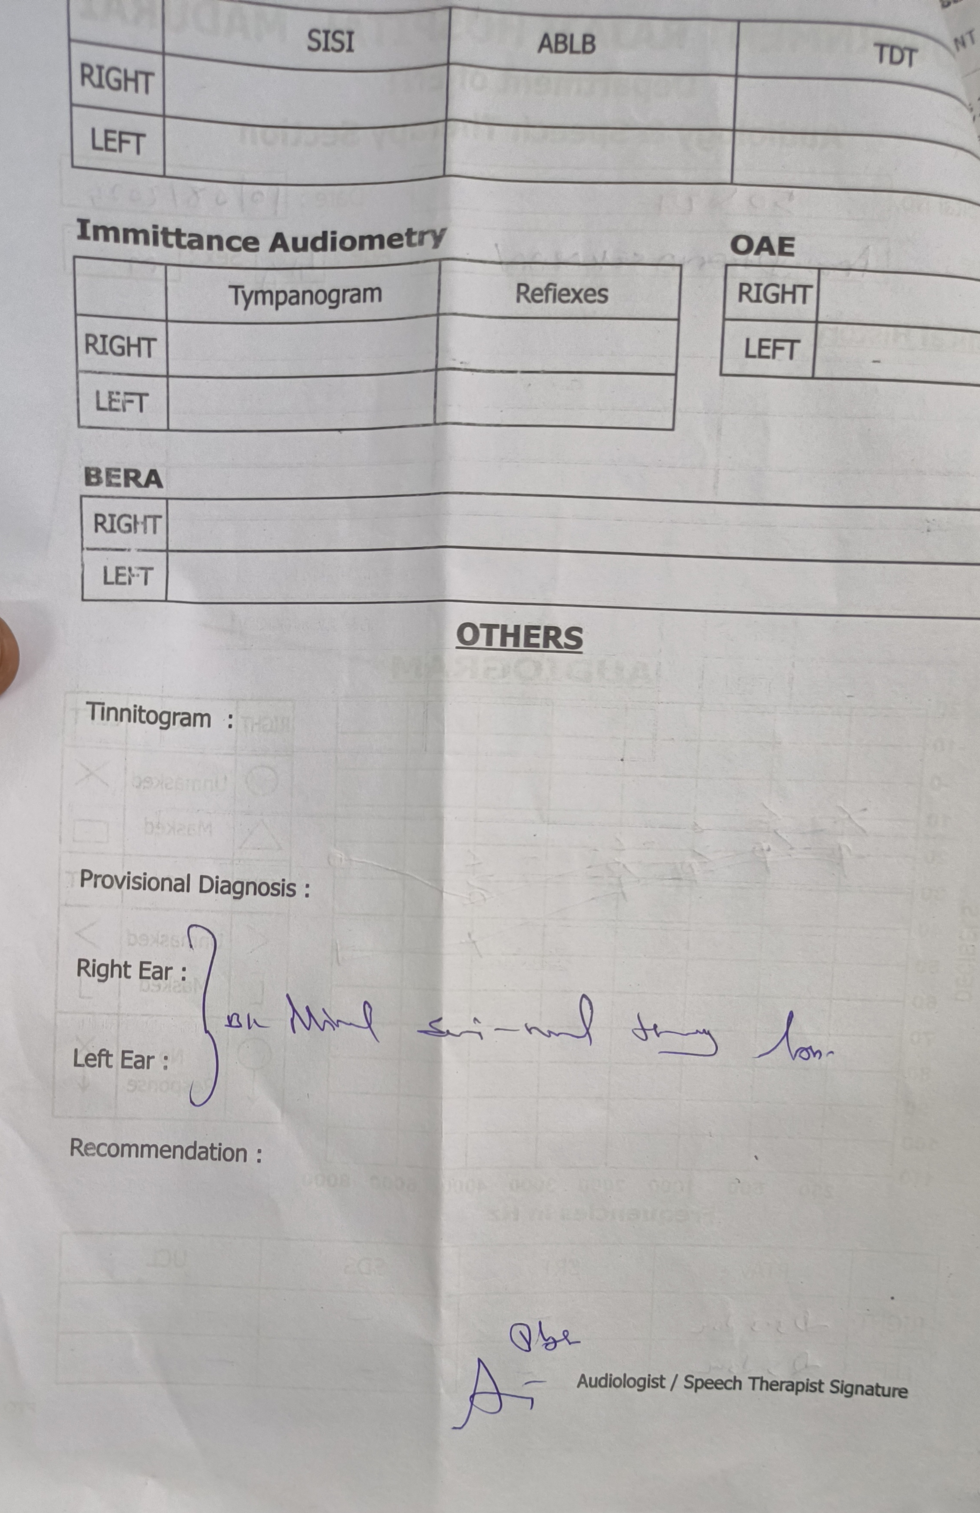
pta

Slide 20
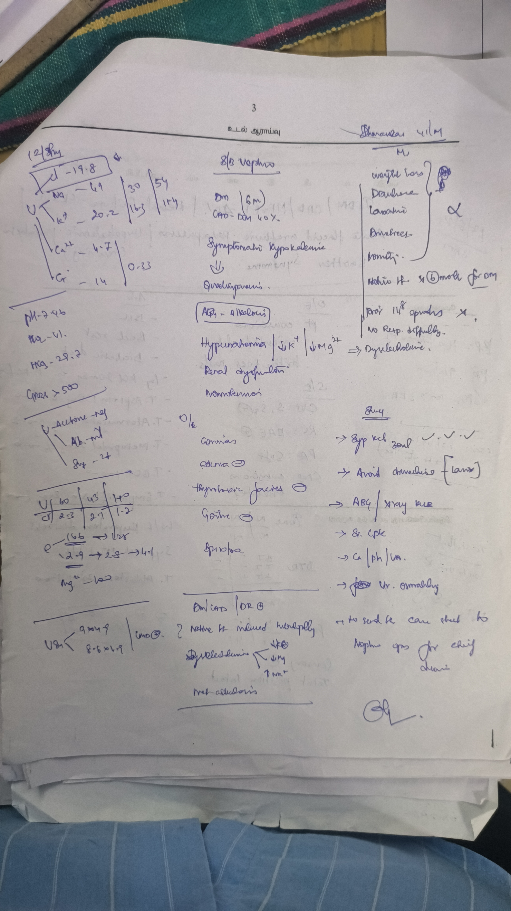
NEPHROLOGY CONSULT

Slide 21
HYPOKALEMIA
RENAL K+ LOSS
NORMAL BP
MET. ALKALOSIS
HYPOMAGNESEMIA
B/L MINIMAL SENSORY HEARING LOSS
ELEVATED URINE Cl levels
URINE Ca/Cr- 0.33
DD's
?BARTTER SYNDROME
?CAM induced Tubulopathy

Slide 22
Final impression
T2DM
CAD - EF40%
Renal Failure -? CRS
Hypokalemic Paralysis (Recovered)
Dyselectrolytemia
? Bartter syndrome/ ? CAM induced Tubulopathy

Slide 23
TREATMENT GIVEN
Diabetic diet
Inj.KCl 40 mEq in RL iv infusion
Inj, magnesium sulphate 1gm iv
Inj. Insulin acc to CBG
T. Aspirin 75mg OD
T.Atorvastatin 20mg HS
T.Metoprolol succinate12.5mg OD
T.Spironolactone 25mg 1-0-0

Slide 24
discussion

