Slide 1
SUICIDE AND IT’S PREVENTION

Slide 2
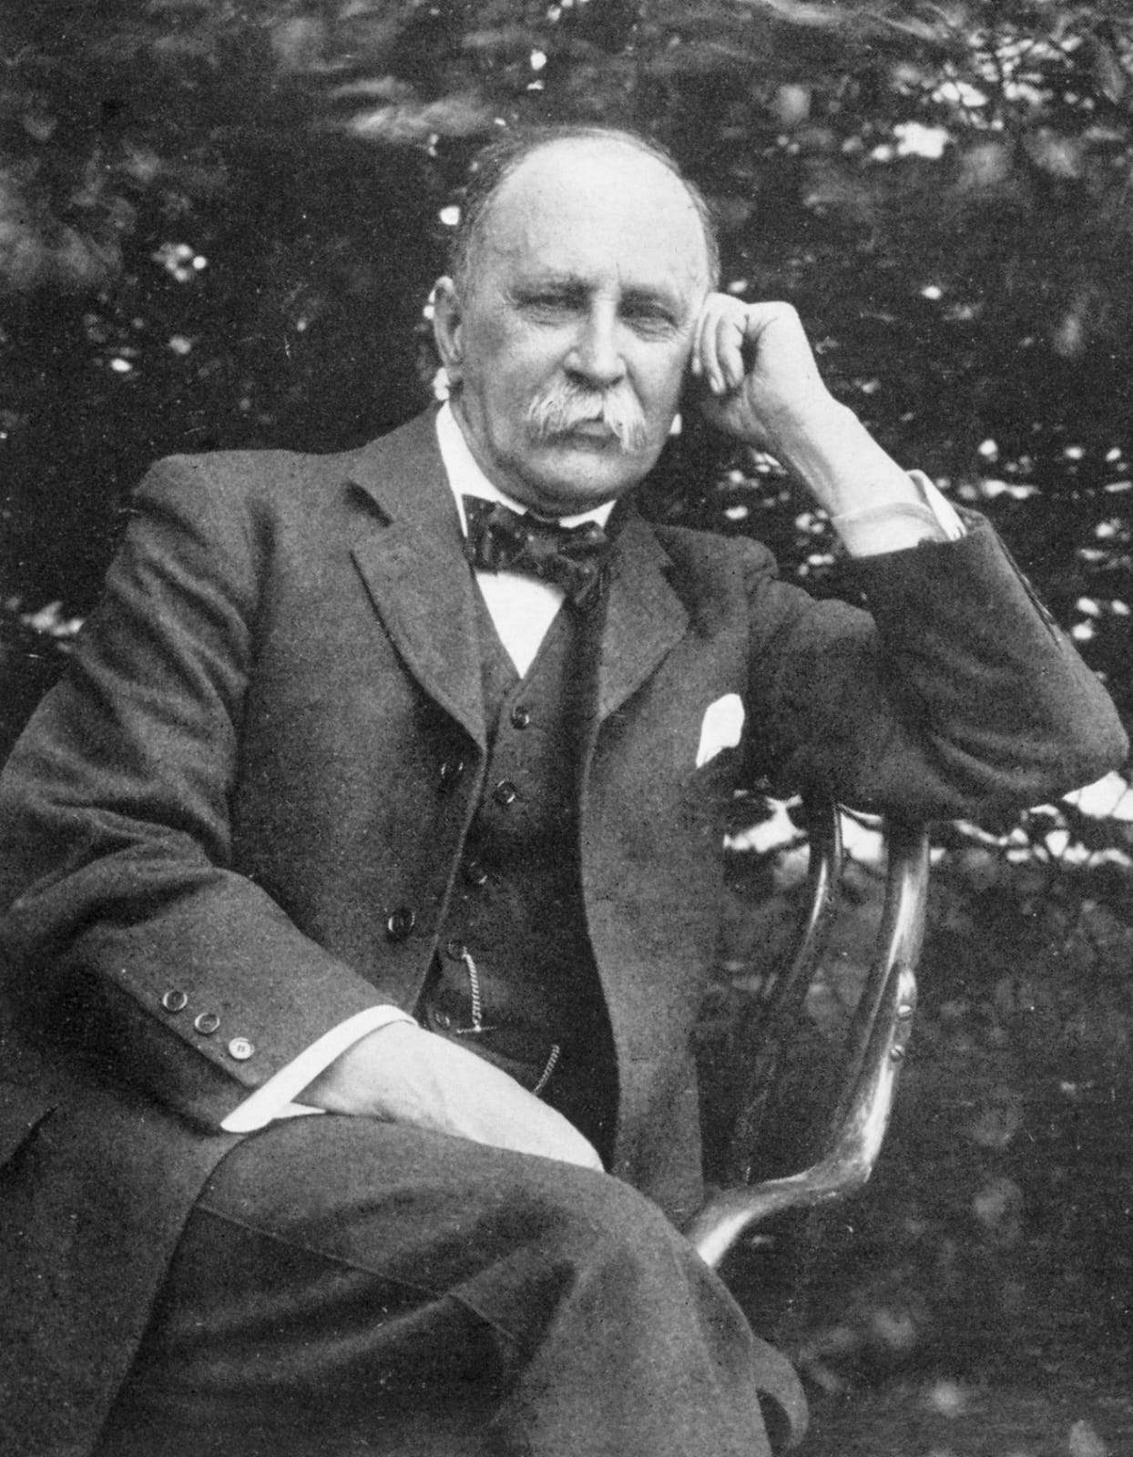
A Quote By Sir William Osler :
“The good physician treats the disease,
the great physician treats the patient,
who has the disease.”

Slide 3
Suicide is preventable condition.
Suicide is the third leading cause of death between ages 15 and 24.
A suicidal patient needs emergent intervention as this can prevent a completed suicide.
As opposed to popular belief suicide is more often a culminating event of an underlying psychiatric disorder ( in 95% of cases) than of any circumstantial life event.
The prevalence of suicide is 10-15% in patients of depression, 10% in schizophrenia and this number rises when alcoholism complicates the picture. Hence the evaluation for an underlying psychiatric disorder is a must in all such patients.

Slide 6
SUICIDE PREVENTION methodology :-
Suicide is preventable condition.
Early recognition of risk factors for suicide.
Early diagnosis and prompt treatment of mental disorders like depression, schizophrenia, bipolar disorder and substance abuse.
Dialectical behaviour therapy.

Slide 7
THANK YOU.

