Slide 1
CPC – March 2024
Dr. K. Rani, professor and HOD
Dr. Sri Janaki, Associate professor
Dr. Subbulakshmi, Assistant professor
Dr. J. Anandha Nivedha, Postgraduate
Department of Pathology, Madurai Medical College

Slide 2
Clinical details
17years/female.
Swelling of B/L lower limbs, facial puffiness, decreased urine output and multiple joints pain.
K/C/O hypothyroidism
Elevated ESR, RFT and serum cholesterol
Low serum albumin
Elevated urine protein
Peripheral smear- hypochromic microcytic anemia with thrombocytopenia
ANA – ds DNA negative, Ro52 positive, Ro60 positive

Slide 3
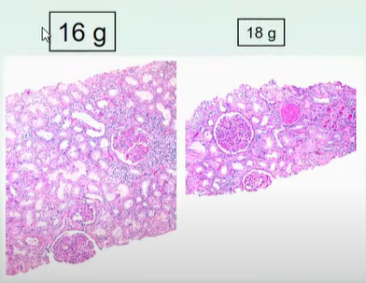
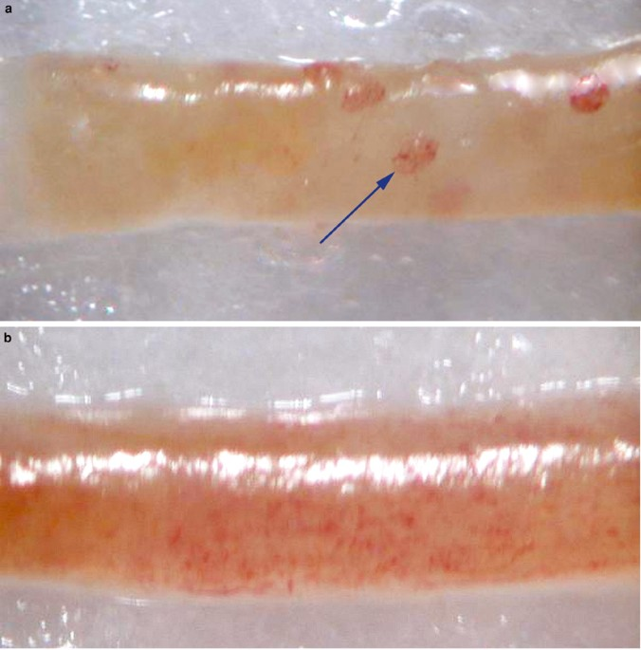
Renal biopsy
16-18G needles for adults and 18G needle for children
Adequacy
Two linear cores with a minimal length of 1 cm and a diameter of at least 1.2 mm
No. of glomeruli for adequate diagnosis
Glomerular lesions – 5
Tubulointerstitial lesions -6-10
Transplanted kidney - 7

Slide 4
Light microscopy
Immuno fluorescence
Electron microscopy

Slide 5
Specimen division
Fixatives
Light microscopy – 10% neutral buffered formalin
Electron microscopy – 2 to 3 % glutaraldehyde
Immunofluorescence – No fixative – delivered in Michel’s media

Slide 6
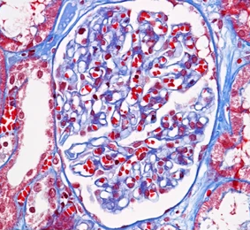
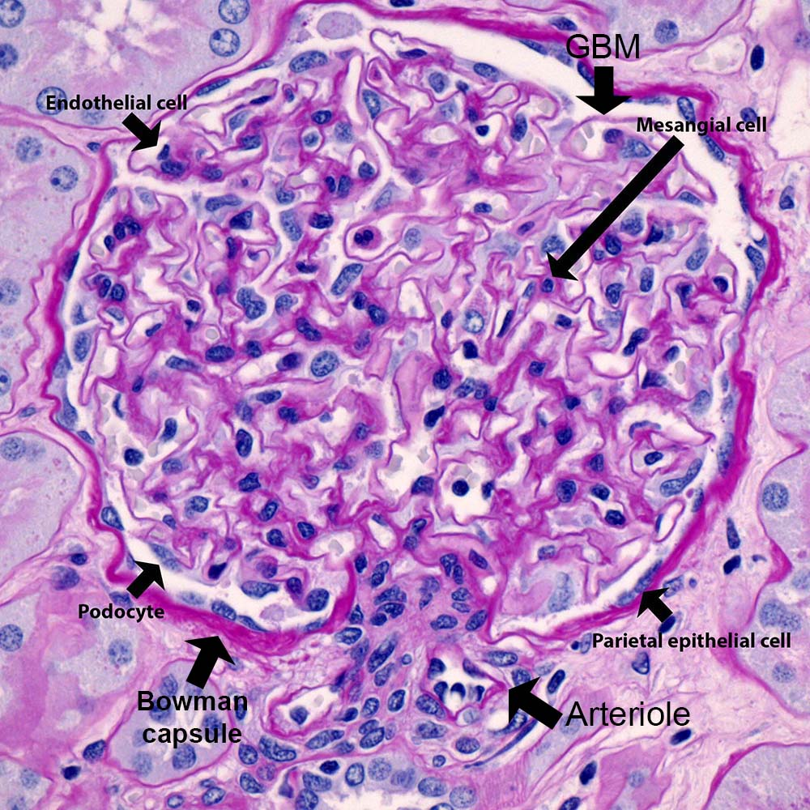
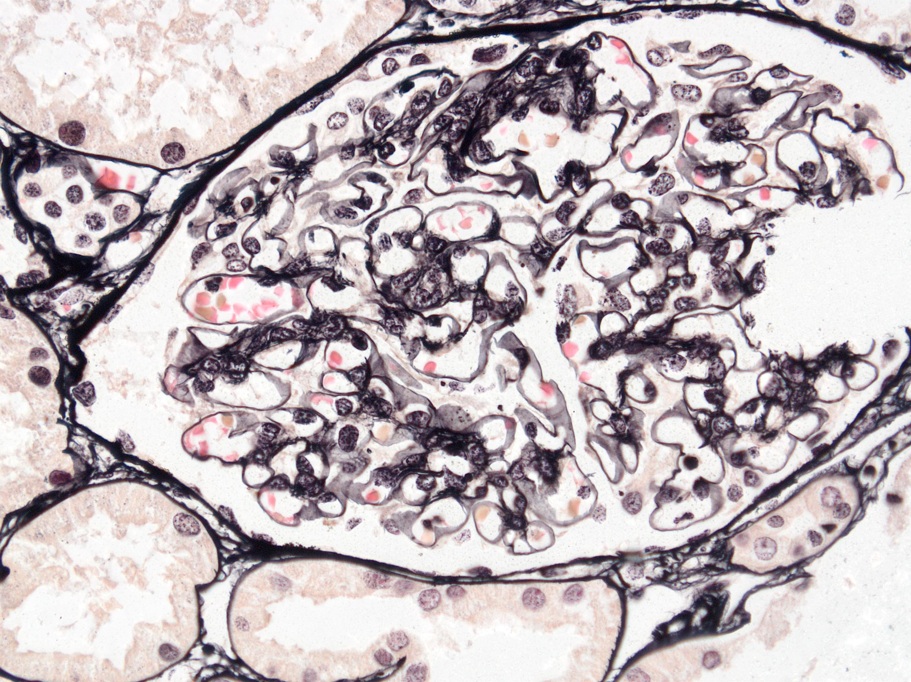
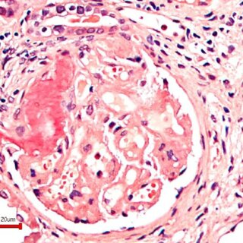
Light microscopy - stains
H&E
Masson’s Trichrome
PAS
Jones Methenamine Silver
Congo red

Slide 7
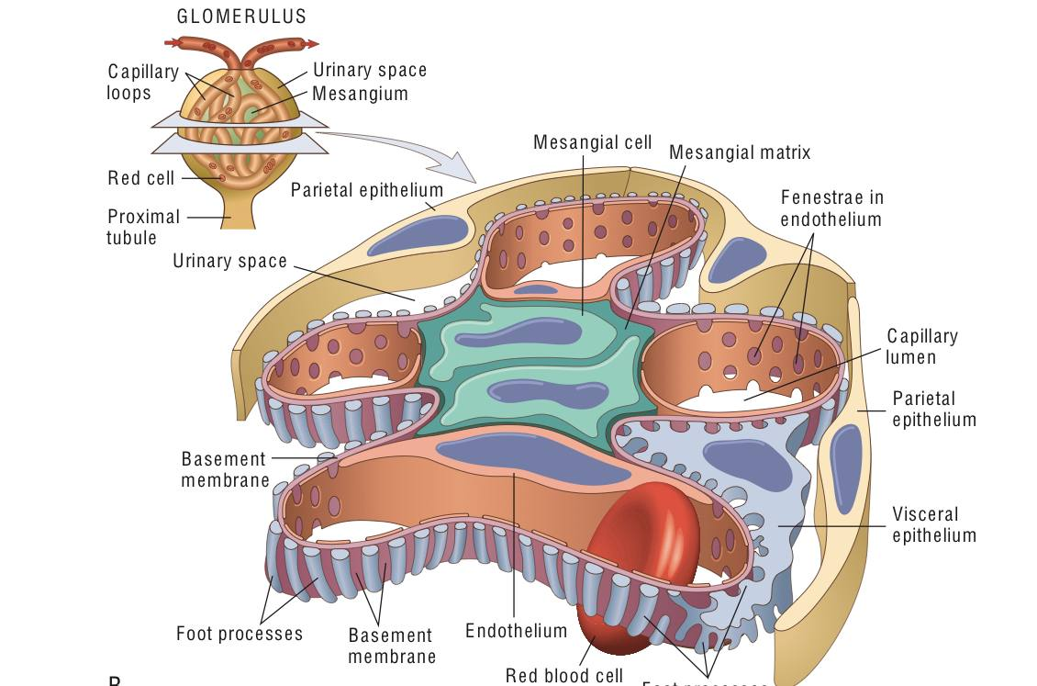
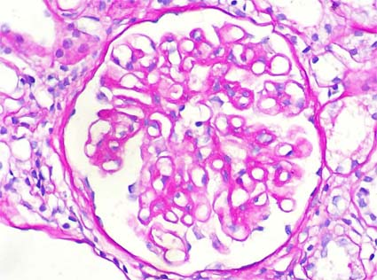

Slide 8
Evaluation of renal biopsy
Glomeruli
Tubulo-interstitium
Vessels

Slide 9
Patterns of glomerular injury
Normal glomeruli
Increased mesangial matrix
Extracapillary proliferation with crescents
Endocapillary proliferation

Slide 10
Immunofluorescence
Heavy chains – IgA, IgG, IgM
Complement components – C3, C1q
Light chains – kappa, Lambda
Albumin, fibrinogen
IgG subclasses(IgG1,2,3,4)
C4d

Slide 11
Intensity – trace to 3+
Location
Glomerular –mesangial, subendothelial and subepithelial
Extracapillary/extraglomerular
-tubular basement membrane, Bowman’s capsule, tubular cytoplasm, intratubular casts, interstitium, blood vessels

Slide 12
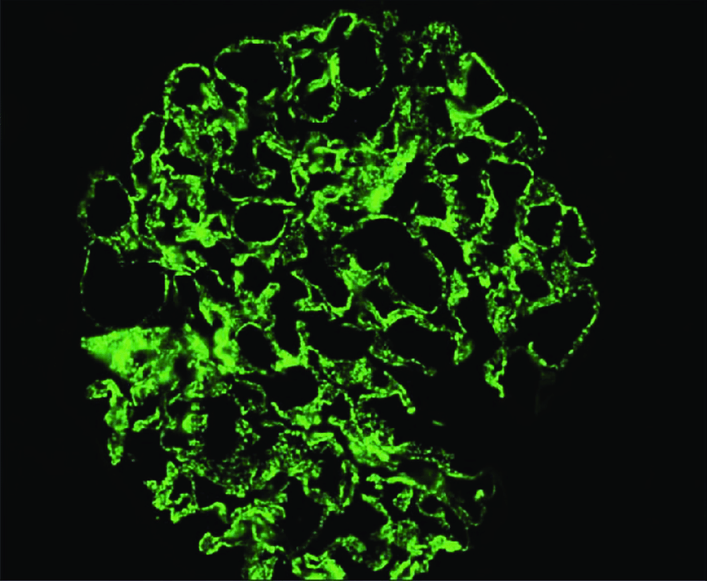
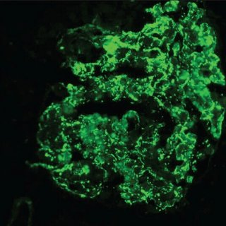
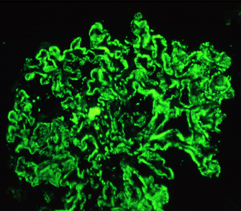
Pattern of staining
Fine granular
Coarse granular
linear

Slide 13
Case discussion
2 linear cores each measuring 0.6 cm were sent, one core in formalin for light microscopy and other in Michel’s medium for immunofluorescence.

Slide 14
Light microscopy
Thirteen glomeruli are seen totally.
Endocapillary and mesangial hypercellularity with lobular accentuation of capillary tuft.
Hyaline thrombi in seven glomeruli.

Slide 15
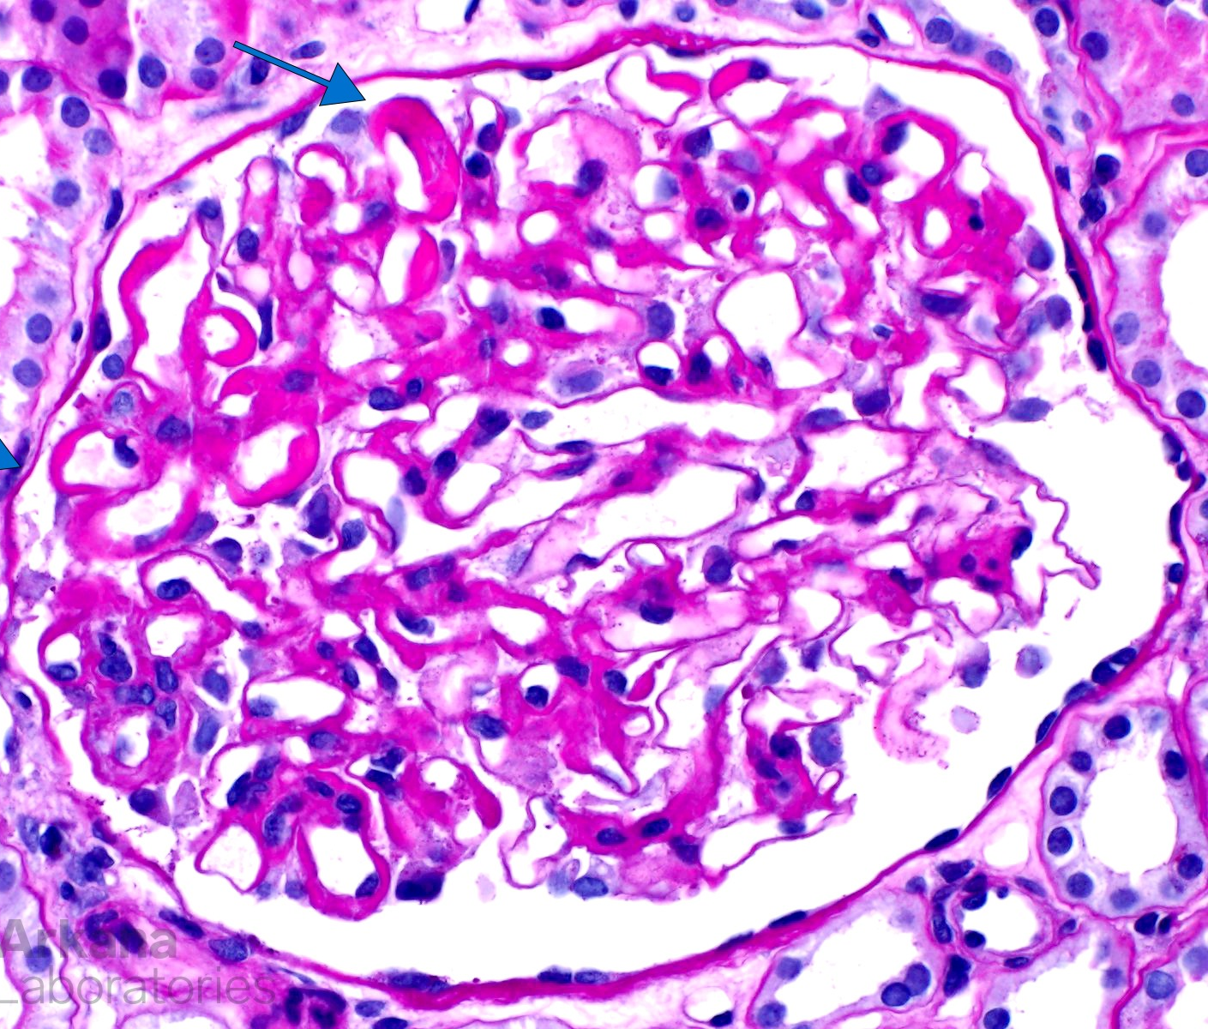
Light microscopy
Double contouring of basement membrane
Wire loop lesions

Slide 16
Light microscopy
Cellular crescents seen in three glomeruli
Neutrophils and karyorrhexis

Slide 17
Light microscopy
No interstitial fibrosis and tubular atrophy.
Small foci of inflammatory cells seen in interstitium
Blood vessels - unremarkable

Slide 18
Immunofluorescence
IgG 3+
IgM 1+
C3 3+
C1q 2+
IgA negative
No light chain restriction

Slide 19
Summary
Endocapillary and mesangial hypercellularity.
Wire loop lesions.
Hyaline thrombi.
Double contouring of basement membrane.
Cellular crescents.
Neutrophils/karyorrhexis
7 glomeruli (>50%)
Immunofluorescence – IgG, C3 and C1q – positive.

Slide 20
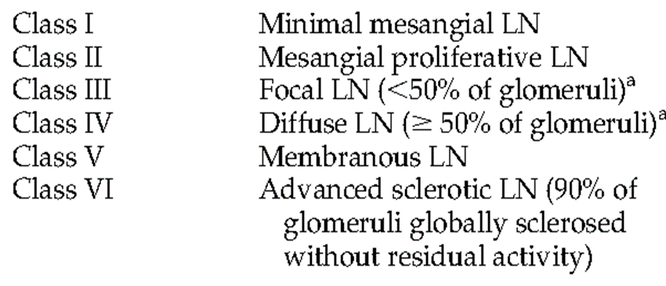
Impression
Lupus nephritis, ISN/RPS Class IV

Slide 21
Modified NIH lupus nephritis activity score
Endocapillary hypercellularity – 3/3
Neutrophils/karyorrhexis – 2/3
Fibrinoid necrosis – 0/6
Hyaline deposits – 3/3
Cellular/fibro cellular crescents – 2/6
Interstitial crescents – 1/3
Total activity score – 11/24
Scoring
Score 1 - < 25 %
Score 2 – 25 – 50 %
Score 3 - > 50 %

Slide 22
Modified NIH lupus nephritis chronicity score
Total glomerulosclerosis – 0/3
Fibrous crescents – 0/3
Tubular atrophy – 0/3
Interstitial fibrosis – 0/3
Total chronicity score – 0/12

Slide 23
Lupus nephritis
Lupus nephritis (LN) occurs in ~50% of patients with SLE and is the most common cause of kidney injury in SLE.
Time of presentation – within first 6- 36 months
Risk factors
Males
Young age
Race – Asian, Blacks & Hispanics > whites
Autoantibodies – Anti- smith, Anti Ro & Anti RNP

Slide 24
Clinical features

Slide 25
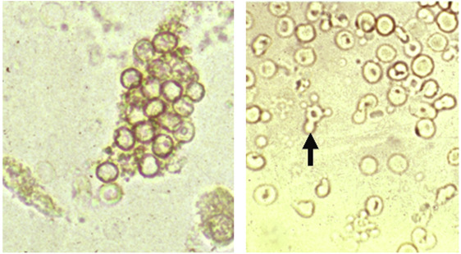
Laboratory tests
24 hour urine protein
24 hour urine creatinine
Protein/creatinine ratio
Urinary sediment – red cell casts, granular casts and hyaline casts
Active lupus nephritis – rising anti DNA antibody titre, hypocomplementemia, hypoalbuminemia , significant proteinuria and hypercholesterolemia
Chronic – hyperuricemia and renal tubular acidosis

Slide 26
Histological abnormalities in LN
Glomerulus
Immune deposits – Mesangial, subendothelial (wire loops), intracapillary (hyaline thrombi)
Glomerular proliferation – mesangial, endocapillary and extracapillary
Glomerular necrosis – karyorrhectic debris
Hematoxylin bodies
Cellular crescents
Tubules and Interstitium
Active – interstitial inflammation and edema
Chronic – tubular atrophy and interstitial fibrosis
Vascular lesions
Arteriosclerosis
Uncomplicated vascular immune deposits
Lupus vasculopathy
Thrombotic microangiopathy
Necrotizing vasculitis

Slide 27
2018 revised ISN/RPS classification of Lupus Nephritis
classes |  | Clinical manifestations
I | Minimal mesangial | asymptomatic
II | Mesangial | microhematuria or mild proteinuria
III | Focal | Hematuria, proteinuria, renal insufficiency
IV | Diffuse | Hematuria, proteinuria, renal insufficiency
V | Membranous | Proteinuria, no renal insufficiency
VI | Advanced sclerosing | Renal insufficiency

Slide 28
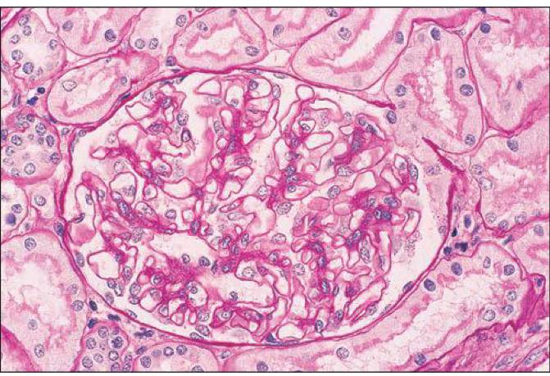
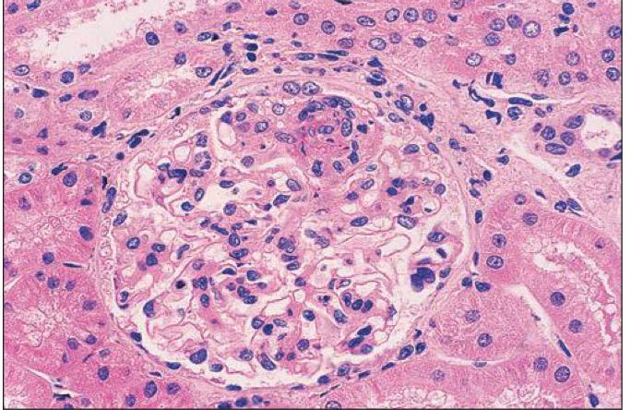
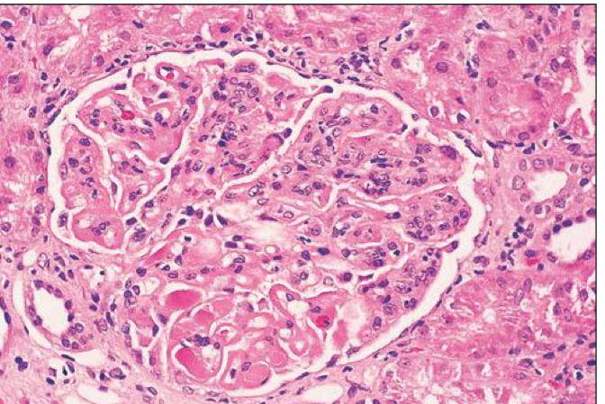
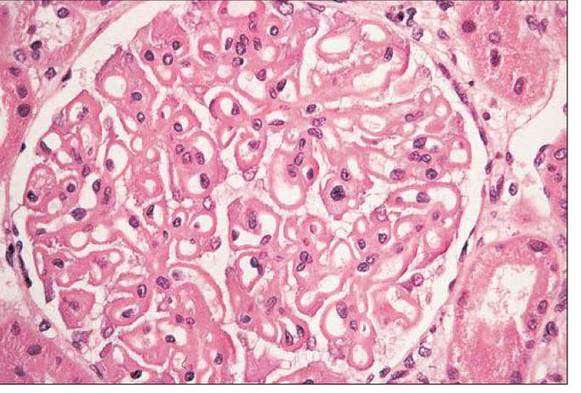
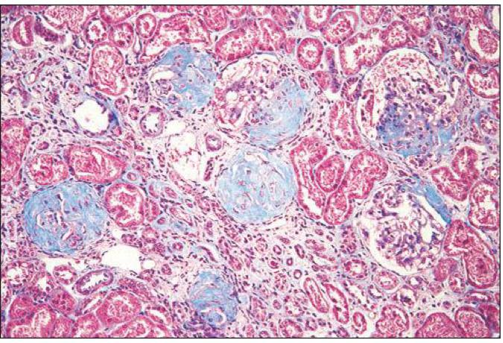
Class I
Class II
Class III
Class IV
Class V
Class VI

Slide 29
Full House immunofluorescence in diffuse LN

Slide 30
Electron microscopy
Granular electron dense deposits are seen in subepithelial, intramembranous, subendothelial and mesangial locations
Tubuloreticular inclusions:

Slide 31
Differential diagnosis
Acute post infectious glomerulonephritis
Membranoproliferative with endocapillary and mesangial hypercellularity
Neutrophilic and later mononuclear infiltration of glomeruli
coarse granular (lumpy bumpy) deposits of polyclonal IgG and C3 along the glomerular capillary walls
HIVICK(HIV associated immune complex kidney disease)
mesangial and focal or diffuse endocapillary hypercellularity
Full house staining
Cryoglobulinemia
Acutely may produce wire loops or thrombi seen in lupus nephritis
membranoproliferative

Slide 32
References
Robbins & Cotran pathologic basis of Diseases
Rosai and Ackerman’s surgical pathology
Sternberg’s diagnostic surgical pathology
Heptinstall’s pathology of the kidney
GLOMERULAR DISEASES: UPDATE FOR THE CLINICIAN:Update on Lupus Nephritis, Almaani, Salem; Meara, Alexa; Rovin, Brad H.
Lupus nephritis: current update
Lupus nephritis: current update
Lupus nephritis: current update
Lupus nephritis: current update

Slide 33
Thank you

