Slide 1
AN INTERESTING CASE OF QUADRIPARESIS
IVTH MEDICINE UNIT
CHIEF
DR.G.BAGIALAKSHMI M.D
ASSISTANT PROFESSORS
DR.S.PEER MOHAMED M.D
DR.N.RAGAVAN M.D

Slide 2
COMPLAINTS
A 59 yrs old female, coming from Dindigul, farmer by occupation, came with chief complaints of
Difficulty in using all 4 limbs for 4 months
Pain in all 4 limbs for 25 days

Slide 3
PRESENTING ILLNESS
Initially started as heaviness involving the left side of upper and lower limbs followed by gradually progressive weakness of all 4 limbs
Associated with pain in all 4 limbs, dull, deep aching pain.
H/O difficulty in rolling over bed ,standing ,climbing stairs (+)
H/O difficulty in holding tumbler, wearing slippers (+)
H/O tripping of toes while walking (+)
No h/o leg cramps

Slide 4
No h/o dysphagia/hoarseness of voice/nasal regurgitation
No h/0 slurring of speech/drooling of saliva/difficulty in chewing food.
No h/o blurring of vision
No h/o sensory disturbances over the body/face
No h/o cotton wool sensation/wash basin sign
No h/o shock like sensation over the back
No Bowel and Bladder disturbances
H/O vertebral pain present over the nape of the neck

Slide 5
No h/o root pain/funicular pain
No h/o diurnal variation of weakness
No h/o fever
No h/o cough with expectoration
No h/o vomiting/headache/seizures
No h/o trauma

Slide 6
Past history
No h/o similar illness in the past
No past h/o tuberculosis
No h/o diabetes, Hypertension, Epilepsy
Hysterectomy done 15 yrs before for DUB

Slide 7
Past history
Past record shows h/o thyroid swelling for which she was evaluated at GRH in DEC 2014. FNAC from thyroid done – s/o colloid goitre
Near-total thyroidectomy was done. HPE reported as ‘multinodular goitre with degenerative changes’.
Patient was on tab. Thyroxine 100mcg/day since then.

Slide 8
Family and personal history
Mixed diet
No addiction
No similar illness in family members

Slide 9
General examination
Conscious
Oriented
Afebrile
No pallor/icterus/cyanosis/clubbing/pedal edema/lymphadenopathy.
Oral cavity: normal

Slide 10
No markers of TB, HIV, syphilis
No neurocutaneous markers
A healed, transverse scar of 6cm length is seen over the anterior aspect of the neck
Height neck ratio 9.6:1
No features of hypothyroidism/latent tetany
No features of Horner's syndrome
E/O breasts - normal

Slide 11
vitals
98%in
Room air
88/min,
regular
130/90mm of Hg

Slide 12
98.4 deg celsius
RR-16/min
Equally felt,
No bruit

Slide 13
Systemic examination
Central nervous system:
Higher functions:
Conscious,
Oriented
Language, speech, memory, intelligence, sleep pattern : normal
Right handedness
Cranial nerve examination : normal.
Fundus examination - Normal

Slide 14
Motor system:
 | RIGHT | LEFT
BULK | NORMAL | NORMAL
UPPER LIMB
ARM | 24 cm | 25cm
FOREARM | 18cm | 18cm
LOWERLIMB
THIGH | 30cm | 30cm
LEG | 21cm | 21cm

Slide 15
TONE | RIGHT | LEFT
UPPER LIMB | Increased | Increased
LOWER LIMB | Increased | Increased

Slide 16
POWER:
POWER | RIGHT | LEFT
SHOULDER
ABDUCTION | 4/5 | 3/5
ADDUCTION | 4/5 | 3/5
FLEXION | 4/5 | 3/5
EXTENSION | 4/5 | 3/5
ELBOW
FLEXION | 4/5 | 3/5
EXTENSION | 4/5 | 3/5
WRIST
FLEXION | 4/5 | 3/5
EXTENSION | 4/5 | 3/5

Slide 17
POWER | RIGHT | LEFT
HIP
FLEXION | 3/5 | 3/5
EXTENSION | 3/5 | 3/5
KNEE
FLEXION | 3/5 | 3/5
EXTENSION | 3/5 | 3/5
ANKLE
DORSI FLEXION | 3/5 | 3/5
PLANTAR FLEXION | 3/5 | 3/5

Slide 18
REFLEXES:
REFLEXES | RIGHT | LEFT
SUPERFICIAL REFLEX:
CORNEAL | PRESENT | PRESENT
CONJUNCTIVAL | PRESENT | PRESENT
ABDOMINAL | ABSENT | ABSENT
ANAL REFLEX | PRESENT
PLANTAR | EXTENSOR | EXTENSOR

Slide 19
REFLEXES | RIGHT | LEFT
DEEP TENDON REFLEX:
JAW | - | -
TRAPEZIUS | + | +
BICEPS | +++ | +++
TRICEPS | +++ | +++
SUPINATOR | +++ | +++
KNEE | +++ | +++
ANKLE | +++ | +++
CLONUS
PATELLAR | ABSENT | ABSENT
ANKLE | ABSENT | ABSENT

Slide 20
SENSORY SYSTEM
On the left upper limb,
Impaired touch and pain sensations over the C5 and C6 dermatomes.
Sensations in the right upper limb are normal

Slide 21
SENSORY SYSTEM – LOWER LIMB
SENSATION | RIGHT | LEFT
TOUCH | NORMAL | NORMAL
PAIN | NORMAL | NORMAL
TEMPERATURE | NORMAL | NORMAL
JOINT SENSE | NORMAL | NORMAL
POSITION SENSE | NORMAL | NORMAL
VIBRATION SENSE | NORMAL | NORMAL

Slide 22
CEREBELLUM : normal
No neck muscle weakness
Spine examination: Bony tenderness present over the C5, C6 and C7 vertebrae
No spinal deformity
Gait : could not be tested

Slide 23
Other system:
CVS:
S1, S2 heard.
JVP not elevated
No murmur
RS:
NVBS+
No added sound.

Slide 24
Abdomen :
Soft
Not tender
No free fluid
Bowel sounds heard

Slide 25
PROVISIONAL DIAGNOSIS
Spastic quadriparesis for evaluation – Extramedullary extradural Cervical compressive myelopathy
Motor level – above C5
Reflex level – above C5
Segmental sensory loss over C5, C6 dermatomes
Differential diagnosis
Intervertebral disc prolapse
Secondaries
Pott’s spine

Slide 26
Investigations:
Hb :11.1 gm%
TC : 13200 cells/mm3
DC : Neutrophils-77%
Lymphocytes-10 %
Monocyte -7 %
Platelet count- 4.76lacs/mm3
ESR: 25mm/hr

Slide 27
Blood sugar(R): 128 mg%
Sr. urea: 24mg%
Sr. creatinine: 0.8mg%
Urine routine
Albumin- +
Sugar- nil
Deposits- 6-8 pus cells

Slide 28
Sr Electrolytes
Sodium-134 mEq/L
Potassium-3.4 mEq/L
Chloride-98 mEq/L
Calcium -9.2 mg/dl

Slide 29
VCTC
Non-reactive
T3 – 84.69 ng/dl
Thyroid profile
T4 – 8.70 µg/dl
TSH – 0.554 µIU/ml

Slide 30
USG Abd and pelvis
Normal study
Chest X-ray
Normal
ECG
Within normal limits

Slide 31
Neurophysician opinion
A case of spastic quadriparesis/cervical compressive myelopathy above c5 level
Suggested – MRI cervical spine with whole spine and brain screening

Slide 32
MRI SPINE

Slide 33
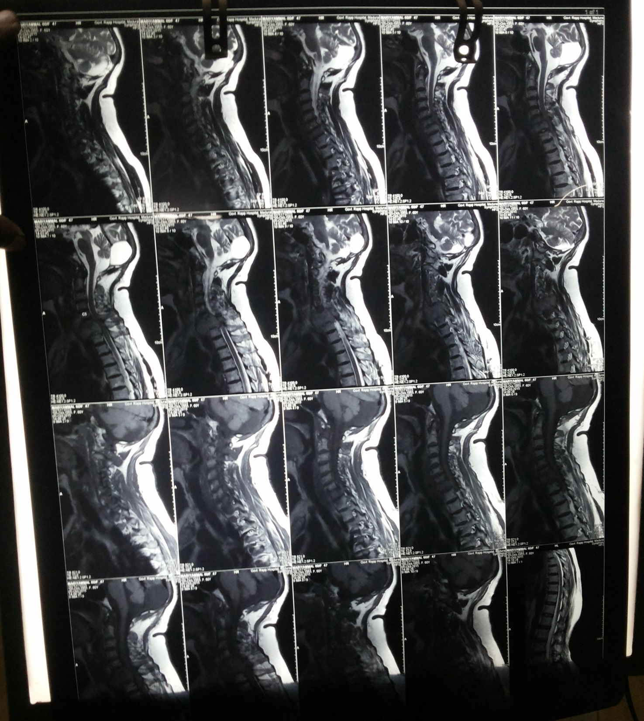

Slide 34
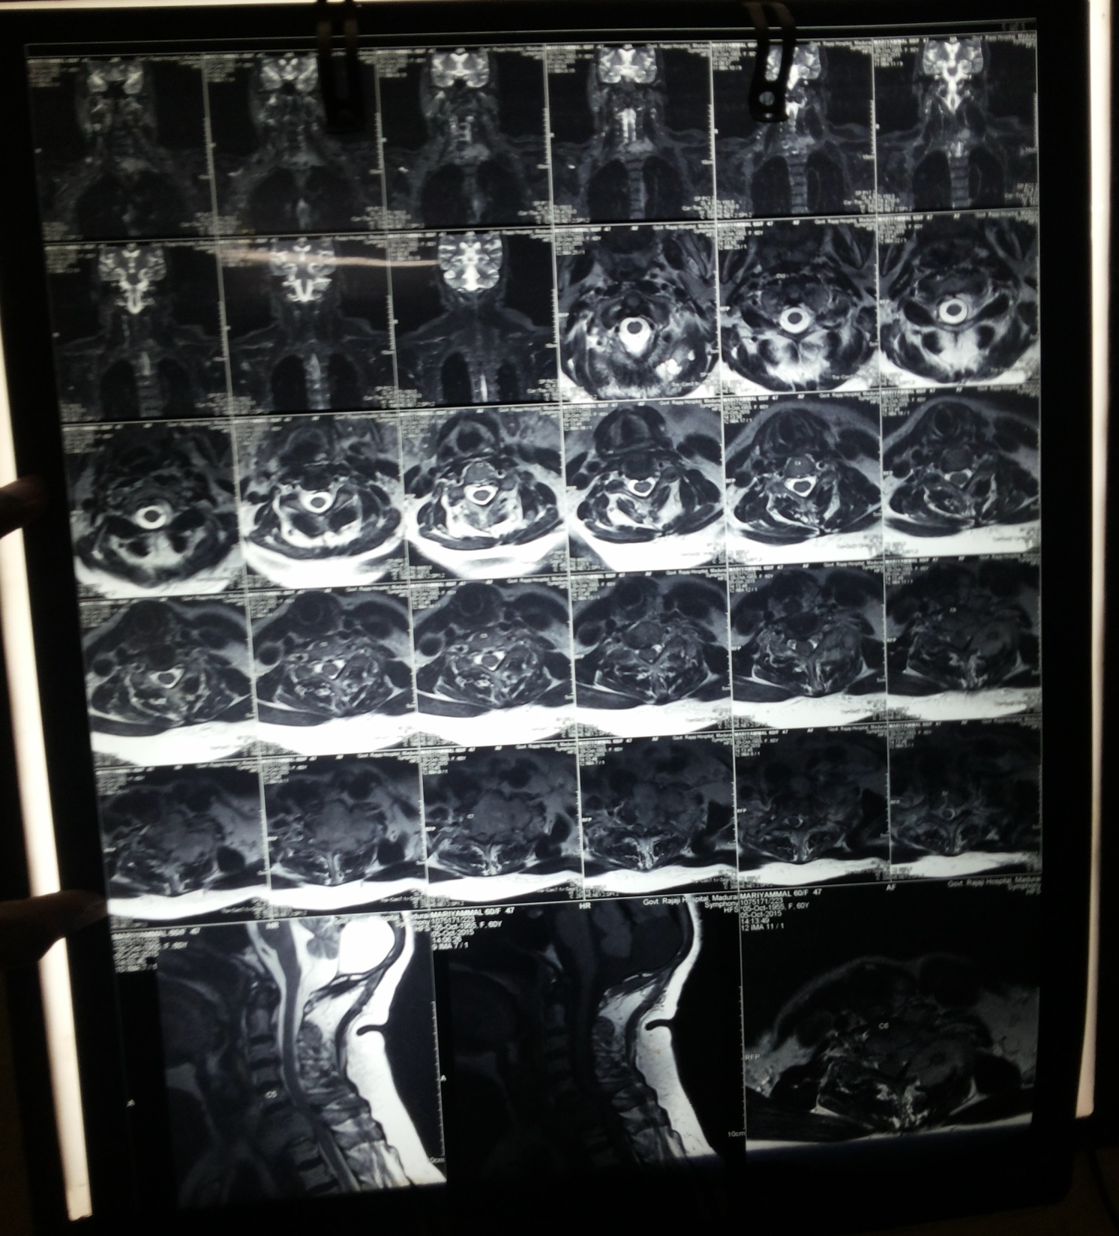

Slide 35
CT SPINE

Slide 36
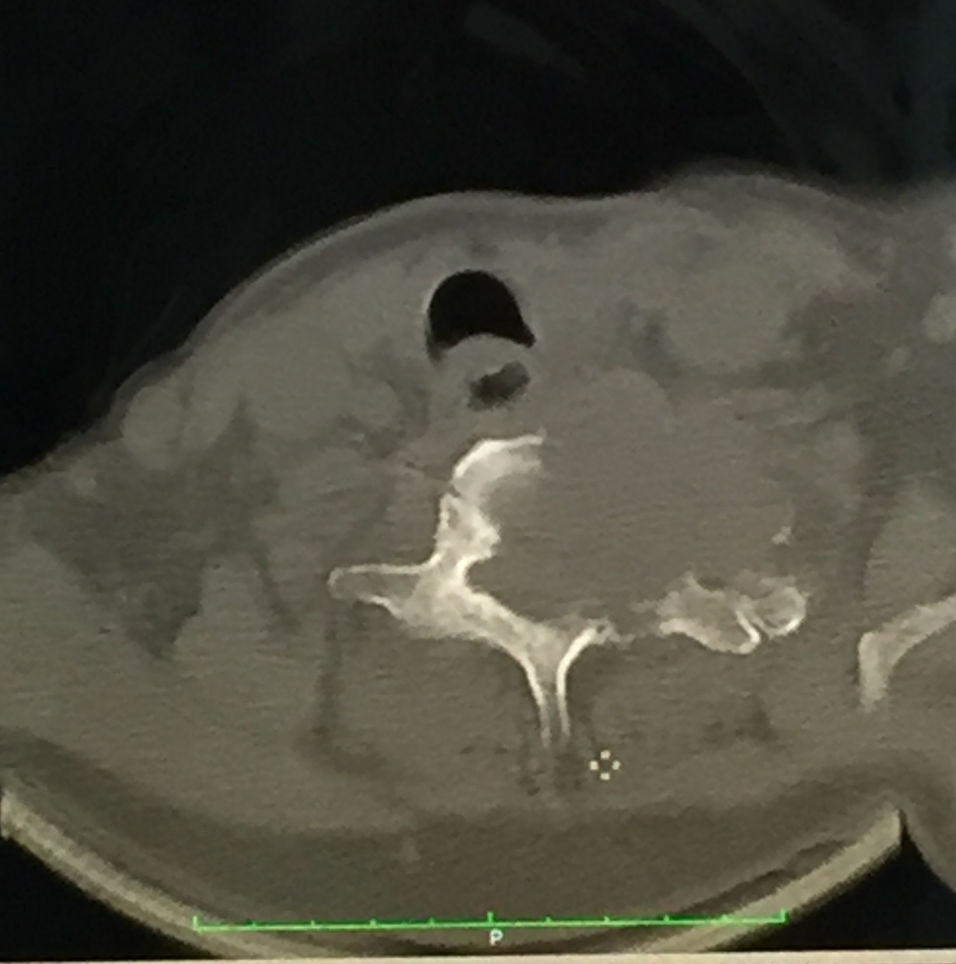

Slide 37
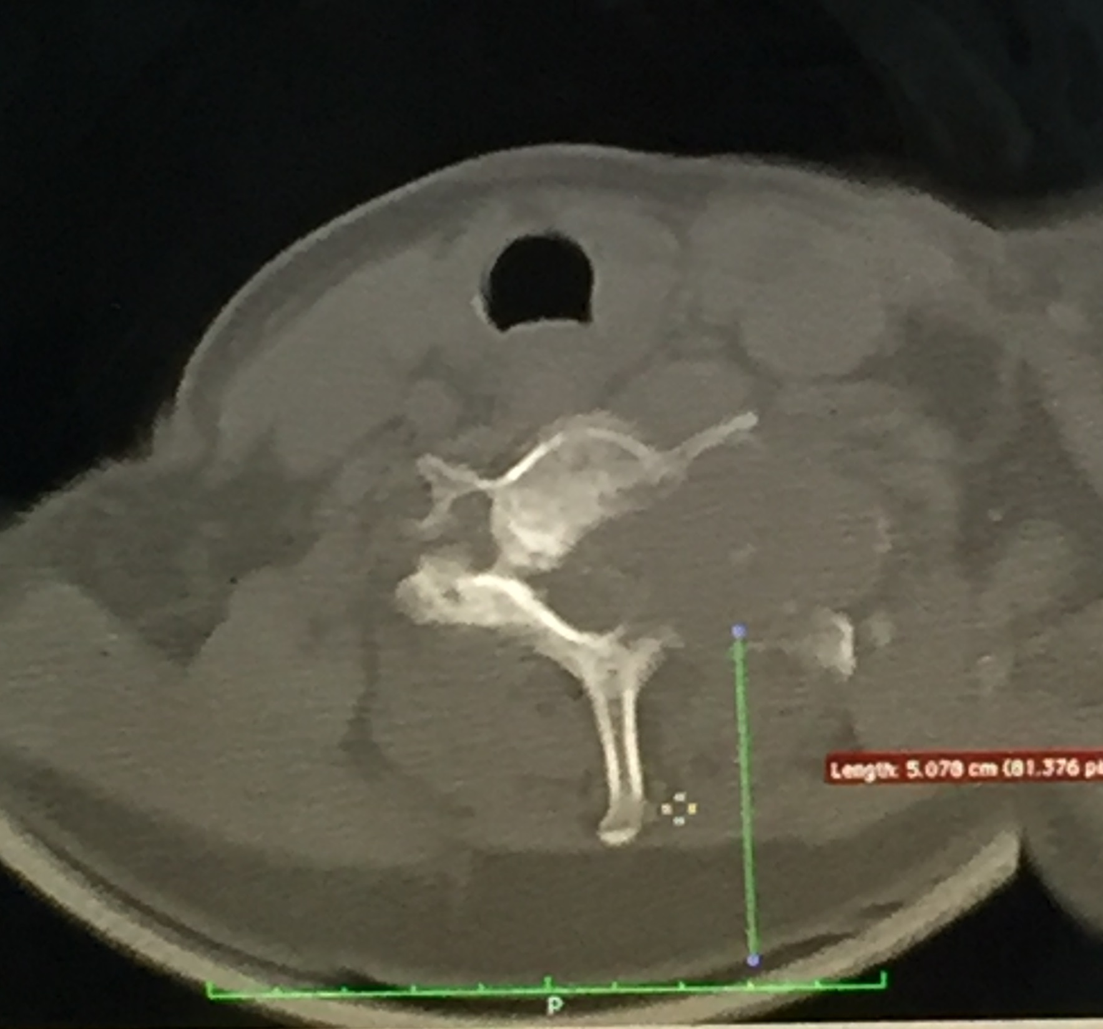

Slide 38
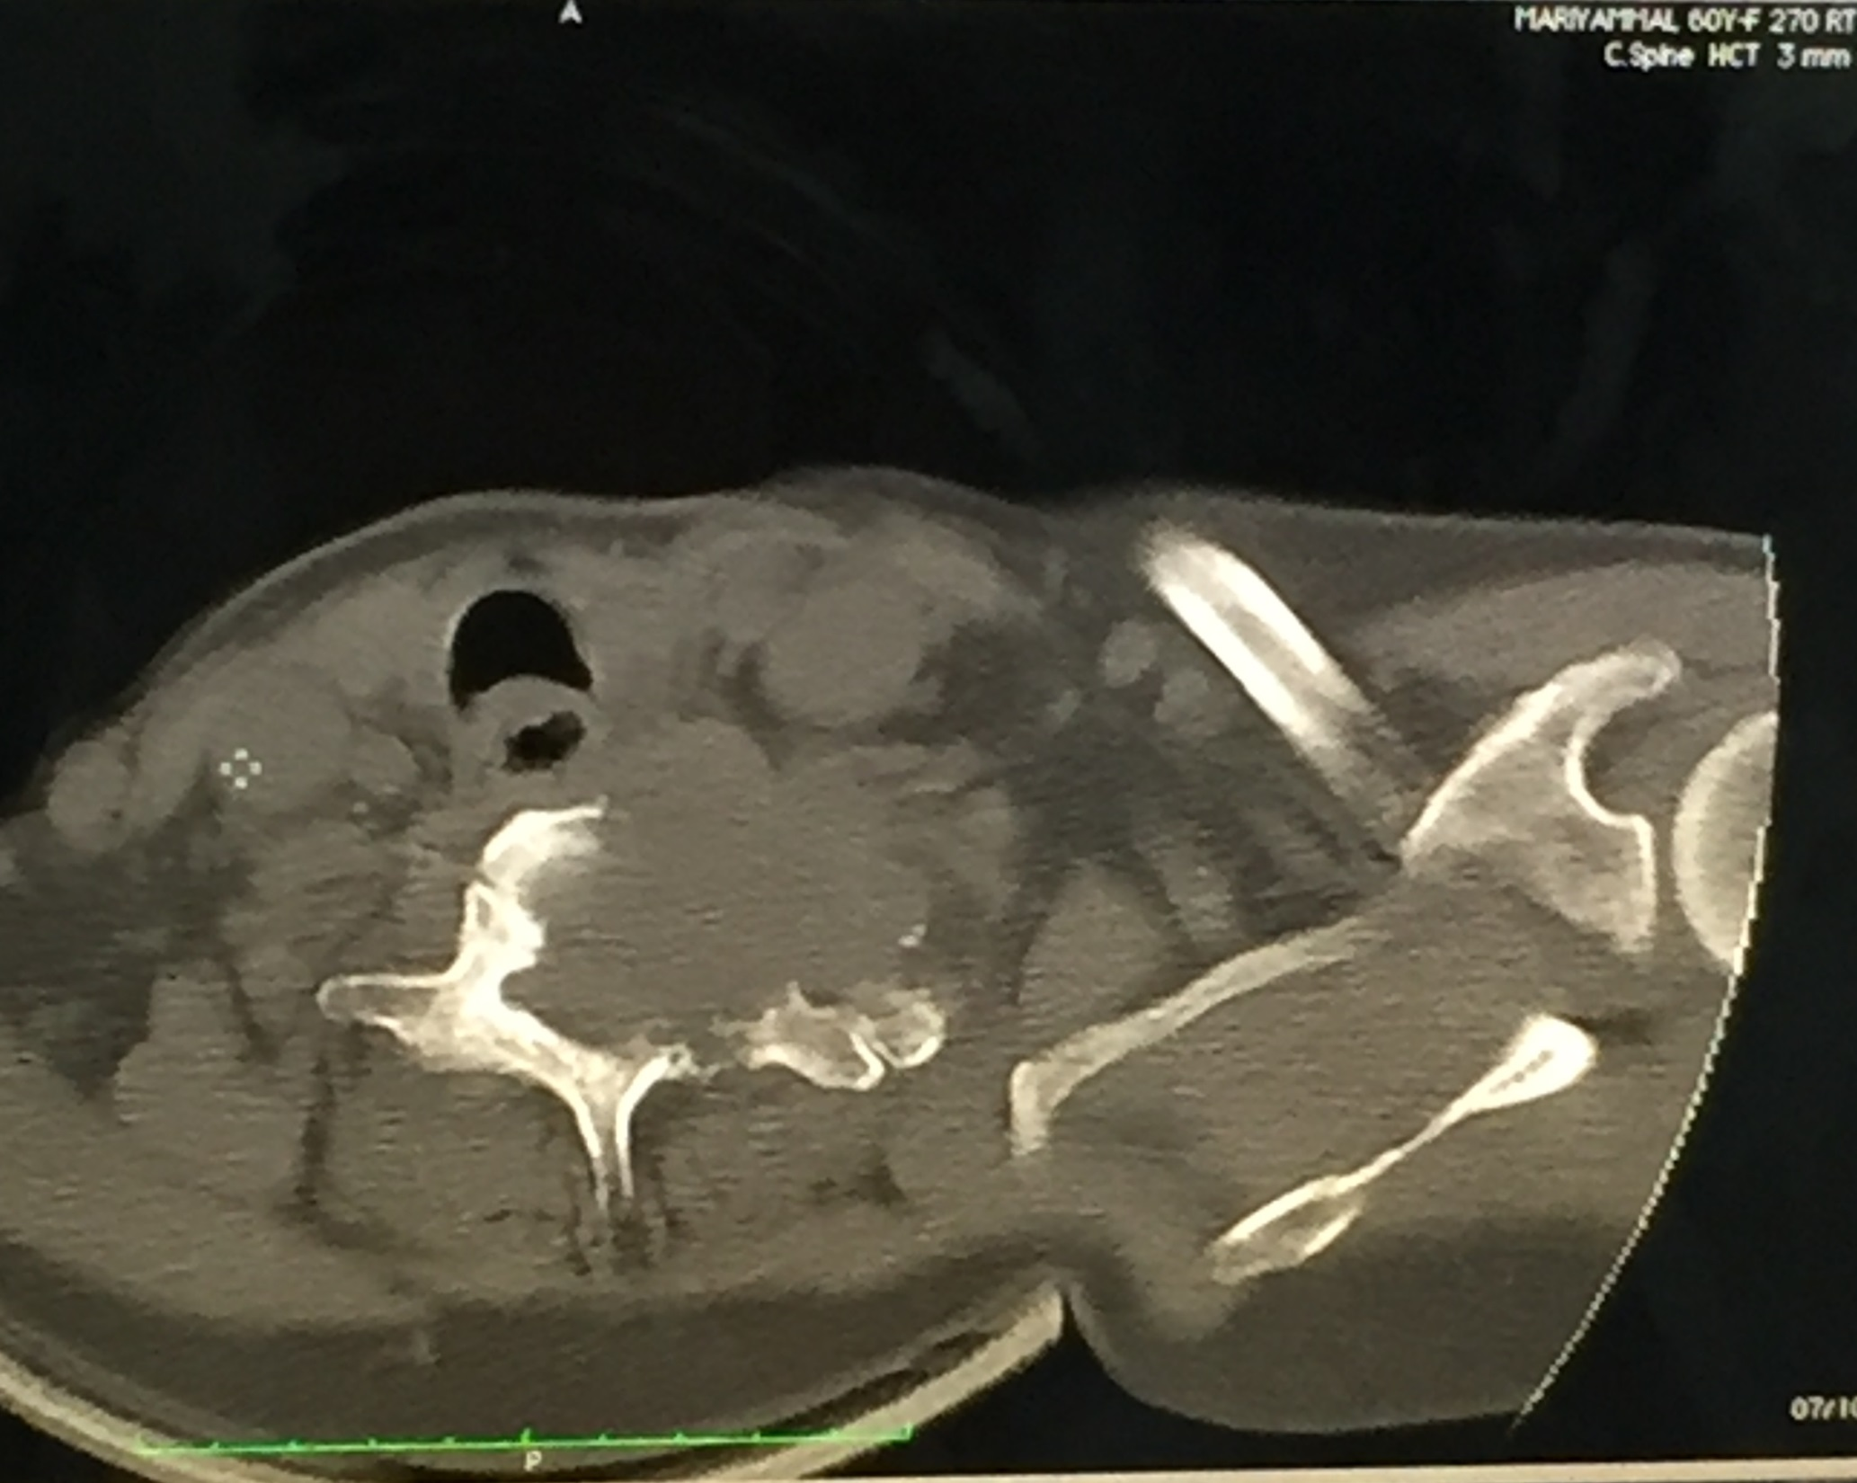

Slide 39
MRI REPORT
E/O T1 hypointense and T2 hyperintense expansile osteoblastic lesion involving body of C6, C7 vertebrae, pedicle, lamina and facet joints. The lesion encroaches into spinal cord canal causing compression of underlying spinal cord.
Diffuse annular disc bulge noted at C3-C4, C4-C5 levels without e/o any nerve root compression.

Slide 40
Lumbar spine screening
Bony alignment normal. Lordosis maintained.
Disc dehydration and disc bulge noted at L3-L4, L4-L5 and L5-S1 levels causing indentation of anterior thecal sac.
Impression – Secondaries spine involving C6, C7 Vertebrae

Slide 41
Medical oncologist
Osteoblastic secondaries involving C6, C7 vertebra
Suggested CT guided biopsy

Slide 42
Neurosurgeon opinion
Secondaries spine at C6, C7 level causing compressive myelopathy
Advised – Image guided biopsy from the secondaries spine and review

Slide 43
Case contd
CT guided biopsy – suggestive of secondary malignancy , thyroid follicles are seen

Slide 44
Post thyroidectomy biopsy was sent for 2nd opinion – suggestive of minimally invasive follicular carcinoma

Slide 45
HPE REPORT
Section studied shows well encapsulated nodular lesion of thyroid with proliferation of closely packed thyroid follicles.
There is nodular proliferation of thyroid follicles with focal areas of calcification and focal area of capsular invasion.
Overall picture is suggestive of minimally invasive follicular carcinoma of thyroid.

Slide 46
FINAL DIAGNOSIS
Spastic quadriparesis due to osteoblastic secondaries at C6, C7 level due to follicular carcinoma of thyroid

Slide 47
Neuro-surgery review
Case of spastic quadriparesis/follicular ca thyroid with secondaries spine
Suggested -
Radiotherapy
Radical resection and decompression

Slide 48
Medical oncologist review
Suggested –
Palliative radiotherapy to cervical spine
Radio- iodine 131

Slide 49
TREATMENT GIVEN
Palliative radiotherapy to cervical spine (#7 cycles)
INJ. DEXAMETHASONE 8 MG iv 12hrly
TAB. Thyroxine 100 mcg/day
TAB. Calcium 1 – 0 - 1
Patient was referred to higher center for radio-iodine therapy.

Slide 50
Aim of presentation
To highlight the unusual presentation of thyroid malignancy with osteoblastic secondaries

Slide 51
THANK YOU

