Slide 1
CLINICOPATHOLOGICAL CONFERENCE

Slide 2
CHIEF COMPLAINTS:
A 28 year old male came with complaints of vomiting and loss of appetite for past 5 days.

Slide 3
History of presenting illness:
Vomiting for 5 days.
4 episodes per day.Vomitus contains food particles .not blood stained.non bilious.non projectile.
Loss of apeitite for 5 days.
No Abdominal pain
No fever
No Malena /hematemesis
No cough/breathlessness/hemoptysis

Slide 4
No chestpain/syncope/paplpiatation
No headache/seizure/loss of consciousness.
No H/o Hematuria/oliguria
No H/o blurring of vision
No H/o yellowish discolouration of skin/sclera
No H/o swelling of limbs

Slide 5
PAST HISTORY:
Patient had undergone one haplomatch type live related renal transplant 3 years ago, with his mother as donor.
He had been doing quite well since his transplant, with a nadir creatinine of 1.6 mg/dL
He was on triple immunosuppressive therapy comprising prednisolone 7.5 mg/day, mycophenolate mofetil (MMF) 1 g/day and tacrolimus 4.5 mg/day.

Slide 6
General examination:
On examination
Conscious
Oriented
Afebrile.
No pallor/pedal edema
No cyanosis/clubbing.
No generalized lymphadenopathy.

Slide 7
Systemic examination:
Cvs: S1S2 heard.
Rs: Bilateral air entry present.NVBS(+).
CNS: Consciuos oriented.NFND.
P/A: Non tender .No organomegaly.

Slide 8
Investigations:
Complete blood count.
HB: 11.9 g/dl. Tc : 10,600. DC: N60%/L30%/M5%/E5%. Platelet:2.10 lakhs.
Urea: 65 .Creatinine:3.4.
LFT: Normal.
Urinalysis: Albumin :2 +; Blood :2+

Slide 9
Vctc: Negative.
Viral markers : Non reactive

Slide 10
Investigations contniued....
USG of abdomen and graft kidney: Normal.
Xray chest : Normal.
Graft biopsy done. biopsy showed interstitial inflammation (i2), tubulitis (t2), and 10% interstitial fibrosis and tubular atrophy. Suggestive of Acute cell mediated rejection(Acmr) BANFF IA, C4D negative.
Patient treated with iv methylprednisolone 500/250/250 mg
Graft function started improving.

Slide 11
Two days later....
Intolerable abdominal pain,profuse vomiting ,small volume diarrhea and tenesmus.
Initiated on empirical antibiotics ,oral nitazoxanide .
Stool microbiological analysis was sent. Xray abdomen taken.

Slide 12
Cmv Dna quantitative PCR was done-1330 copies.started on oral valgancicyclovir.
Patient developed high grade fever spikes (+)and new onset dyspnea.
Worsening of sepsis considered.Blood and urine cultures sent.Antibiotics escalated.chest imaging done.
Immunosuppression was reduced.

Slide 13
Respiratory distress worsened.
Started on non-invasive ventilation.

Slide 14
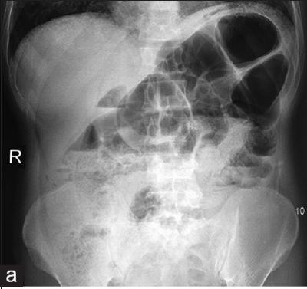
X ray abdomen:

Slide 15
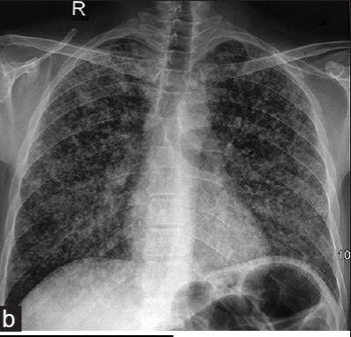
Repeat X ray chest

Slide 16
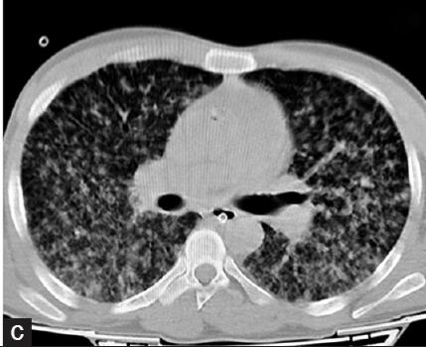
Ct chest

Slide 17
ATT and amphotericin b was started empirically.
Tacrolimus and MMF were with held
After 3 days of ATT And Antifungal therapy,he further deteriorated.
Tachypnea worsened.Had hemoptysis.HB dropped to 5 mg/dl. Sputum samples sent for analysis.

Slide 18
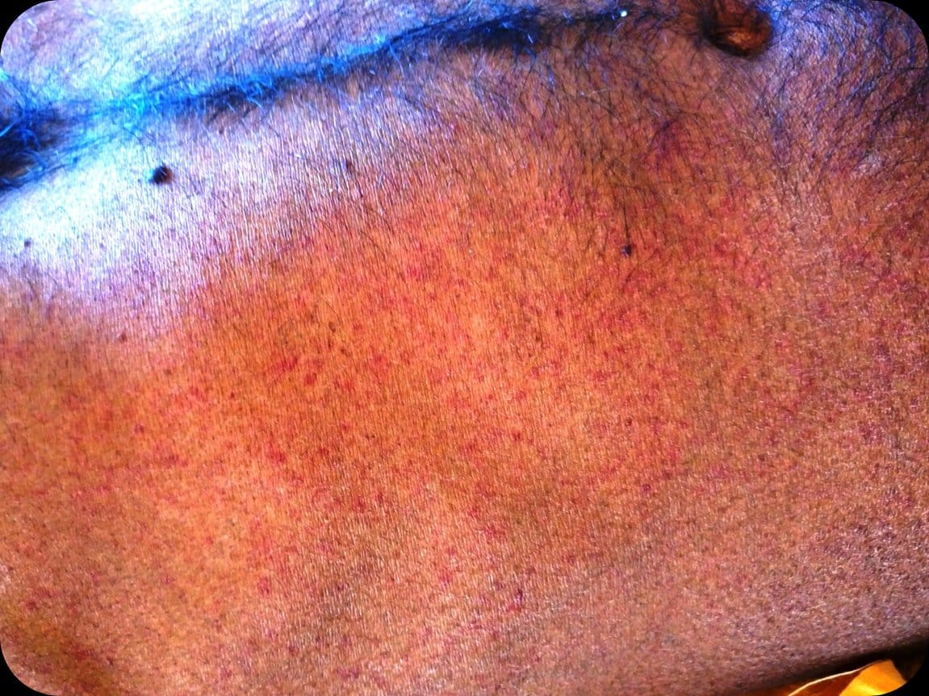
Patient Started on oral ivermectin but His condition deteriorated.He started to develop petechial rash Over the abdomen

Slide 19
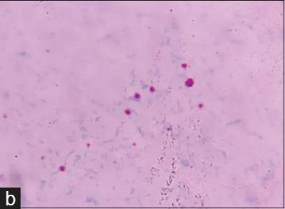
Stool microscopy

Slide 20
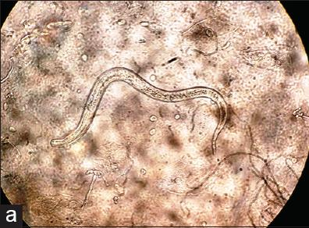
Wet mount of sputum

Slide 21
What next??

