Slide 1
Radio imaging for discussion ii medical unit chief: dr. David Pradeep kumar MD MRCP assT proFs: dr. prabhu md dr. naseema banu md dr. Ramkumar md presentor: DR. SNEHA SRINIVASAN

Slide 2
A 70 year old male came with chief complaints of inability to open right eyelids for past 1 month
HISTORY OF PRESENTING ILLNESS:
Patient was apparently normal before 1 month , then presented with chief complaints of
Right eyelids drooping for past 1 month
C/O of giddiness and headache for past 7 days
C/O of vomiting on and off for past 7 days
C/O diplopia for 7 days
No other specific complaints
PAST HISTORY:
Not a known case of Diabetes, Hypertension , Tuberculosis, HIV, Thyroid disorder, and bronchial asthma

Slide 3
GENERAL EXAMINATION:
conscious, comfortable, afebrile, no pallor, no jaundice, no clubbing, no cyanosis, no pedal edema, no significant lymphadenopathy
VITALS:
BP – 110/60 mm/Hg – left upper arm in supine posture
PR – 88/ min regular rhythm, normal volume, no specific character, felt equally in all peripheral vessels, no radio radial and radio femoral delay
SPO2- 98 % in room air
RR – 16/min

Slide 4
SYSTEMIC EXAMINATION
CENTRAL NERVOUS SYSTEM
HIGHER MENTAL FUNCTIONS
Conscious, oriented to time, place and person
Immediate, recent, long term memory intact
Intelligence normal
Right Handedness
CRANIAL NERVES
Right Eye : Pupil dilated 4mm non reactive to light
Right Eye: Absent extraocular movements
Left Eye: Only adduction present
All other cranial nerve examinations normal
Motor and sensory system : normal
No signs of meningeal irritation
OTHER SYSTEM EXAMINATION : normal

Slide 5
During course of treatment, patient developed ptosis of opposite eye
and epistaxis

Slide 6
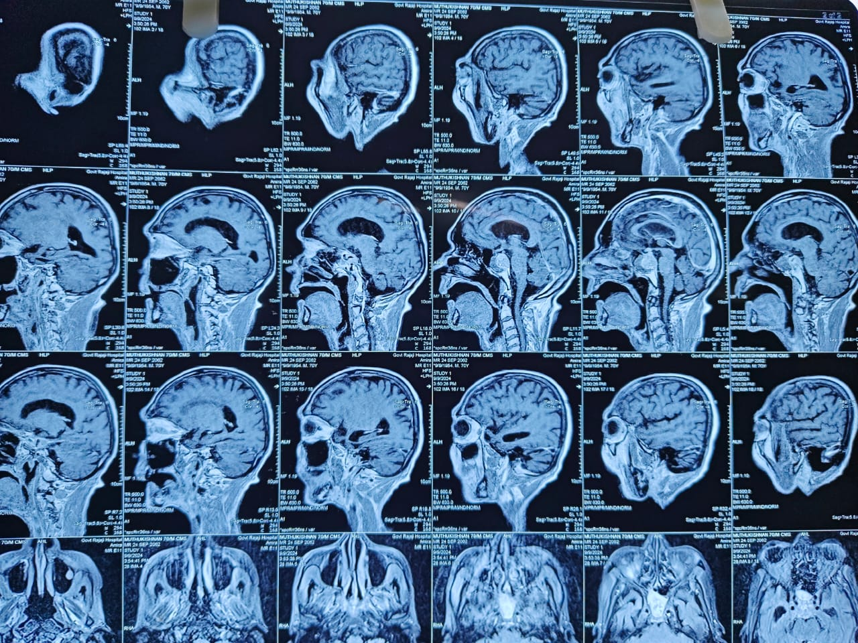

Slide 9
THANK YOU

