Slide 1
POVERTY IN PLENTY
BY 1ST MEDICAL UNIT
HOD & CHIEF : PROF.DR.M.NATARAJAN MD
ASST PROF : DR.PALANIKUMARAN MD D.DIAB
DR.VASANTHA KALYANI MD DCP
DR.SURESH KUMAR MD
PRESENTOR : DR.M.BOOBALAN (1st yr PG)

Slide 2
A 60 year old female came with chief complaints of Abdomen distension for 2 months -Gradual onset, progressive -Not associated with pain
H/O swelling of both legs for 1 month
-Gradual onset progresive upto midthigh -associateD WITH PAIN
h/o breathing difficulty for 7 days
-aggravated on exertion
-relieved by rest
-NOT ASSOCIATED WITH orthopnea ,PND
h/o reduced urine output
No h/o chest pain, palpitation, GIDDINESS, SYNCOPE

Slide 3
NO H/O REDUCED URINE OUTPUT
NO H/O YELLOWISH DISCOLORATION OF EYES,SKIN
NO H/O EASY FATIGUABLITY
NO H/O FACIAL PUFFINESS

Slide 4
PAST HISTORY:
Not a known case of DM/SHTN/BA/TB/THYROID DISORDER/CAD/CKD
No h/o similar episodes in the past.
PERSONAL HISTORY:
Mixed diet
Normal bowel bladder habits
Sleep pattern normal
NO ADVERSE SOCIAL HABITS
MenstruAL HISTORY:
ATTAINED MENARCHE AT 13 YEARS, P2 L1
Attained menopause 20 years back

Slide 5
On examination,
Pt conscious
oriented
afebrile
no pallor ,cyanosis, clubbing
Mild icterus +
B/L pitting pedal edema,
no generalized lymphadenopathy
Vitals
BP:140/90mmhg
PR:90/min
spo2:99%RA

Slide 6
Systemic examination
CVS: S1S2 +, no murmur
RS: BAE+
Air entry decreased on basal areas
P/A: Tense, uniformly distended
fluid thrill +
abdominal wall edema+
Dilated veins+
hepatojugular reflex absent

Slide 7
DISTANCE FROM XIPHISTERNuM TO PUBIC SYMPHYSIS – 33cm
xiphisternum TO umbilicus - 18cm
umbilicus to pubic symphysiS - 15cm
Right spinoumbilical distance - 24cm
Left spinoumbilical distance - 24cm
Tanyol sign - POSITIVE
DILATED VEINS + = FLOW AWAY FROM UMBILICUS

Slide 8
CNS EXAMINATION
 | RIGHT | LEFT
TONE
UPPERLIMB | Normal | Normal
LOWERLIMB | Normal | Normal
POWER
UPPERLIMB | 5/5 | 5/5
LOWERLIMB | 5/5 | 5/5
REFLEXES
UPPERLIMB | + | +
LOWEIMB | + | +

Slide 9
Local examination :-
right lower limb- swelling, warmth, tenderness +
Left lower limb- swelling, warmth, tenderness +

Slide 10
INVESTIGATIONS
DATE | 15/06 | 20/06
WBC | 16400 | 16.5
HB | 17 | 15.8
RBC | 7.12mil | 6.73mil
HCt | 54.1 | 52
plt | 218000 | 286000
RBS | 86
UREA | 38
CREATININE | 1.2
Sr.Na+ | 136
Sr.K+ | 3.8
DATE | 15/06 | 17/06 | 20/06
TB | 10.7 | 7.5 | 3.6
DIRECT | 3.7 | 4.2 | 2.0
INDIRECT | 7.0 | 3.3 | 1.6
SGOT | 75 | 69 | 37
SGPT | 33 | 33 | 39
ALP | 124 | 120 | 130
T.PROTEIN | 6
Sr.Albumin | 3
Sr.Globulin. | 3
Uric acid | 8.9

Slide 11
FASTING LIPID PROFILE
Chol-136
TGL -132
HDL – 40
D DIMER – 1747 ng/ml
URINE ROUTINE
ALB-Nil
SUG-Nil
DEPOSITS-2 to 3 pus cells
VCTC- NR
VM- Negative

Slide 12
ASCITIC FLUID ANALYSIS – LOW PROTEIN, HIGH SAAG ASCITES
EcG- 88/MIN
NORMAL SINUS RHYTHM
NORMAL AXIS
ECHO –
EF -70%,
NO RWMA AT REST
MILD MR,
GRADE 1 LV DIASTOLIC DYSFUNCTION

Slide 14
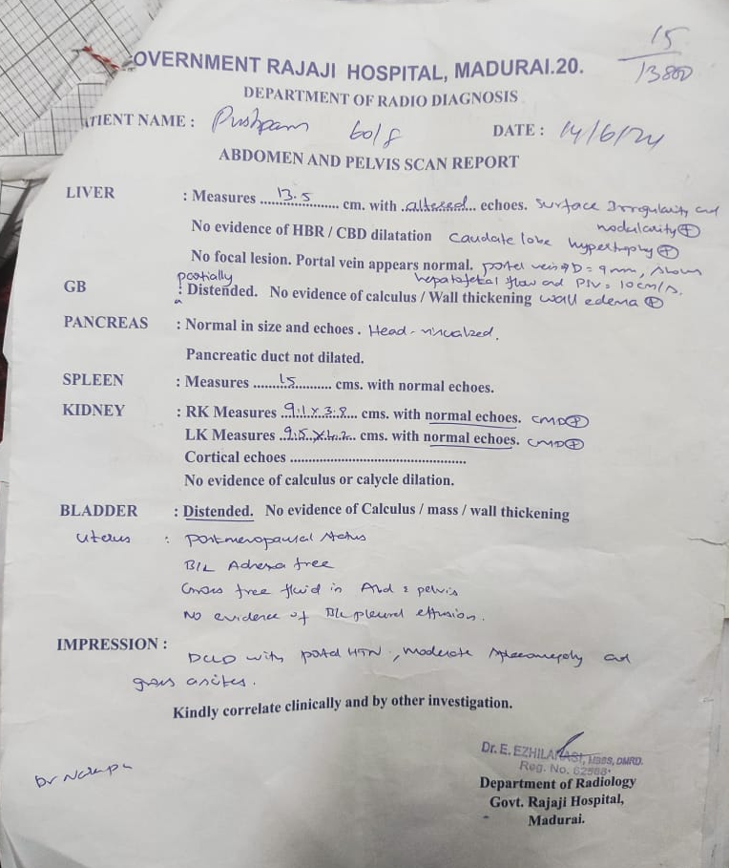

Slide 15
WHAT NEXT ?

