Slide 1
JOURNAL CLUB
By 5th medical unit
Chief: Prof.Dr.A.Senthamarai M.D.
Asst prof: Dr.P.Sudha M.D.
Dr.M.J.Senthil kumar M.D.
Dr.S.Sugadev M.D.
Presentor : N.S.Srikantan

Slide 2
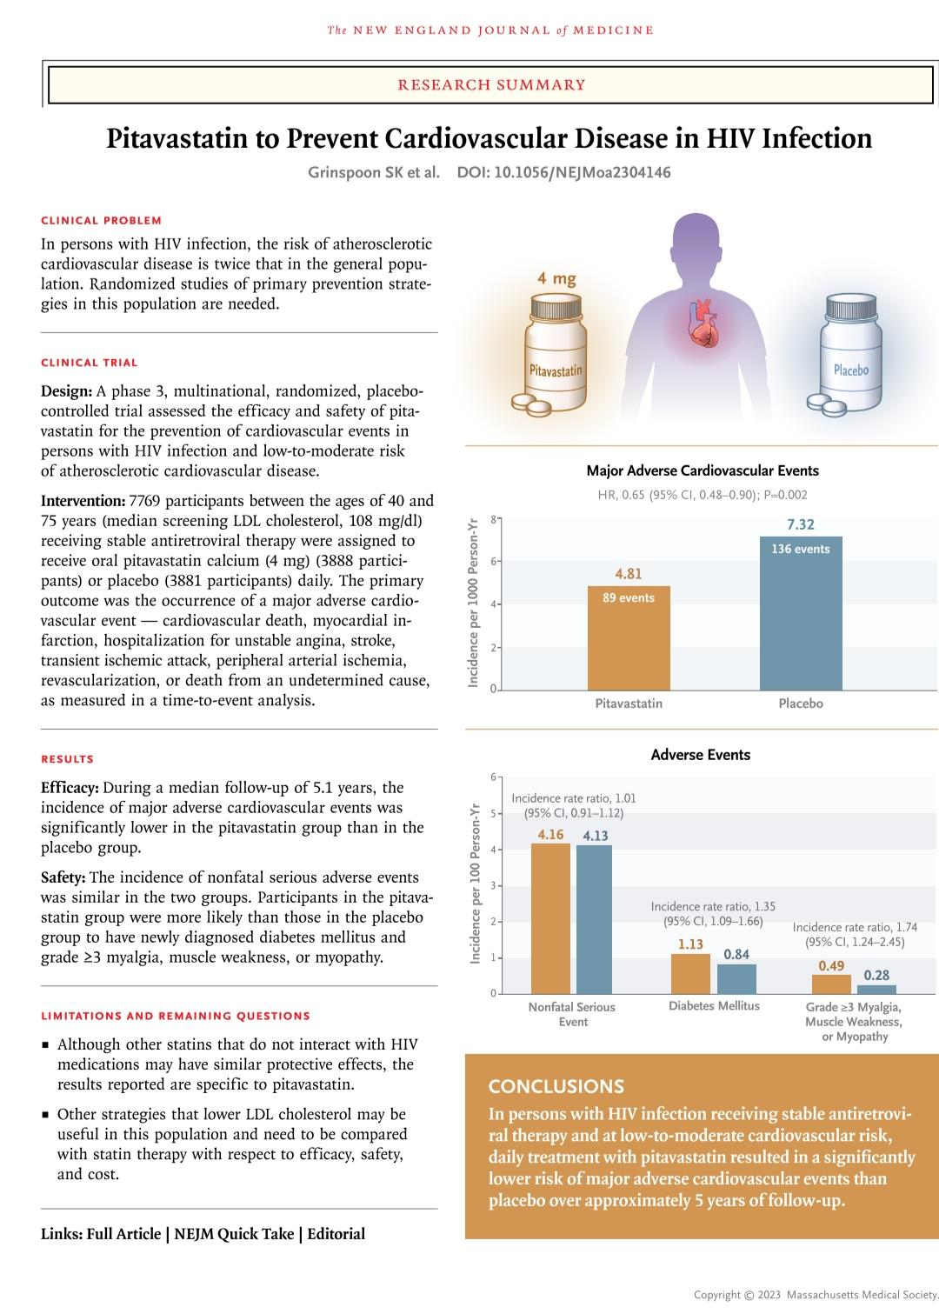
Pitavastatin to Prevent Cardiovascular Disease in HIV Infection
Published on August 24, 2023.

Slide 3
Background
The risk of atherosclerotic cardiovascular disease, including myocardial infarction and stroke, is up to twice as high among persons with human immunodeficiency virus (HIV) infection compared to general population, including younger persons and those at lower traditional risk for cardiovascular disease.
The mechanisms of the increase in risk of cardiovascular disease in this population are not completely understood but may relate to traditional risk factors, as well as to residual inflammation and immune activation
Large cohort studies have suggested that an increase in the risk of cardiovascular disease persists after controlling traditional risk factors in these patients.
This intervention was chosen with the knowledge that statin therapy simultaneously lowers low-density lipoprotein (LDL) cholesterol, a main driver of atherosclerotic cardiovascular disease, and has beneficial effects on relevant inflammatory and immune pathways.

Slide 4
METHOD OF STUDY
A phase 3, multinational, randomized, placebo- controlled trial assessed the efficacy and safety of pitavastatin for the prevention of cardiovascular events in persons with HIV infection and low-to-moderate risk of atherosclerotic cardiovascular disease.

Slide 5
Inclusion criteria
Men and women age ≥40 and ≤75 years of age
Documentation of HIV-1 infection
Combination antiretroviral therapy (ART) for at least 180 days prior to study entry.
CD4+ cell count >100 cells/mm3 obtained within 180 days prior to study entry
Laboratory values obtained within 90 days prior to study entry
Fasting LDL cholesterol as follows:
If ASCVD risk score <7.5%, LDL cholesterol must be <190 mg/dL
If ASCVD risk score ≥7.5% and ≤10%, LDL must be <160 mg/dL
If ASCVD risk score >10% and ≤15%, LDL must be <130 mg/dL
NOTE: If LDL <70 mg/dL, participant is eligible regardless of 10-year ASCVD risk score in line with the ACC/AHA 2013 Prevention Guidelines.

Slide 6
Inclusion criteria contd.
Fasting triglycerides <500 mg/dL Hemoglobin >8 g/dL for female participants and >9 g/dL for male participants Glomerular filtration rate (GFR) ≥60 mL/min/1.73m2 or creatinine clearance (CrCl) ≥60 mL/min
Female participants of reproductive potential must have a negative serum or urine pregnancy test within 48 hours prior to entry
For women of reproductive potential, willingness to use contraceptives for atleast two weeks before initiation of study and 6 weeks after cessation of study drug.

Slide 7
Exclusion criteria
Clinical ASCVD, including a previous diagnosis of any of the following: acute MI ,acute coronary syndromes, stable or unstable angina
Coronary or other arterial revascularization
Stroke/TIA Peripheral arterial disease presumed to be of atherosclerotic origin Current diabetes mellitus if LDL ≥70 mg/dl
10-year ASCVD risk score estimated by Pooled Cohort Equations >15% Active cancer within 12 months prior to study entry. Known decompensated cirrhosis History of myositis or myopathy with active disease in the 180 days prior to study entry.
Known untreated symptomatic thyroid disease.

Slide 8
Exclusion criteria contd.
History of allergy or severe adverse reaction to statins. Use of specific immunosuppressants or immunomodulatory agents, Current use of erythromycin, colchicine, or rifampin. Use of any statin drugs, gemfibrozil, or PCSK9 inhibitors in the 90 days prior to study entry. Serious illness or trauma requiring systemic treatment or hospitalization in the 30 days prior to study entry. Known active or recent (not fully resolved within 30 days prior to study entry) systemic bacterial, fungal, parasitic, or viral infections (except HIV, HBV, human papillomavirus [HPV], or HCV). Current breastfeeding

Slide 9
Trial procedures
In this phase 3 trial, randomly assigned 7769 participants with HIV infection with a low-to-moderate risk of cardiovascular disease who were receiving antiretroviral therapy received daily pitavastatin calcium (at a dose of 4 mg) or placebo
Participants were assigned in a 1:1 ratio to receive oral pitavastatin calcium (at a dose of 4 mg per day) or identical placebo

Slide 10
Endpoints
Primary outcome
The occurrence of a major adverse cardiovascular event
myocardial infarction;
hospitalization for unstable angina;
stroke;
transient ischemic attack (TIA);
peripheral arterial ischemia;
revascularization of a coronary, carotid, or peripheral artery;
death from an undetermined cause.

Slide 11
Secondary outcomes assessed
Key secondary outcomes assessed were
Time to death from any cause;
Time to occurrence of individual components of the primary outcome;
Assessment of LDL and non–high-density lipoprotein (non-HDL) cholesterol levels
targeted safety events - including incidence of diabetes mellitus and liver injury, myalgia, muscle weakness, or myopathy of grade 3 (inability to perform social activities) or grade 4 (disabling)
treatment-limitations

Slide 13
Results
Median age of participants: 50 years
Median CD4 count: 621 cells per cubic millimeter (448 to 827 interquartile range)
Median follow up duration – 5.1 years
Incidence of major cardiovascular event in pitavastatin group – 4.81 per thousand person years
Incidence of major cardiovascular event in placebo group – 7.32 per 1000 person years
Hazard ratio – 0.65 with 95% confidence interval (p=0.002)

Slide 14
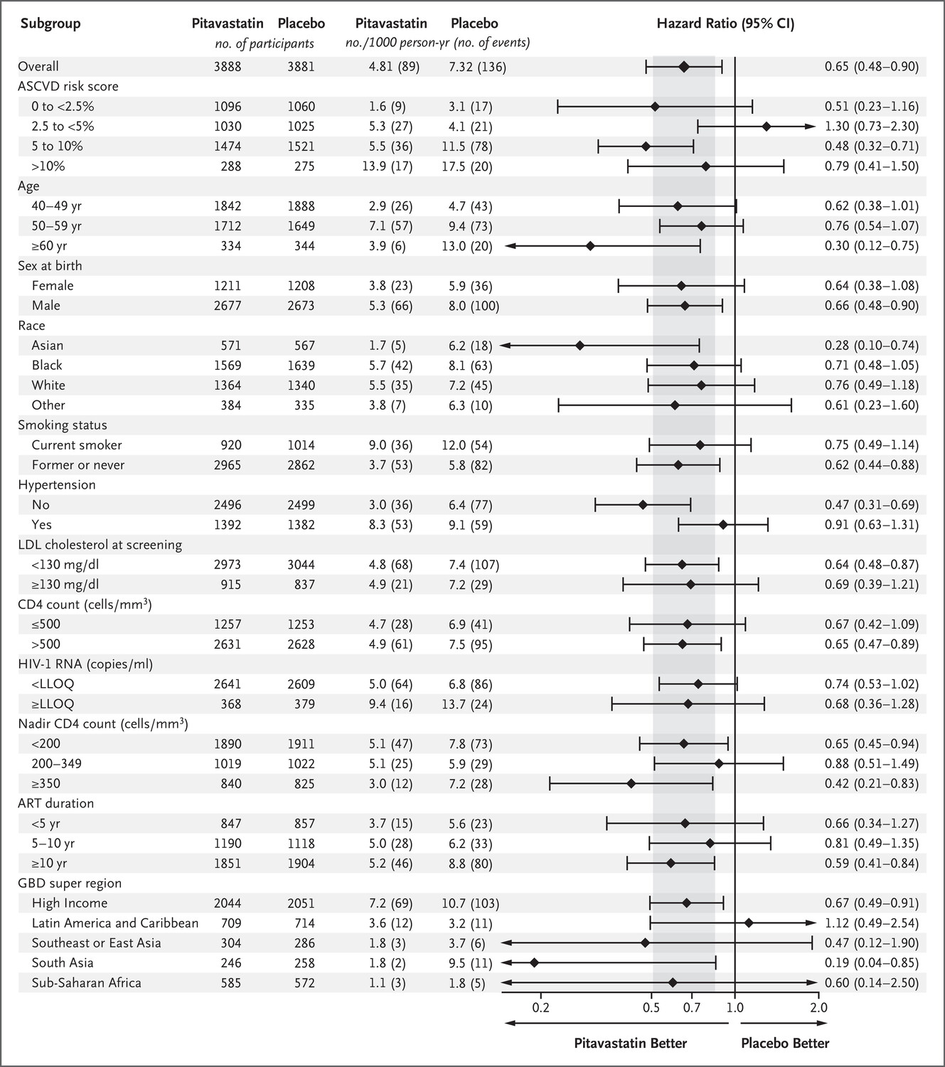

Slide 15
Safety
A higher rate of diabetes mellitus was seen in the pitavastatin group (incidence rate ratio, 1.35; 95% CI)
Participants in the pitavastatin group frequently had myalgia or myopathy of grade 3 or higher (incidence rate ratio, 1.74; 95%CI)
Muscle-related symptoms led to withdrawal in 44 participants (1.1%) in the pitavastatin group and in 21 (0.5%) in the placebo group.
However, serious adverse events like rhabdomyolysis, and liver dysfunction (grade 3 or higher ALT level) occurred rarely and had similar frequencies in the two groups.

Slide 16
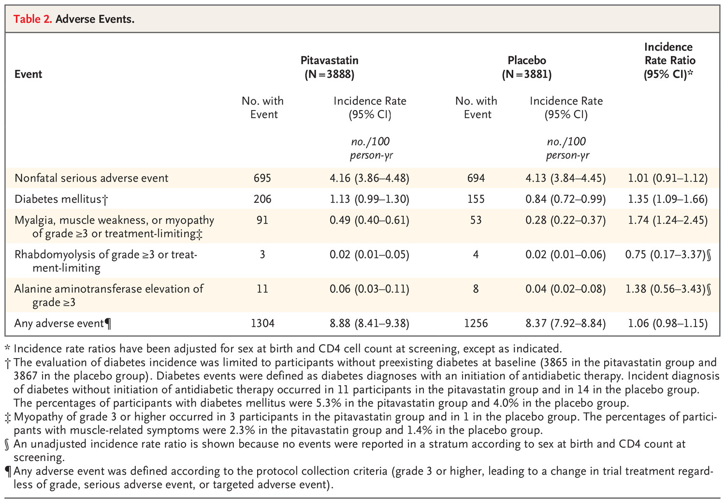

Slide 17
Conclusion
Participants in the pitavastatin group had a lower incidence of major adverse cardiovascular events than those in the placebo group,
The hazard reduction was 35% over a median of 5.1 years of follow-up.
the median screening LDL cholesterol level was 108 mg/dl and incidence of major adverse cardiovascular events was similar among participants in the pitavastatin group regardless of the screening LDL cholesterol level.
In addition to the lowering of LDL cholesterol levels, statin therapy reduces measures of immune activation and inflammation in persons with HIV infection.
This is consistent with a study of rosuvastatin involving older persons (median age, 66 years) who did not have HIV infection but who had increased C-reactive protein levels without elevated LDL cholesterol levels.

Slide 18
Limitation
The results of this study are specific to pitavastatin. Other statins may also have similar protective effects.
This study doesn’t compare other strategies that lower LDL cholesterol which may be useful and doesn’t compare their efficacy to statin therapy alone.

Slide 19
Thank you

