Slide 1
ELECTRIC BLEEDS
CHIEF PROF: Dr . DAVID PRADEEP KUMAR M.D,MRCP
ASST PROF: Dr. NASEEMA BANU M.D
ASST PROFESSOR: Dr. RAM KUMAR M.D
ASST PROFESSOR: Dr. NABIL FAYAZ M.D

Slide 2
An apparently healthy 60 year old male admitted with
h/o electrocution (at the ground level) in the left hand around 3:00 pm on 23/11/2023
Followed by giddiness and numbness of left half of body and right half of face

Slide 3
HISTORY OF PRESENTING ILLNESS
Patient was asymptomatic before electrocution
Following electrocution,
H/o giddiness
H/o inability to use the left UL & LL
H/o inability to sit / walk without support
H/o numbness & decreased sensation over left half of the body
H/o of loss of sensation over right half of face
H/o tremulousness in both hands (R >L)
No h/o raised ICT symptoms – pre / post electrocution
No head injury, Loss of consciousness
No incontinence

Slide 4
No h/o wound at electrocution site
No h/o difficulty in speech
No h/o difficulty in swallowing
No h/o hoarseness of voice
No h/o deviation of angle of mouth
No cardio respiratory symptoms

Slide 5
PAST HISTORY
Systemic Hypertension for 2 years – on Rx
Not a k/c/o Diabetes mellitus, Coronary artery disease, Chronic kidney disease, Asthma, TB, Epilepsy

Slide 6
PERSONAL HISTORY
Mixed diet
Normal bowel and bladder habits
Normal sleep pattern
Known alcoholic and smoker 40 years

Slide 7
GENERAL EXAMINATION
Patient was
Conscious
Moderately built and nourished
No pallor, icterus, cyanosis, clubbing
No pedal edema
No generalized lymphadenopathy

Slide 8
VITALS
PR- 86/min, regular rhythm, normal volume, no specific character, felt equally in all peripheral vessels, no delays
BP-160/90 mm Hg (right UL)
SpO2 - 98% in room air
RR- 16/min

Slide 9
CNS EXAMINATION
Conscious
Oriented to time, place, person
Right handed individual
Intelligence and behavior normal
Memory intact

Slide 10
Cranial nerves
1, 2 – normal
3, 4, 6 - EOM – lateral abduction restricted on right side
5 - Touch, pain & temperature – lost over right half of face
7 - normal
8 – hearing – Normal, Nystagmus +
9, 10, 11, 12 - normal

Slide 11
MOTOR SYSTEM
 |  | RIGHT | LEFT
BULK |  | Normal | Normal
TONE | UL | Normal | Hypotonia
 | LL | Normal | Hypotonia
POWER | UL | 5/5 | 3/5
 | LL | 5/5 | 3/5
DTR | UL | + | ++
 | LL | + | ++
PLANTAR |  | Flexor | Extensor

Slide 12
SENSORY SYSTEM
PRIMARY SENSATION | RIGHT | LEFT
Crude Touch | Intact | Not felt
Pain | Intact | Not felt
Temperature | Intact | Not felt
Vibration | Intact | Intact
Joint position sense | Intact | Intact

Slide 13
CEREBELLUM
 | Right | Left
TREMOR | Intentional tremor | No tremor
FINGER NOSE TEST | Past pointing | --
FINGER - FINGER NOSE TEST | Past pointing | --
DYSDIADOCHOKINESIA | Incordination | --
NYSTAGMUS +
ROMBERG SIGN-Positive
Swaying to right side

Slide 14
SPINE EXAMINATION-
No swelling, No tenderness, No deformity
MENINGEAL SIGNS-
No neck rigidity
Kernig’s sign - Negative
Brudzinski’s sign – Negative
FUNDUS EXAMINATION- Normal

Slide 15
OTHER SYSTEMS
CVS- S1, S2
No murmur
RS- Bilateral normal VBS
P/A- Soft, BS normal
No organomegaly

Slide 16
INVESTIGATIONS
 | 23/11 | 04/12
TC | 13800 | 5800
Hb | 13.3 | 12.0
PCV | 40 | 36.7
PLT | 2,20,000 | 2,18,000
UREA | 27mg/dl | 27
CREATININE | 1.0mg/dl | 1.0
Na+ | 136Meq/l | 126
K+ Ca + | 3.6Meq/l 8.9 mg/dl | 4.2
CK | 151
CPK-MB PT/INR | 33 1.6

Slide 17
TOT. BILIRUBIN | 1.2 mg/dl
DIR. BILIRUBIN | 0.6mg/dl
IND. BILIRUBIN | 0.6mg/dl
SGOT | 22 U/L
SGPT | 17U/L
ALP | 64U/L
FBS | 77mg/dl
RBS | 109mg/dl
TOT. CHOLESTEROL | 140mg/dl
TGL | 100mg/dl
HDL | 61mg/dl
LDL | 66mg/dl

Slide 18
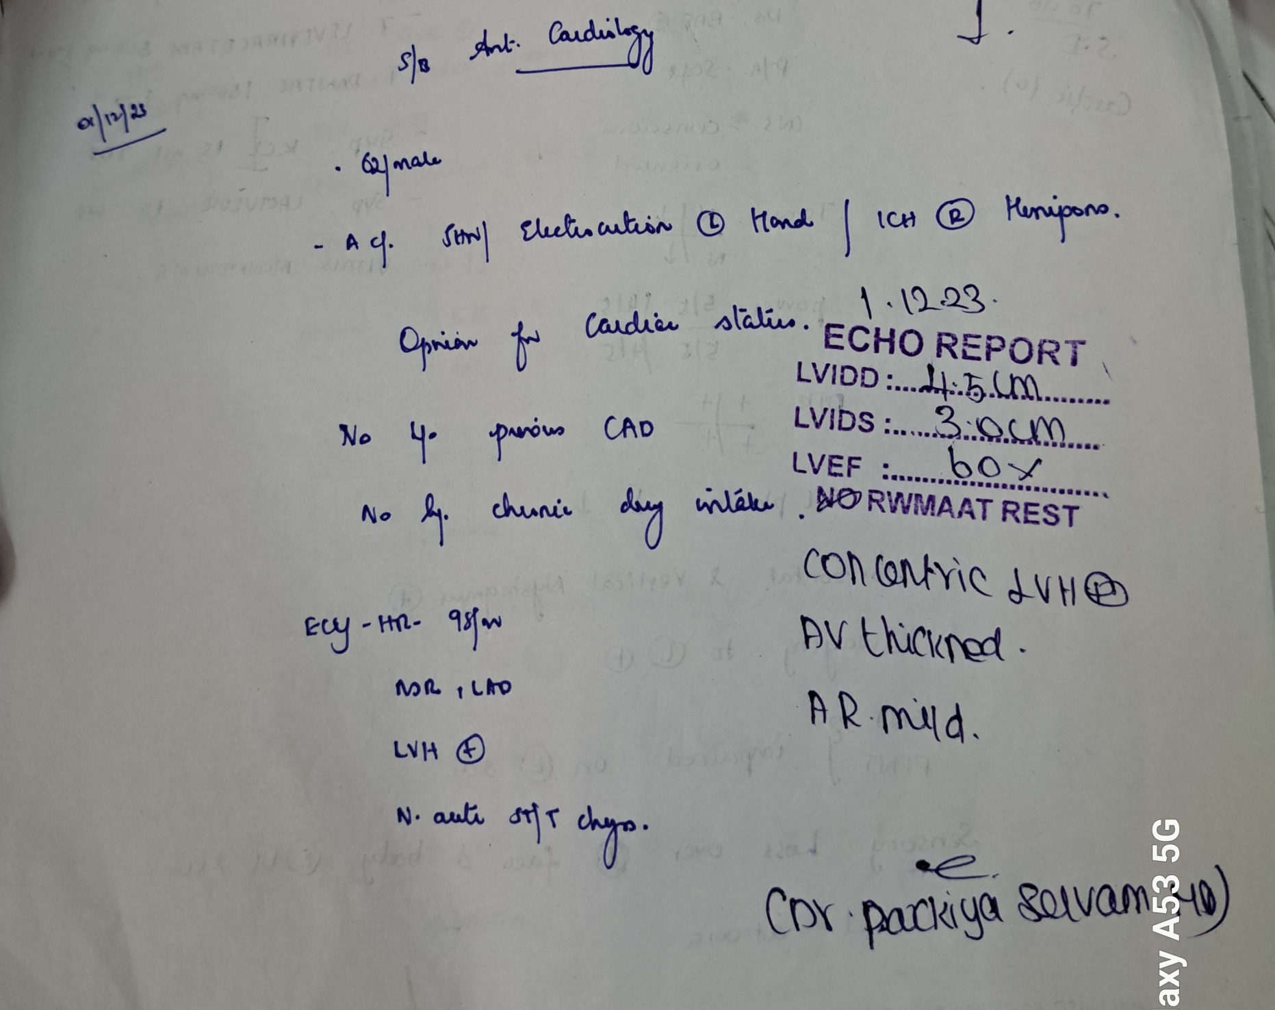

Slide 19
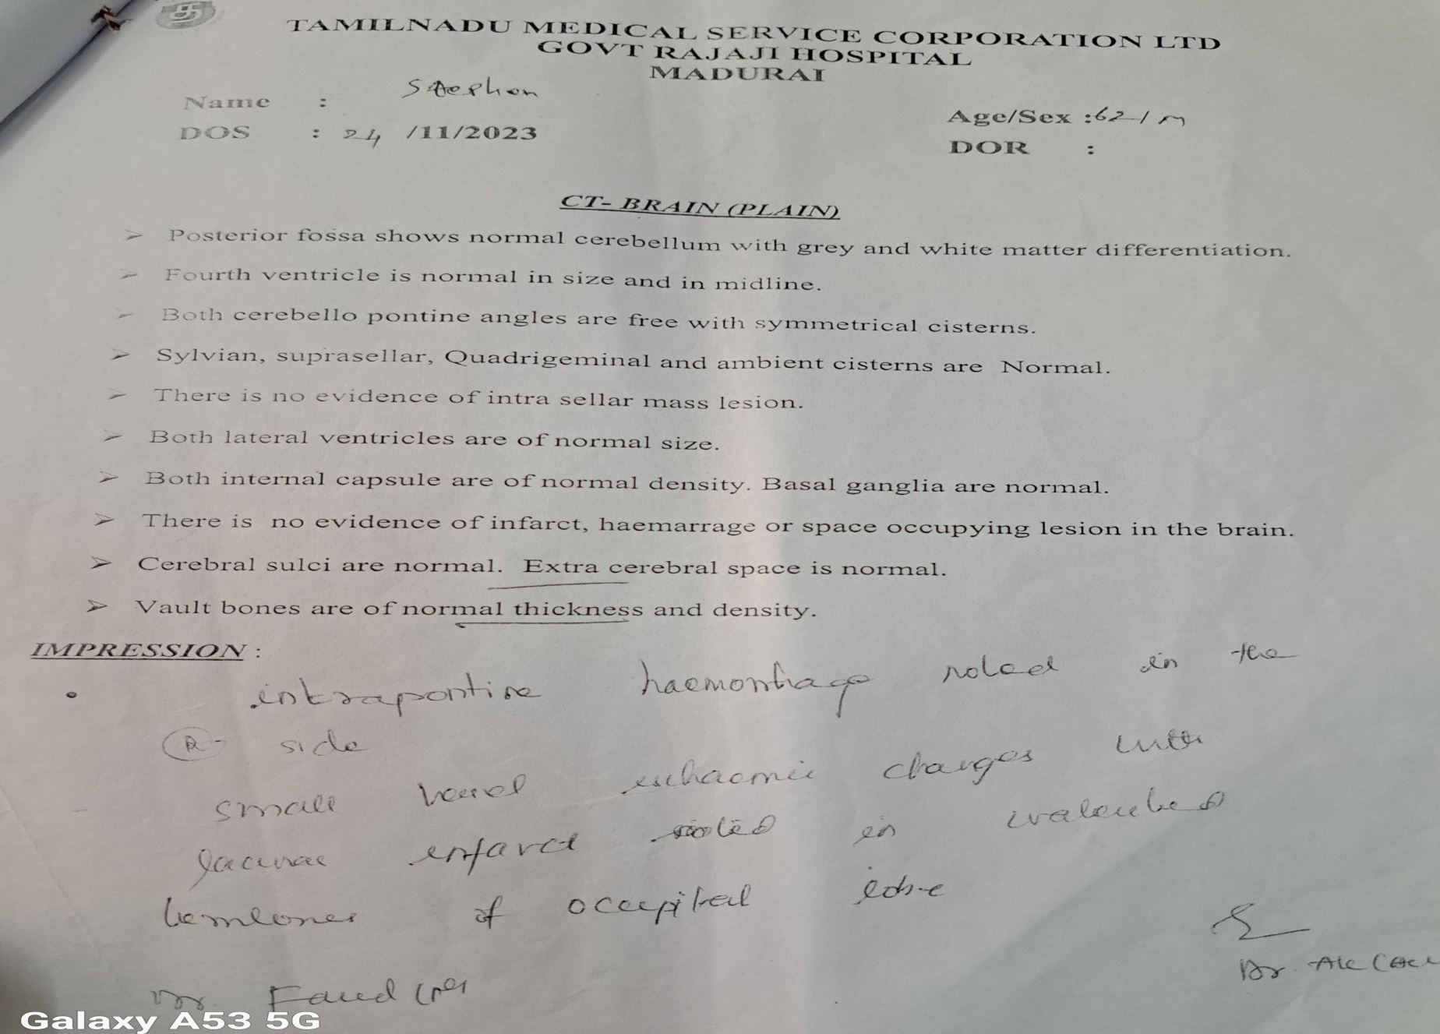

Slide 20
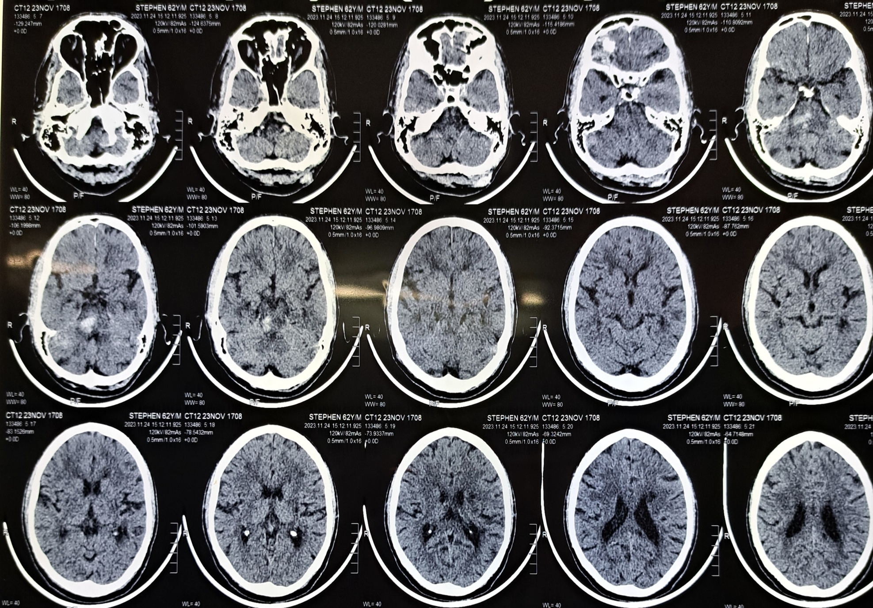

Slide 21
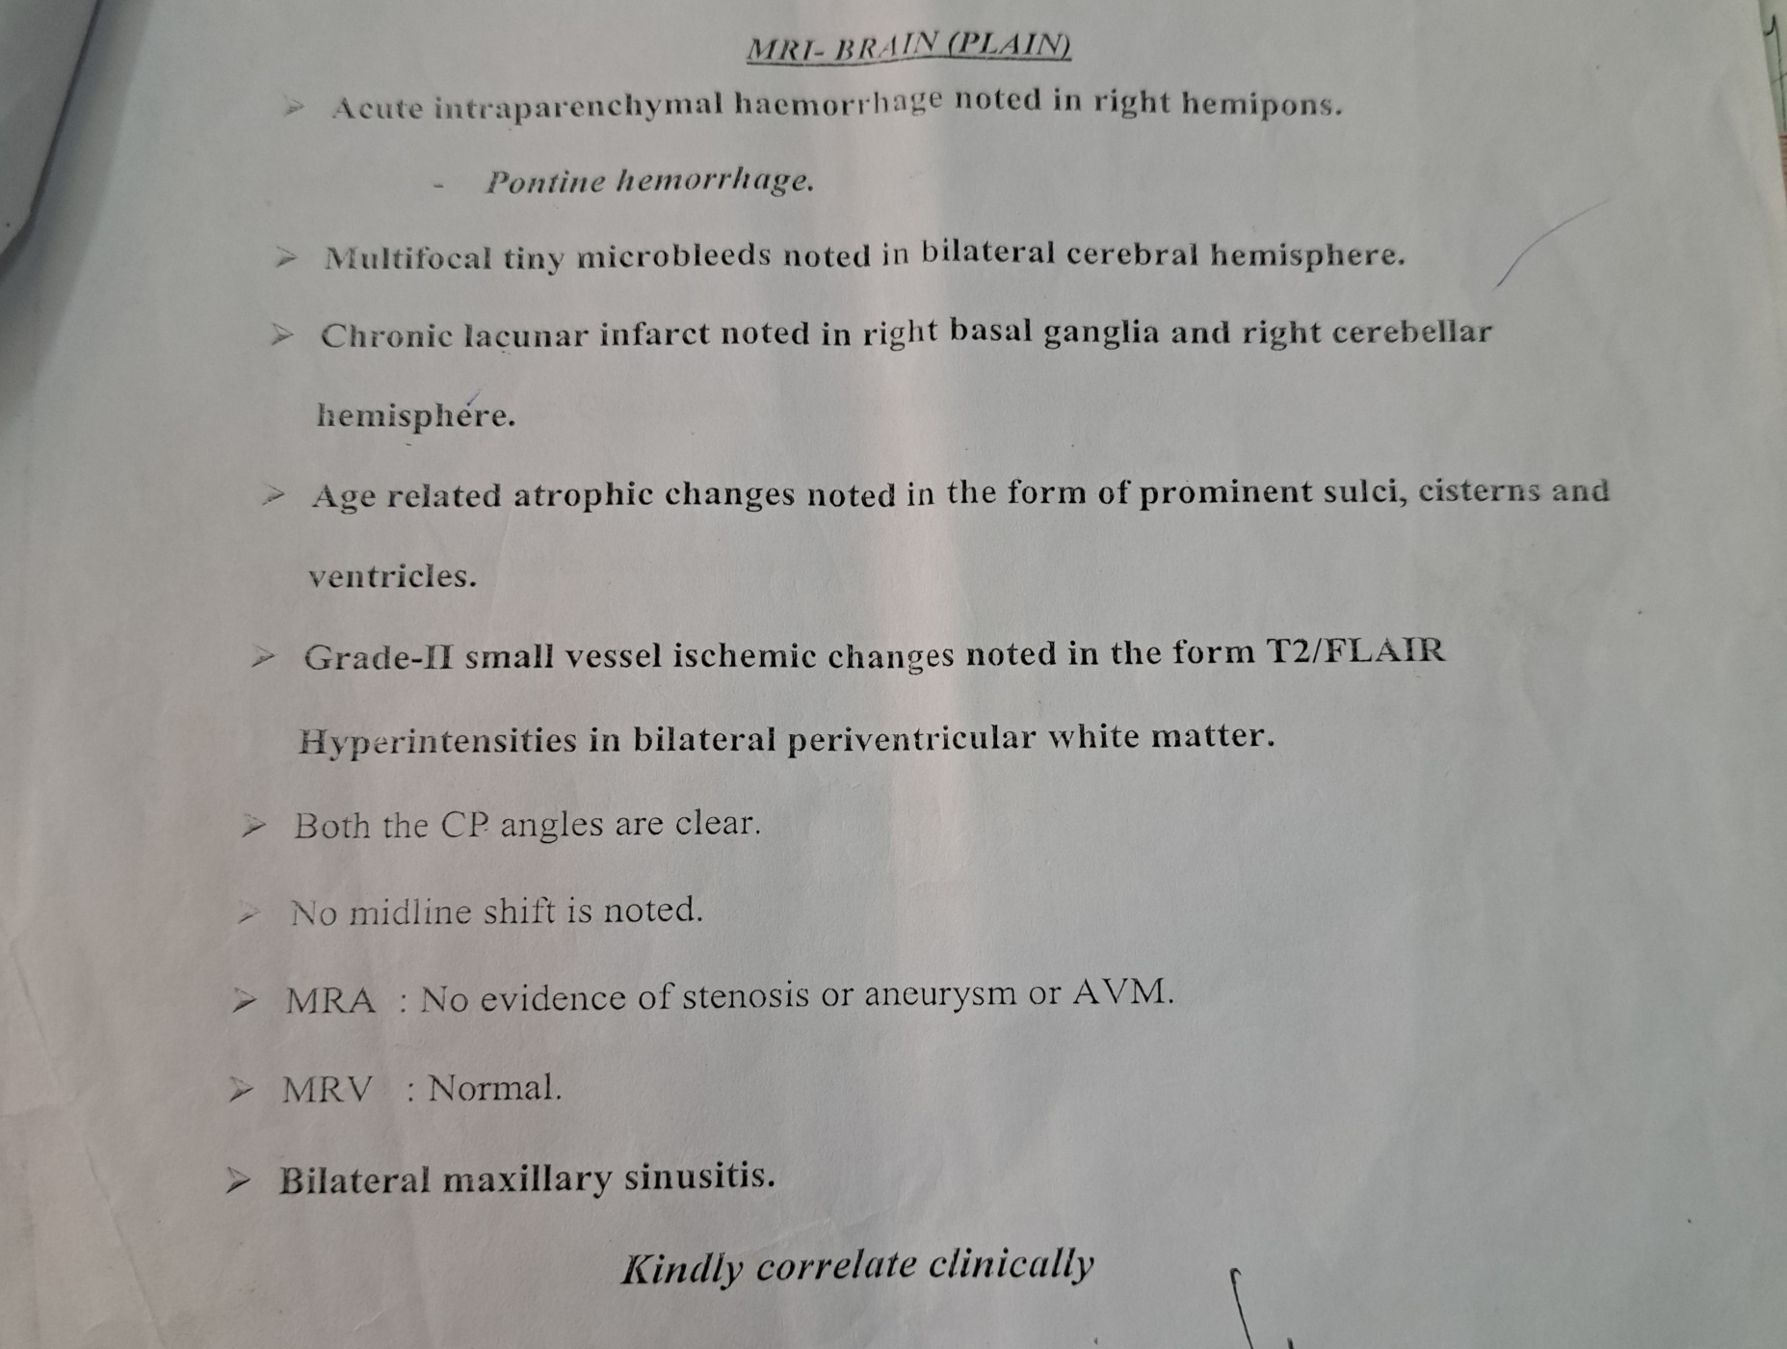

Slide 22
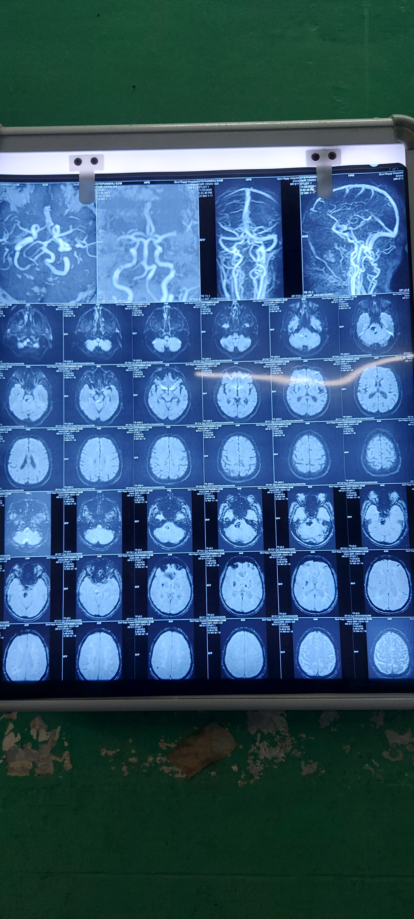

Slide 23
Neurophysician opinion:
Imp:CVA Left Hemiparesis(Brainstem hemorrhage)
Rx
Bp monitoring 4th hourly
Inj.Mannitol 100ml iv tds

Slide 24
TREATMENT
Inj Mannitol 100ml iv tds for 5 days
Inj Phenytoin 100mg iv tds
Tab. Nifedipine 10 mg 2tds
Tab. Prazosin 2mg bd
Tab. Atorvastatin 10 mg 2hs
Physiotherapy

Slide 25
Patients initial symptoms of Giddiness, Ataxia & weakness (from 3/5 to 4+/5) gradually improved over a period of 10 days except for the sensory complaints
Diagnosis
A case of Right hemi Pontine bleed secondary to electrocution

Slide 26


