Slide 1
JAUNDICE IN PREGNANCY
CHIEF : | Prof. Dr.M.NATARAJAN MD
ASST PROF : | Dr.PALANIKUMARAN MD, D.Diab Dr.VASANTHAKALYANI MD DCP Dr.SURESHKUMAR MD
PRESENTOR : | Dr.KRUTHIKA PG

Slide 2
PHYSIOLOGICAL CHANGES IN PREGNANCY
ELEVATED ↑ | DECREASED ↓ | NO CHANGE
WBC | Hb | Platelet
ALP | Total Bilirubin | Prothrombin Time
AFP | Serum Albumin | AST, ALT

Slide 3
LIVER DISEASES IN PREGNANCY
IIIrd Trimester
AFLP
IInd Trimester
IHC
HELLP
Ist Trimester
Hyperemesis
Gravidarum
Viral Hepatitis, Drug Induced Hepatitis, Gallstones, Buddchiari Syndrome
ANY TRIMESTER

Slide 4
LIVER DISEASES IN PREGNANCY
Liver Diseases in Pregnancy are categorized as follows :
Liver Diseases that are unique to Pregnancy.
Liver Diseases that are exacerbated by Pregnancy.
Chronic Liver Diseases during Pregnancy.
Liver Disease that are not related but coincidental to Pregnancy.

Slide 5
LIVER DISORDERS UNIQUE TO PREGNANCY

Slide 6
LIVER DISORDERS UNIQUE TO PREGNANCY
INTRAHEPATIC CHOLESTASIS
HYPEREMESIS GRAVIDARUM
AFLP
HELLP

Slide 7
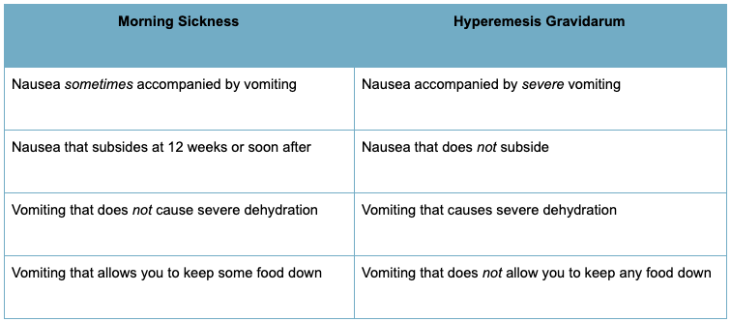
HYPEREMESIS GRAVIDARUM
Hyperemesis is used to describe the severe end of the symptom spectrum including weight loss exceeding 5% of pre-pregnancy body weight.

Slide 8
HYPEREMESIS GRAVIDARUM
ETIOLOGY
Hormonal Changes
Human Chorionic gonadotropin ↑
Estrogen ↑
Progesterone ↑
Abnormal Thyroid function
Psychosomatic Depression
Helicobacter pylori
Nutrient deficiency (Zinc, Vitamin B₆)
Immunologic Dysregulation

Slide 9
HYPEREMESIS GRAVIDARUM

Slide 10
HYPEREMESIS GRAVIDARUM
LAB FINDINGS
Hypokalemic hypochloremic metabolic alkalosis
LFT - ALT > AST
BUN, Urine Specific gravity
Hematocrit, Bilirubin
Lymphocyte
Mg 2+, Ca 2+

Slide 11
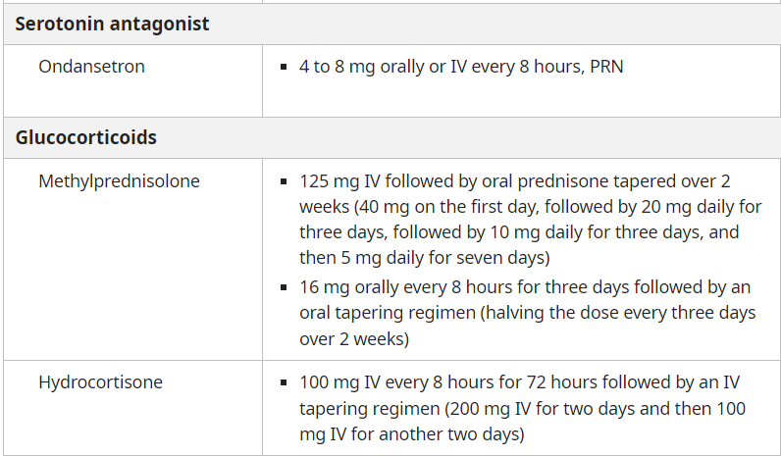
HYPEREMESIS GRAVIDARUM

Slide 12
HYPEREMESIS GRAVIDARUM
Complications
Maternal Complications
Extreme Electrolyte Imbalance
Drug Induced Extrapyramidal Symptoms
Oculogyric Crisis
Fetal Complications
Fetal Loss
Low Birth Weight Baby, Small for Gestational Age.
Prognosis :
Maternal, Fetal Mortality extremely rare.
Recurrence : Common.

Slide 13
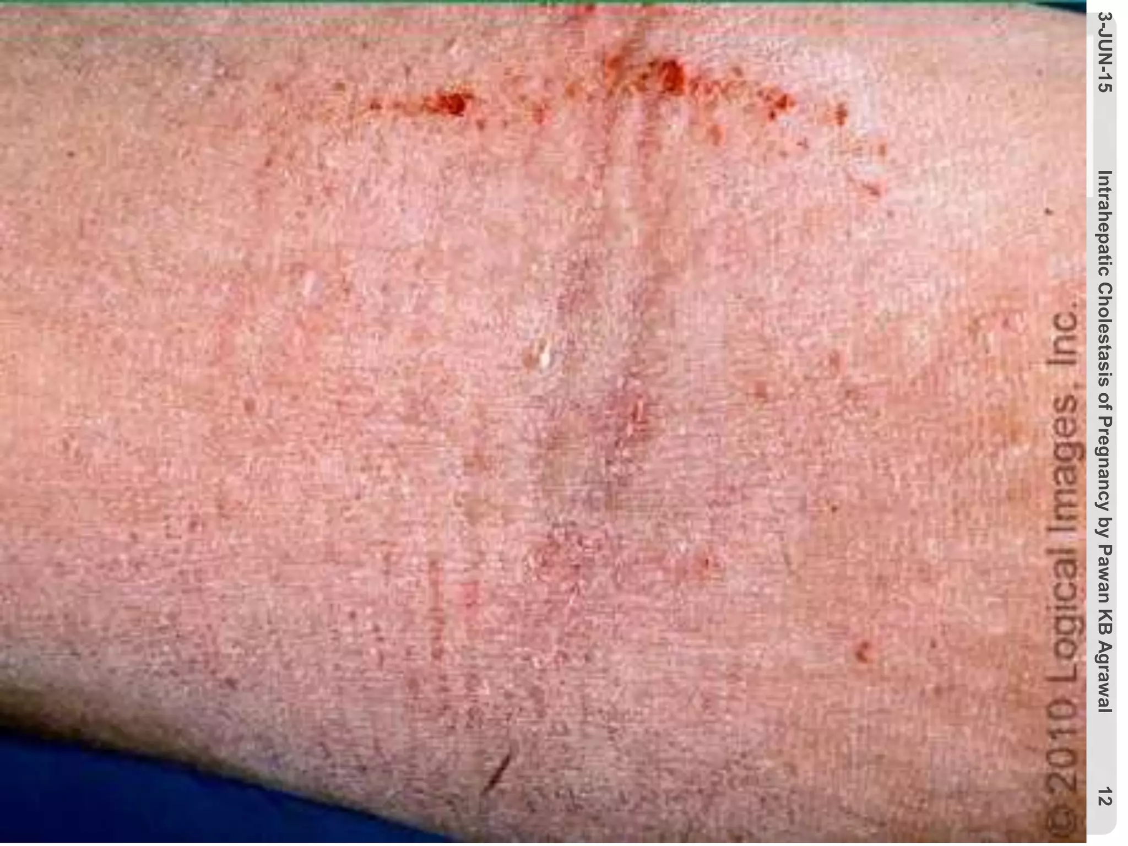
INTRAHEPATIC CHOLESTASIS OF PREGNANCY
DEFINITION
Intrahepatic cholestasis of pregnancy is characterized by pruritus and an elevation in serum bile acid concentrations typically developing in late 2nd or 3rd trimester and rapidly resolving after delivery.
RISK FACTORS
Advanced Maternal Age.
Multiple Pregnancies.
Family History of Intrahepatic cholestasis.
Chronic Hep C infection.

Slide 14
INTRAHEPATIC CHOLESTASIS OF PREGNANCY

Slide 15
INTRAHEPATIC CHOLESTASIS OF PREGNANCY
CLINICAL PRESENTATION :
Severe Pruritus - often generalised predominates on Palms and Soles.
Skin lesions often absent and limited to excoriations.
Worse at night.
Only 14 - 25% develop jaundice 1-4 weeks after the onset of itching.
INVESTIGATIONS
Increased Serum Total Bile Acid - Marked elevation of the Cholic/ Chenodeoxycholic acid ratio.
Serum Aminotransferase levels are increased.
Total and Direct Bilirubin increased.
Alkaline phosphatase is increased possibly 4 fold.
PT prolonged, secondary to Vit K deficiency due to fat malabsorption.

Slide 16
INTRAHEPATIC CHOLESTASIS OF PREGNANCY
ULTRASONOGRAPHY :
Biliary ducts not dilated.
Hepatic parenchyma normal.
PATHOLOGY :
Liver HPE characterised by cholestasis without inflammation.
Bile plugs in hepatocytes and canaliculi, predominant in zone 3.

Slide 17
INTRAHEPATIC CHOLESTASIS OF PREGNANCY
PROGNOSIS :
Maternal
Steatorrhoea
Vitamin K deficiency
Cholestasis recurs in 60 - 70 % of subsequent pregnancies.
Fetal
IUD 3%.
Preterm Birth
Respiratory Distress Syndrome
Meconium Stained Amniotic fluid

Slide 18
INTRAHEPATIC CHOLESTASIS OF PREGNANCY
MANAGEMENT :
Antihistamines like cetrizine and topical emollients can be used for symptomatic relief.
DRUG OF CHOICE - Ursodeoxycholic Acid 15 mg/kg/day until delivery. If Pruritus not relieved in 2 weeks dose titrated to a maximum of 21 mg/kg/day.
Timing of Delivery
Total Bile Acids < 40 mmol/L - Delivery at 37 to 38 weeks.
Total Bile Acids = 40 - 99 mmol/L - Delivery at 36 to 37 weeks.
Total Bile Acids > 100 mmol/L - Delivery at 36 weeks.

Slide 19
HELLP SYNDROME
HELLP Syndrome
Hemolysis, Elevated Liver enzymes, Low Platelet count.
Represents severe form of Preeclampsia.
PATHOGENESIS
Micro angiopathy
Activation of intravascular coagulation.
HISTOLOGY
Microvascular fibrin deposition.
Neutrophilic infiltrate
Fatty infiltration
Lobular necrosis
Periportal hemorrhage

Slide 20
HELLP SYNDROME
SIGNS AND SYMPTOMS | FREQUENCY %
Proteinuria | 86 - 100
Malaise | 90 - 100
Hypertension | 82 - 88
Right Upper quadrant Epigastric Pain | 40 - 90
Nausea, Vomiting | 29 - 84
Headache | 33 - 61
Visual Changes | 10 - 20
Jaundice | 5

Slide 21
HELLP SYNDROME
PREECLAMPSIA Hypertension + Proteinuria |  | HELLP SYNDROME Hemolysis Elevated Liver Enzymes Low Platelet Count LDH > 600 AST > 70 Platelet < 1,00,000 |  | HEPATIC HEMATOMA RUPTURE Severe Sudden Right Upper Quadrant Pain and Shock

Slide 22
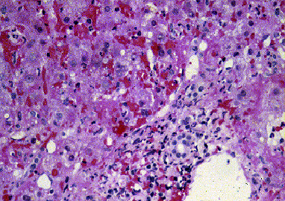
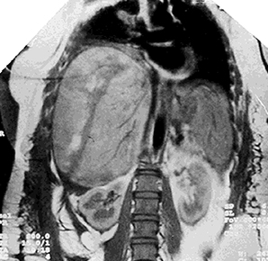
HELLP SYNDROME
The zones immediately adjacent to the portal triads show collections of red blood cells, without inflammation or necrosis of hepatocytes
HEPATIC HEMATOMA WITH RUPTURE

Slide 23
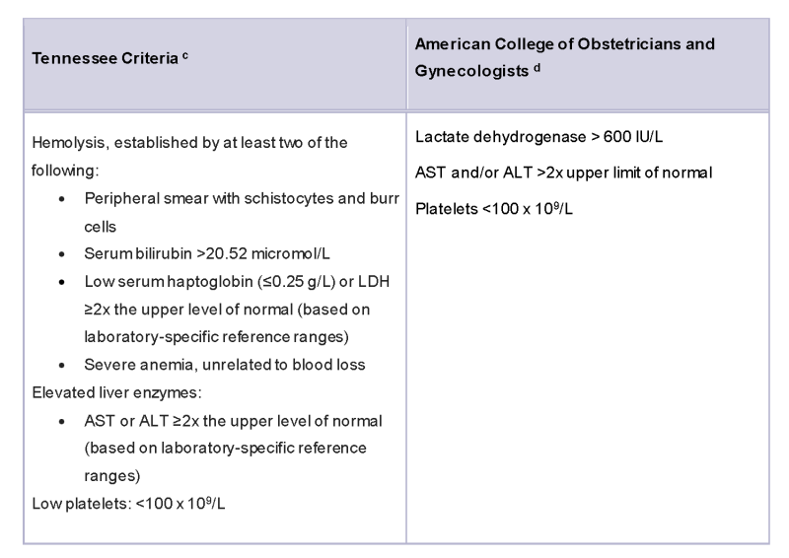
HELLP SYNDROME
DIAGNOSTIC
CRITERIA

Slide 24
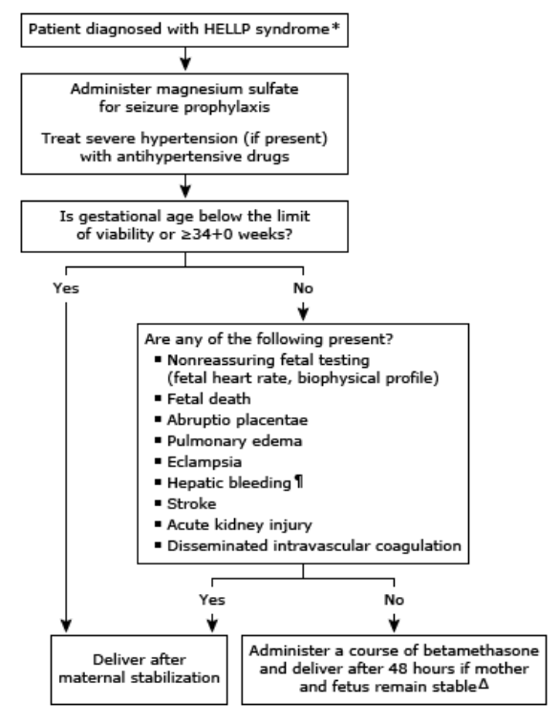
HELLP SYNDROME
Delivery is the cornerstone of HELLP and is the only effective treatment

Slide 25
ACUTE FATTY LIVER OF PREGNANCY
Obstetric Emergency characterised by Maternal Liver dysfunction and/or failure lead to maternal and fetal complications including death.
Incidence 1 in 20,000 pregnancies.
RISK FACTORS
Fetal long chain 3 Hydroxyacyl CoA dehydrogenase def.
Prior episode of AFLP
Multiple gestation
Preeclampsia/HELLP
Male fetal sex
BMI<20
Nulliparity

Slide 26
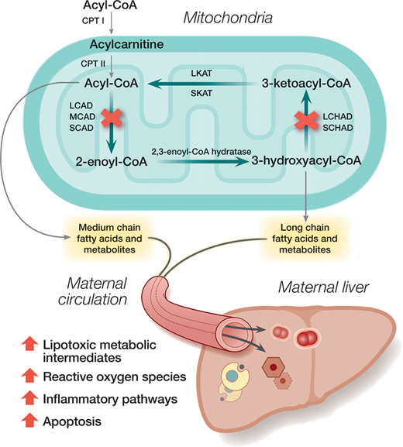
ACUTE FATTY LIVER OF PREGNANCY
PATHOGENESIS
Free Fatty Acids ↑ in pregnancy to fuel fetoplacental growth and development.
Maternal fetal fatty Acid Metabolism is Defective
↑ Intermediate products of metabolism can accumulate in maternal blood and Hepatocytes
Deleterious effect on maternal Hepatocytes

Slide 27
ACUTE FATTY LIVER OF PREGNANCY
CLINICAL PRESENTATION
Nausea, Vomiting, Abdominal Pain, Malaise, Headache.
Jaundice, Ascites, Encephalopathy DIC rapidly develop.
Multi-organ Failure.
Arginine vasopressin deficiency due to reduced clearance of Vasopressinase by impaired liver.

Slide 28
ACUTE FATTY LIVER OF PREGNANCY
LAB FINDINGS
↑ Serum Aminotransferases.
↑ Serum bilirubin
↑ WBC.
↑ Ammonia.
↑ Urate
Prolonged PT.
↓ Platelet,
↓ fibrinogen
↓ cholesterol
Fragmented RBC and blood cells
Proteinuria.

Slide 29
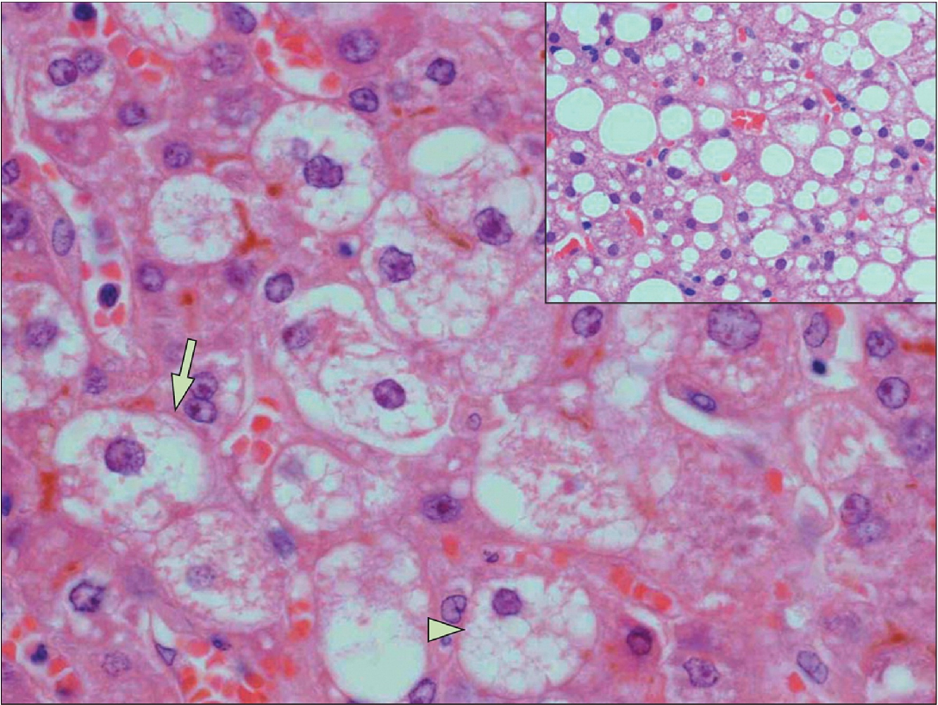
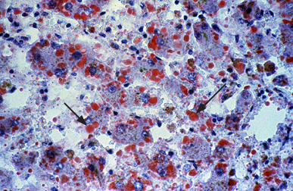
ACUTE FATTY LIVER OF PREGNANCY
High power view of an oil red O stain of a liver biopsy from a patient with acute fatty liver of pregnancy. There are vacuolated hepatocytes containing microvesicular fat which stain red
Lipid Droplets Around Nucleus

Slide 30
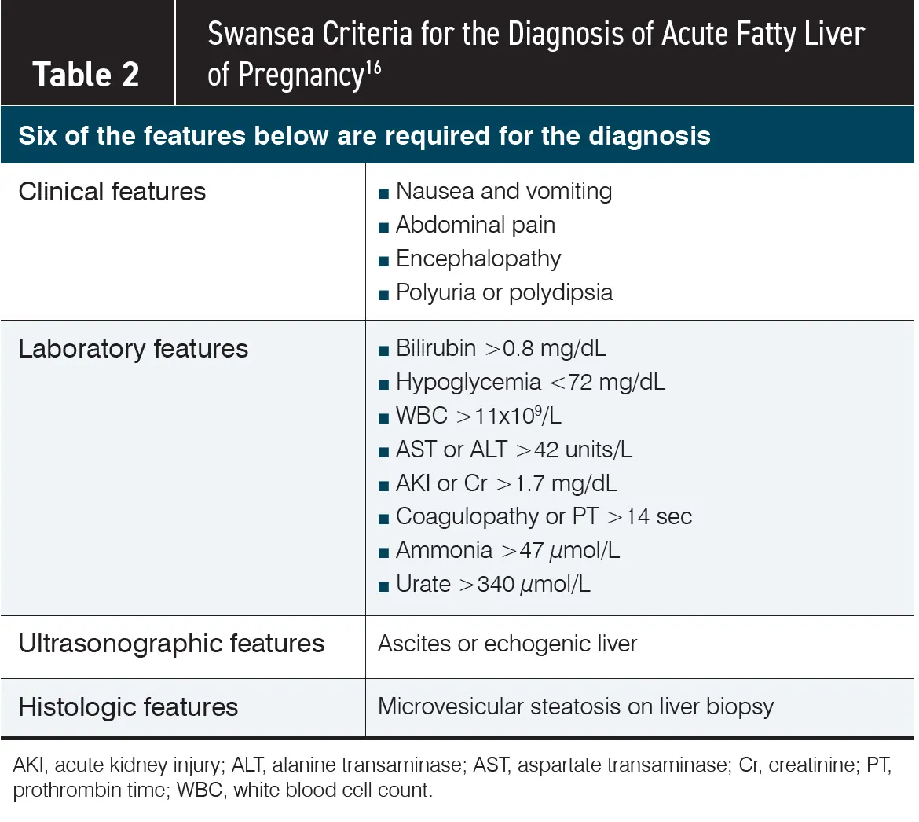
ACUTE FATTY LIVER OF PREGNANCY
Diagnostic
Criteria

Slide 31
ACUTE FATTY LIVER OF PREGNANCY
PROGNOSIS :
Maternal Mortality - 18%
Fetal Mortality - 36%
MANAGEMENT
Prompt delivery of the fetus regardless of gestational age.
Monitoring for Hypoglycemia
Monitoring of Coagulopathy
Other Therapy
Plasma Exchange may be an option for patients with progressive disease despite delivery
Evaluation for liver transplant

Slide 32
SUMMARY
 | AMINO TRANSFERASE | TOTAL BILIRUBIN | OTHER LAB PARAMETERS | RECURRENCE RATE
HYPEREMESIS GRAVIDARUM | <200 | <4 | ALT > AST | Common
HELLP | <500 | ↑ | Platelet < 1,00,000 LDH > 600 AST 2 x ULN | 30%
INTRAHEPATIC CHOLESTASIS | <500 | <6 | Bile Acids ↑ Serum Aminotransferases 2 x ULN | 70%
AFLP | <500 | ↑ | WBC, INR ↑ serum creatinine↑ Ammonia, uric acid↑ Platelet, Fibrinogen ↓ Antithrombin ↓ | Rare

Slide 33
LIVER DISEASES THAT ARE EXACERBATED BY PREGNANCY

Slide 34
LIVER DISEASES EXACERBATED BY PREGNANCY
GALLSTONES
BUDD CHIARI SYNDROME

Slide 35
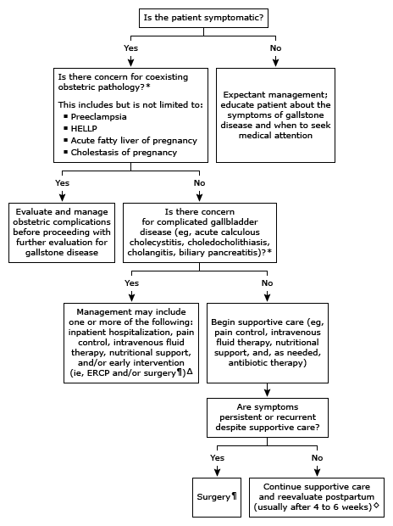
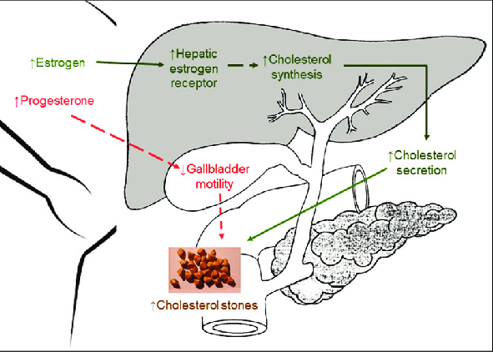
GALLSTONES IN PREGNANCY

Slide 36
GALLSTONES IN PREGNANCY
TREATMENT
Pain control - NSAIDs generally avoided after 32 weeks.
Antibiotic Therapy
Laparoscopic Cholecystectomy when indicated preferred during IInd Trimester
AMPICILLIN SULBACTAM 3gm IV 6th Hourly
or
PIPERACILLIN TAZOBACTAM 3.375gm IV 6th Hourly
TO AVOID FLUOROQUINOLONES, CARBAPENEM, AMINOGLYCOSIDES

Slide 37
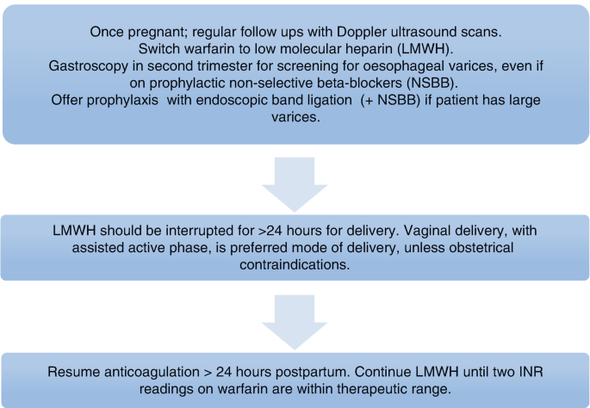
BUDD CHIARI SYNDROME
Pregnancy may exacerbate other coagulable state that predispose to Budd chiari such as :
APLA,
PNH,
Factor V leiden and
Protein S deficiency.
Vit K antagonist contraindicated in Pregnancy.

Slide 38
CHRONIC LIVER DISEASES DURING PREGNANCY

Slide 39
CHRONIC LIVER DISEASES DURING PREGNANCY
CIRRHOSIS AND PORTAL HYPERTENSION
HEPATITIS B
HEPATITIS C
HEPATITIS E
SOLID LIVER LESIONS

Slide 40
CHRONIC LIVER DISEASES DURING PREGNANCY
CIRRHOSIS and PHTN
Spontaneous Abortion, prematurity and perinatal death.
PHTN worsens due BV, extrinsic IVC compression
25% variceal bleed.
10% maternal mortality.
Management - Banding, Propranolol (Category C) - Growth retardation, Neonatal Bradycardia, Hypoglycemia.
HEPATITIS B
Hepatitis DNA should be measured at 26 to 28 weeks.
Hepatic flare - Increase in ALT > 3 to 4 fold ALT.
Increased risk of prematurity, LBW, Antepartum Haemorrhage.
Patients who become pregnant while receiving Antiviral therapy - Entecavir, Adefovir, Interferon -> Tenofovir disoproxil fumarate.

Slide 41
CHRONIC LIVER DISEASES DURING PREGNANCY
HEPATITIS C
Incidence 10%.
No antiviral therapy during pregnancy
HEPATITIS E
Wilson’s Disease
Continue Drug therapy
D Penicillamine is safe. Decrease dose 25 - 20% of prepregnancy dose.
SOLID LIVER LESIONS
Hepatocellular adenoma -May grow , Surveillance imaging needed.
Other solid liver lesions FNH Hepatic hemangioma no monitoring needed.

Slide 42
CHRONIC LIVER DISEASES DURING PREGNANCY
AUTOIMMUNE HEPATITIS
Obstetric complications - targeted involvement of maternal-fetal interface structures by autoantibodies and natural immune cells activated by the disease.
↑ risk of first-trimester miscarriage and preterm delivery.
Thrombosis is another complication that occurs due to endothelial damage and complement system activation, leading to worse perinatal outcomes
Investigations
ANA anti-smooth muscle antimitochondrial, and anti-liver/kidney microsomal-1 (ALKM-1) antibodies

Slide 43
CHRONIC LIVER DISEASES DURING PREGNANCY
Treatment
Glucocorticoids at the lowest possible doses, alone or in combination with azathioprine
mycophenolate mofetil (MMF) and tacrolimus, are contraindicated in pregnancy
Azathioprine (category D) should be discontinued if possible.
Postpartum flares 12-16%

Slide 44
LIVER DISEASE COINCIDENTAL TO PREGNANCY

Slide 45
LIVER DISEASE COINCIDENTAL TO PREGNANCY
HEPATITIS A
HEPATITIS B
HEPATITIS E
OTHER VIRUSES

Slide 46
LIVER DISEASE COINCIDENTAL TO PREGNANCY
HEPATITIS A
Increases the risk of gestational complications including Premature contractions, placental separations, PROM.
Treatment Supportive.
HEPATITIS E
Increased risk of acute liver failure in 3rd trimester.
Ribavirin and interferon contraindication in pregnancy.
Treatment Supportive care.

Slide 47
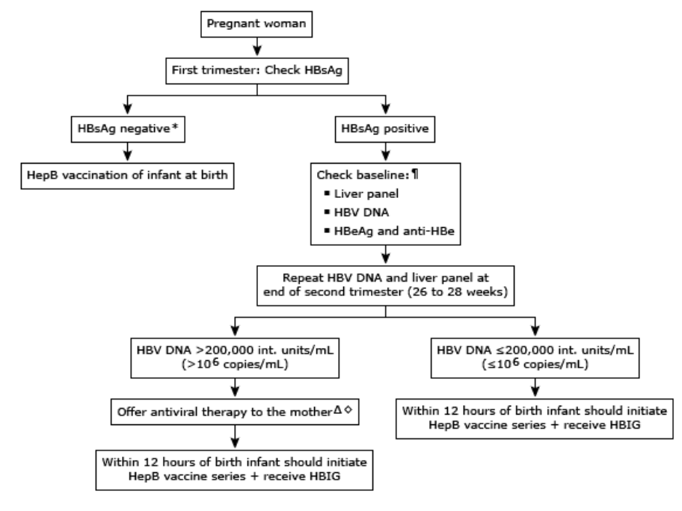
LIVER DISEASE COINCIDENTAL TO PREGNANCY
HEPATITIS B
Vaccine series at Birth, 1, 3, 6 months.
HBIG (0.5 mL) administered intramuscularly at a separate site.
These infants should be tested for anti-HBs and HBsAg at age 9 to 12 months or one to two months after the last dose of hepatitis B vaccine.

Slide 48
LIVER DISEASE COINCIDENTAL TO PREGNANCY
OTHER VIRUSES
Cytomegalovirus, Epstein-Barr virus and adenoviruses cause systemic infection that are self limited requiring only supportive care.

Slide 49
THANK YOU

