Slide 1
POST RENAL TRANSPLANT MILIARY MOTTLING...NOT ALWAYS TUBERCULOSIS.

Slide 2
RECAP.
Vomiting and loss of apetite.
Acute cell mediated rejection.
Started on glucocorticoid therapy.
Enterocolitis and Respiratory distress(miliary mottling).
Stool: oocysts of cryptospora.Modified afb staining.
Patient started on ATT AND ANTIFUNGALS.

Slide 3
Patient deteriorated after att and ANTIFUNGALS Wet Mount of the sputum: Strongyloides.
Absolute eosinophil count :660 cells/cu.mm
Att stopped .Diagnosis of STRONGYLOIDES HYPERINFECTION SYNDROME
was made patient started on oral ivermectin.No clinical response.

Slide 6
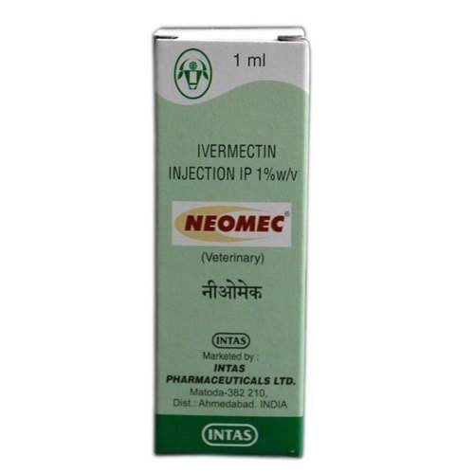
Veterinary formulation of ivermectin was procured.Administered at a dose of 200 mcg/day.Divided into two equal portions;at two separate sites subcutaneously.
Patient tolerated the therapy well.

Slide 7
After 3 doses of parenteral ivermectin ,symptoms started subsiding.
Immunosuppressants were gradually reintroduced.
After 7 doses of subcutaneous ivermectin, he was switched over to oral ivermectin therapy.
Continued for 2 weeks after 3 consecutive stool specimens are negative for Strongyloides larva.

Slide 8
SHS vs Disseminated strongyloidiasis.
SHS is estimated to happen in 1.5 to 2.5 percent of patient with strongyloidiasis.
SHS and Disseminated strongyloidiasis are not synonymous.
Disseminated disease is defined by the presence of parasites in organs outside traditional life cycle.

Slide 9
Pathogenesis:
Corticosteroid induce SHS by Increasing apoptosis of Th2 cells; reducing the eosinophil count;inhibiting mast cell response.
Increase ecdysteroid like substances (sterols with non hormonal anabolic effects) in the body mainly in the intestinal wall.
Ecdysteroids induce increase production of autoinfective filiariform LARVAE-HYPERINFECTION

Slide 10
Diagnois
Key: HIGH INDEX OF SUSPICION.
EOSINOPHILIA .93.5 % SENSITIVE AND 93.1% specific in strongyloidiasis.
Peripheral eosinophilia in SHS –good prognostic factor.
ELISA – PPV of 91% and NPV of 98%.
Standard stool analysis- Insensitive for detecting Strongyloides.

Slide 11
Imaging:
Ct chest: Ground glass opacity; interlobular septal thickening; consolidation.
Our patient - extensive miliary pattern of infiltrates.
Hemoptysis,hemoglobin drop and respiratory distress-diffuse alveolar hemorrhage.

Slide 12
Prognosis
HYPERINFECTION syndrome- High morbidity and mortality.
If left untreated , mortality rate 100%.

Slide 13
Treatment:
Ivermectin ,albendazole and mebendazole are effective.
Ivermectin is the drug of choice.
Oral ivermectin preferred for intestinal strongyloidiasis.
But ,patinets with SHS experience paralytic ileus ,profuse vomiting and diarrhoea.
Limits the delivery and absorption of oral medications.
Parenteral ivermectin – Available only for veterinary use.
Used occasionally in humans with severe strongyloidiasis,refractory to oral agents.

