Slide 1
RADIO IMAGING FOR DISCUSSION
II MEDICAL UNIT
CHIEF:DR.DAVID PRADEEP KUMAR
ASSITANT PROFESSORS:DR.PRABHU
DR.NASEEMA BANU
DR.RAM KUMAR

Slide 2
A 36 year old male referred from private hospital as a case of fever with thrombocytopenia
HOPI
H/o fever for 3 days
H/o myalgia
H/o hematochezia
H/o orthopnea for 1 years
No h/o gum bleeding and Malena
PAST HISTORY
k/c/o hemorrhoids for 2 years on conservative treatment
H/o RTA 1yr back - pelvic fracture with plating done (Records NA)
PERSONAL HISTORY
mixed diet
Alcoholic
Driver

Slide 3
O/E
Pt conscious, oriented
Pallor+
No cyanosis, clubbing, icterus, pedal edema, lymphadenopathy
Vitals
BP: 110/70mmHg
PR:96/min
SP02:98%RA
S/E
CVS : S1S2+ No murmur
RS : BAE+ NVBS
P/A : soft /BS+
CNS: conscious, oriented

Slide 4
INVESTIGATIONS
 | 21/08 | 23/08
RBS | 102
Urea | 25
Creatinine | 0.9
Sr Na | 138
Sr.K | 4.2
T.B | 0.7 | 0.8
SGOT | 102 | 130
SGPT | 80 | 70
ALP | 220 | 180
 | 21/08 | 22/08 | 23/08
TC | 3200 | 3400 | 4100
HB | 7.1 | 7.0 | 7.2
MCV | 75 | 70 | 72
PLT | 56000 | 50000 | 62000
PT | 14.08
INR | 1.01

Slide 5
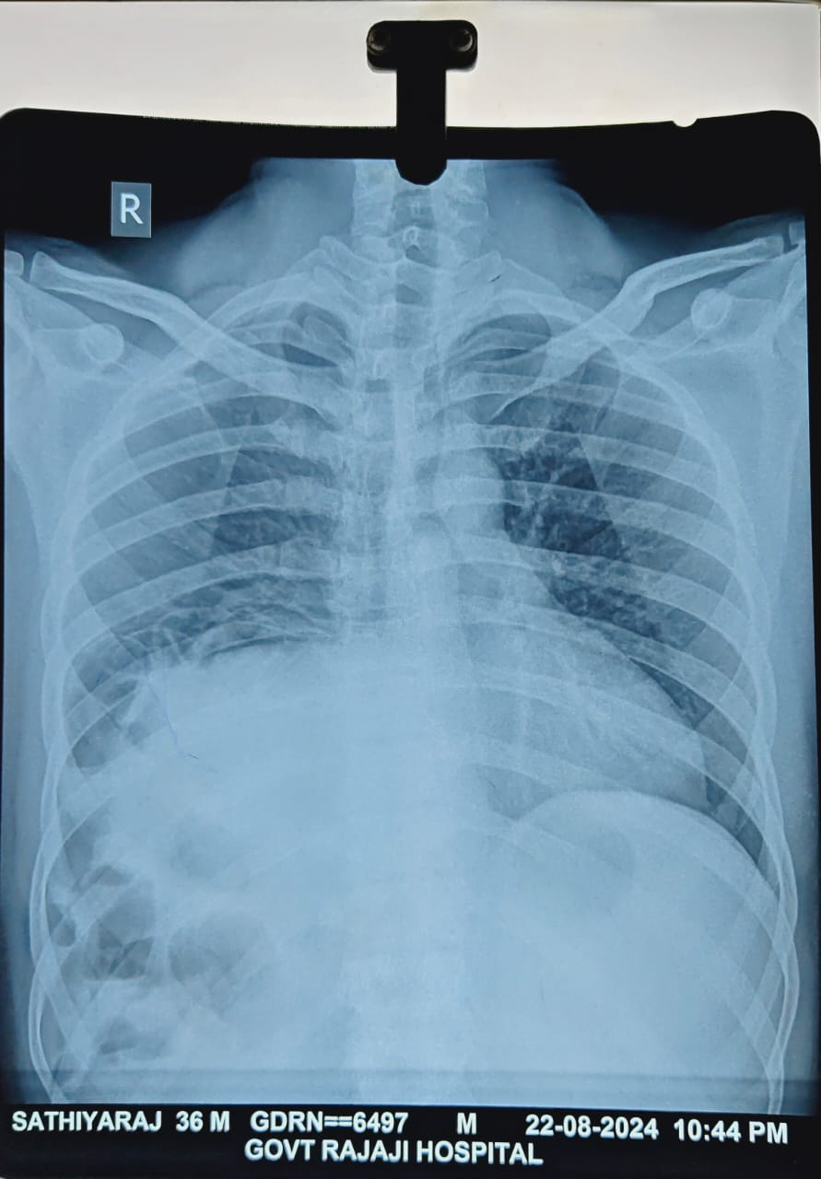

Slide 6
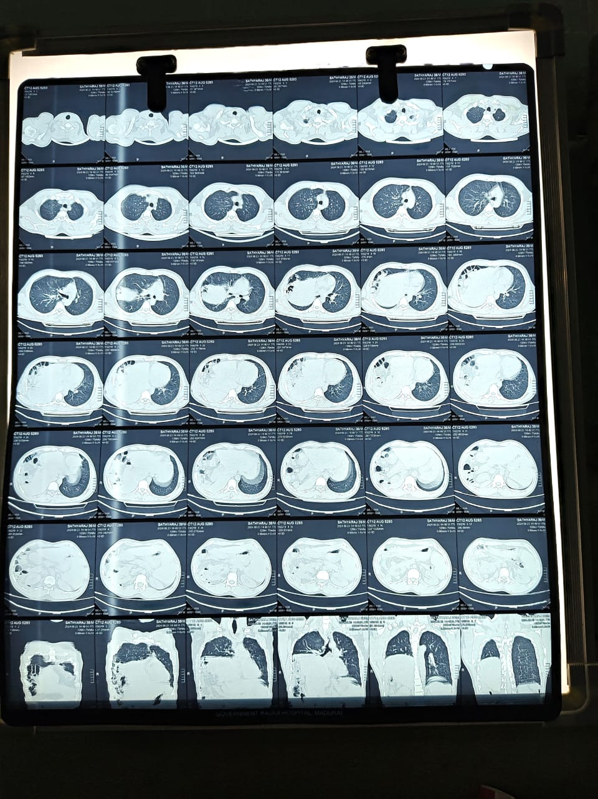

Slide 7
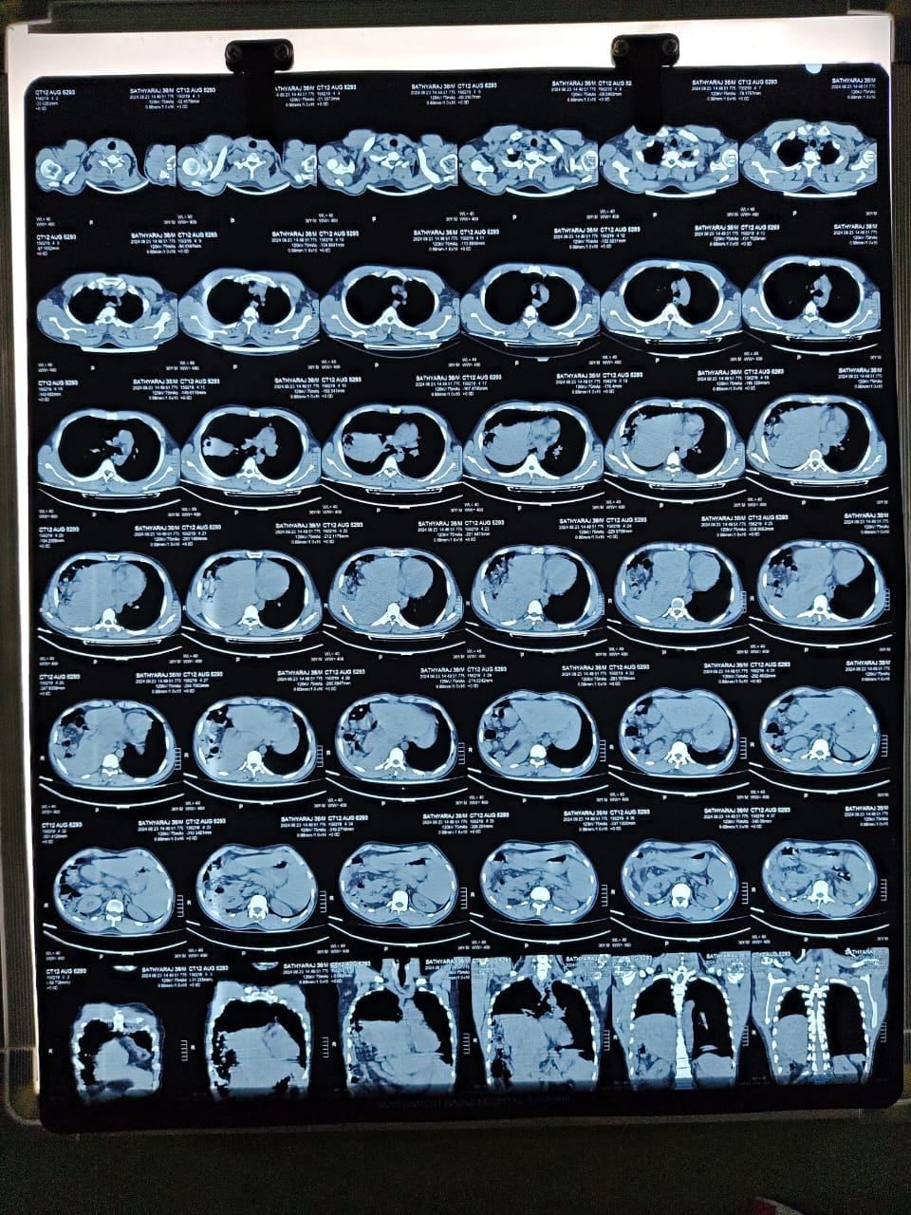

Slide 8
LETS DISCUSS

