Slide 1
JOURNAL PRESENTATION
BY2nd MEDICAL UNIT
CHIEF – Dr Bagialakshmi M D
Asst Prof : Dr Vallidevi MD
Dr Ponsenthil kumar MD
Dr Ilamaran MD
Presentor: Dr Hariharan

Slide 3
BACKGROUND OF THE STUDY
Microalbuminuria is not a satisfactory for early detection of diabetic kidney disease since some Patients with chronic kidney disease have normal
Albuminuria despite underlying kidney damage. This is called as normalbuminuric CKD .

Slide 4
Markers used To diagnose kidney injury are
Urinary retinol binding protein
Fatty acid binding protein
Neutrophil gelatinase associated lipocalcin
Kidney injury molecule
Cystatin C

Slide 5
The activation of inflammatory Pathways such as Tumor necrosis factor is said to be involved in the development of insulin resistance.
The circulating levels of soluble T receptors sTNFR 1 and 2 are Have demonstrated to be a predictive marker in ESRD in Caucasian people.

Slide 6
OBJECTIVE OF STUDY
To assess the relationship between soluble Tumor necrosis factor 1 as a biomarker for early detection of kidney involvement in diabetic kidney disease.

Slide 7
STUDY DESIGN
OBSERVATIONAL
Cross sectional type of study
STNFR -1 was measured using a quantitative ELISA kit
Anthropometric assessment like waist circumference, height, weight, BMI were also measured.

Slide 8
METHOD OF STUDY
PARTICIPANTS ENROLLEMENT
INCLUSION CRITERIA:160 Type 2 DM patients were recruited based on
Normoalbuminuria
Microalbuminuria
Macroabluminuria
Normal glucose tolerance subjects as controls

Slide 9
Data analysis was done with stastical package for social sciences – software
Standardized regression analysis was done to Assess how incremental changes in STNFR1 was associated with Microalbuminuria and Macroalbuminuria

Slide 10
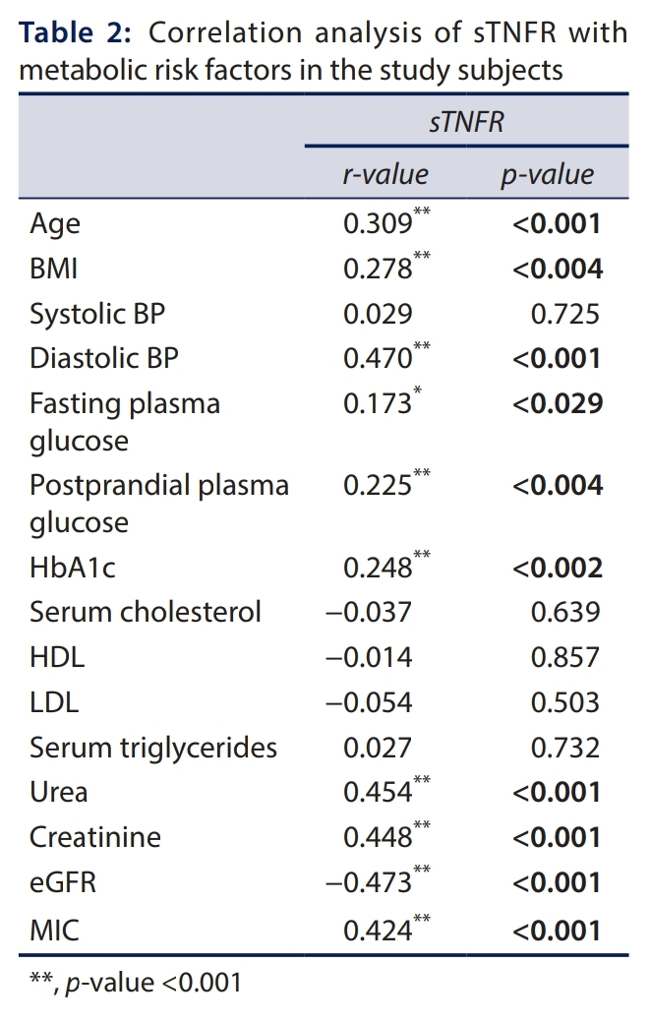
Results

Slide 11
TNFR1 levels were positively correlated with age, BMI, diastolic blood pressure,fasting plasma glucose, postprandial plasma glucose, HbA1c, urea, creatinine, and MIC.
There was no Significant correlation between systolic blood pressure, cholesterol, HDL and LDL cholesterol, and serum triglycerides.
Soluble tumor necrosis factor receptor1 (sTNFR1) level was highest in MAC with a 2.3-fold increase, followed by MIC with a 1.3-fold increase when compared to the Normalbuminuric group. The levels of STNFR1 were not different between normal glucose tolerance and Normalbuminuric group

Slide 12
There was a positive correlation with age and several other metabolic parameters with STFNR1 and no correlation with lipids. This finding implies that hyperglycemia is central in the regulation of circulation sTNFR1 levels.
There was a negative correlation of sTNFR1 with eGFR, indicating the association of STNFR1 with renal decline.

Slide 13
Studies support the potential role of sTNFR1 in predicting the severity of renal disease. In this context, we found a positive correlation between sTNFR1 and glycemic parameters, including fasting glucose and HbA1c. The correlation between sTNFR1 and established kidney injury markers such as Serum creatinine and MIC suggest a diagnostic as well as prognostic value of sTNFR1. The significant negative correlation of sTNFR1 with eGFR also substantiates the role of sTNFR1 in assessing diabetic kidney injury.

Slide 14
Limitations
Since it is a cross sectional study, No cause and effect relationship can be Established between the levels of STNFR and Microalbuminuria / Macroalbuminuria.

Slide 15
Conclusion
In summary, we report that in Asian Indians, the sTNFR1 profile is higher in MIC
and MAC, suggesting that it has the potential
to be used as an early diagnostic marker for MIC or MAC.

Slide 16
Discussion
Diabetic kidney disease (DKD) is characterized by glomerular apoptosis and is directly related to HbA1C and diabetic duration, and has been shown to be associated with an increase of proinflammatory cytokines such as TNF-α.19 Soluble forms of TNFR1 and TNFR2 are generated, possibly due to alternative splicing that results in the loss of the transmembrane and cytoplasmic domain.
The underlying chronic proinflammatory state possibly results in the generation of STNFR1, perhaps a way of counteracting the effects of TNF-α.
They analysed the relationship of plasma levels of sTNFR1 with different stages of DKD grouped by MAC. We found that levels of
sTNFR1 were increased with the severity of diabetic kidney disease, with MIC showing high levels of sTNFR1 and MAC displaying very high levels.

