Slide 1
VENTRICULAR TACHYCARDIA CAUSES AND MANAGEMENT
By MEDICAL UNIT – 5
CHIEF : Prof . DR.B.Palani kumar MD
Assistant prof : DR . P.S. Valli devi MD
DR. P. Pon Senthil kumar MD
DR. M. Ilamaran MD

Slide 2
Classification of ventricular arrhythmias
BY CLINICAL PRESENTATION ;
HEMODYNAMICALLY STABLE
Asymptomatic
Minimal symptoms e.g, Palpitation
HEMODYNAMICALLY UNSTABLE ;
Presyncope
Syncope
Sudden cardiac death
Sudden cardiac arrest .

Slide 3
CLASSIFICATION BY ECG
NON SUSTAINED VENTRICULAR TACHYCARDIA
Monomorphic
Polymorphic
SUSTAINED VT
Monomorphic
Polymorphic
BUNDLE BRANCH RE ENTRANT TACYCARDIA
BIDIRECTIONAL VT
TORSADES DE POINTES
VENTRICULAR FIBRILLATION
VENTRICULAR FLUTTER

Slide 4
GROSS CLASSIFICATION OF VT
VT IN STRUCTURALLY ABNORMAL HEART
VT IN STRUCTURALLY NORMAL HEART .
IDIOPATHIC VT WITHOUT STRUCTURAL HEART DISEASE

Slide 5
VT IN STRUCTURALLY ABNORMAL HEART
1.VT In Coronary artery disease
2. VT in Non ischemic Dilated cardiomyopathy
3. Arrhythmogeinc RV Cardiomyopathy
4. Bundle branch re entry VT
5. VT long after repair of congenital heart disease
6.VT in Hypertrophic cardiomyopathy
7.VT in LV assist devices

Slide 6
VT IN STRUCTURALLY NORMAL HEART
GENETIC ARRHYMIA SYNDROME
Long QT Syndrome – Torsades de pointes
Brugada syndrome
Catecholaminergic polymorphic VT
Short QT and Early repolarization syndrome

Slide 7
1. VT IN CORONARY ARTERY DISEASE
Incidence of VT varies depends on type of ACS
Clinical presentation ;
Tolerated sustained VT to Sudden cardiac death
With in first 2 days – Sustained Polymorphic VT
During subacute / healing phase – Reduced LVEF - lead to SCD
Chronic phase – Scar myocardium – Recurrent Monomorphic VT .
MECHANISM ;
1. Re entry – VT associated with Scar
2. Automaticity – VT from ischemic border during acute phase
3. Triggered activity – VT during ischemia due to delayed or early after depolarization

Slide 8
CLINICAL PRESENTATION ;
Mild symptoms like palpitation
Symptoms of hypoperfusion- light headedness, altered sensorium, presyncope and syncope
Exacerbation of angina and sudden collapse
HEMODYNAMIC CONSEQUENCE DEPENDS ON:
Ventricular rate
Duration of VT
Presence and extend of LV dysfunction
Loss of atrioventricular synchrony

Slide 9
MANAGEMENT
ACUTE MANAGEMENT
VT with hemodynamic compromise – DC version
MEDICAL MANAGEMENT :
DOC- Amiodorone
Alternate drugs- procainamide,sotolol
Treatment of underlying ischemia
ICD - if revascularization is not possible and significant LV dysfunction

Slide 10
LONG TERM MANAGEMENT
Secondary Prevention of SCD – ICD implantation Done
Adjuvant antiarrhymic therapy – to reduce frequency of ventricular arrhythmia
to reduce the rate of VT ,
suppress other arrhythmias
Betablockers and other ACE inhibitors
CATHETER ABLATION
Recurrent VT causing frequent ICD shocks
Refractory to antiarrhythmic medications
VT storm or incessant VT refractory to antiarrhythmic medication.

Slide 11
2.Ventricular tachycardia IN NON-ISCHEMIC DCM
CAUSES :
Postviral
Inflammatory – myocarditis,sarcoidosis,chagas disease
Cardiomyopathy due to lamin A/C mutation
MECHANISM OF VT :
Scar related reentry
Progressive replacement of fibrosis
SITE of origin : -Scar adjacent to valve annulus of either ventricle

Slide 12
TREATMENT;
ICD
INDICATIONS :
H/O sustained VT ,
unexplained syncope
NYHA class ll, lll heart failure symptoms
Malignant familial arrhythmogenic cardiomyopathies
ADDITIONAL DRUGS AND CATHETER ABLATION -In case of recurrent VT

Slide 13
3.ARRHYTHMOGENIC RV CARDIOMYOPATHY
Progressive disease, in which normal myocardium is replaced by fibrofatty tissue
Usually RV involved sometimes LV and septum may also involve
Predominantly involves triangle of dysplasia
PATHOGENESIS :
Familial inheritance – AD / AR
Metabolic disorder affecting RV
Infectious and immunological cause
Mutation in desmosomal proteins

Slide 14
AUTOSOMAL RECESSIVE FORMS OF ARVC
Associated with cardio cutaneous syndromes that includes
NAXOS DISEASE
CARVAJAL SYNDROME
Mutation in plakophyllin -2 and plakoglobin, desmoplakin
CLINICAL FEATURES
2nd – 5th decade
Palpitation,syncope,cardiac arrest
Presented as monomorphic VT

Slide 15
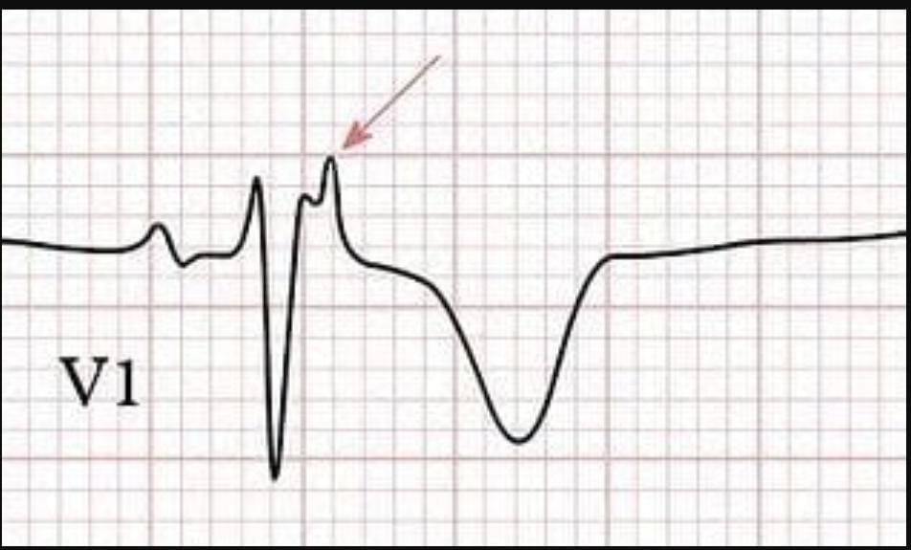
ECG
WIDE QRS in right precordial leads
T wave inversion in V1-V3
Prolonged S wave upstroke in V1- V3
Notched deflection at the end of QRS – Epsilon waves
TREATMENT
ICD
Exercise induced VT – Beta blockers and limiting exercise
Catheter ablation prevents / reduce VT [ epicardial mapping and ablation are required ]

Slide 16
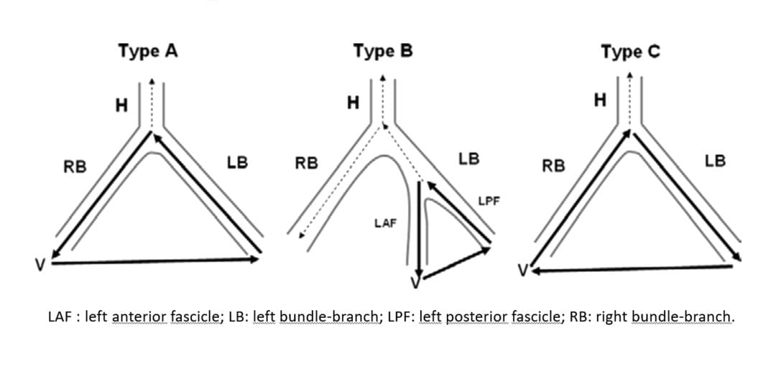
4.BUNDLE BRANCH REENTRY VT
Only reentrant VT with well defined reentry circuit via Purkinje system
TYPES OF BBRVT

Slide 17
CLINICAL PRSENTATION
unstable presentation with syncope/cardiac arrest.
INVESTIGATION
Electrophysiological studies.
TREATMENT
Catheter ablation.

Slide 18
5.VT long after repair of congenital heart disease
Substrate of sustained VT - THOSE WITH REPAIR OF VSD in TOF
MECHANISM
Circuit reentry around scar area
HIGH RISK INDIVIDUALS
Age > 5 yrs at the time of repair
High grade ventricular ectopy
Inducible VT in Electrophysiological study
Abnormal RV hemodynamics
Sinus rhythm with QRS > 180 msecs
TREATMENT
ICD
To control recurrent episode – catheter ablation and drugs

Slide 19
6.VT IN HYPERTROPHIC CARDIOMYOPATY
CAUSE ;
Betamyocin heavy chain mutation – relationship between severity of LVH and risk of SCD
Troponin mutation – high risk for SCD irrespective of LVH
Risk factor for SCD
Young age ,
Nonsustained VT
Failure of BP to increase during exercise ,
Recent syncope
Ventricular wall thickness> 3cm
Severity of LV outflow obstruction

Slide 20
TREATMENT
Surical myectomy
Transcoronary ethanol septal ablation
HIGH RISK - ICD

Slide 21
VT IN STRUCTURALLY NORMAL HEART
1.LONG QT SYNDROME
CAUSE;
Mutation in gene coding for cardiac ion channels responsible for ventricular repolarization QTc - prolonged to > 440msecs in men and 460msecs in women
7 types based on different genes
LQTS 1 LQTS-2
Due to abnormalities of K channels due to abnormal K channels
Occurs during exertion [ swimming ] sudden auditory stimuli/
Emotional upset

Slide 22
LQTS-3
Due to mutation in Na channels
Sudden death during sleep
High risk individuals:
QTc> 500msecs
Female gender
H/O syncope/cardiac arrest
TREATMENT;
Betablockers [ non selective agents – nodolol and propanolol]
ICD – high risk individuals
Recurrent syncope despite of betablockers

Slide 23
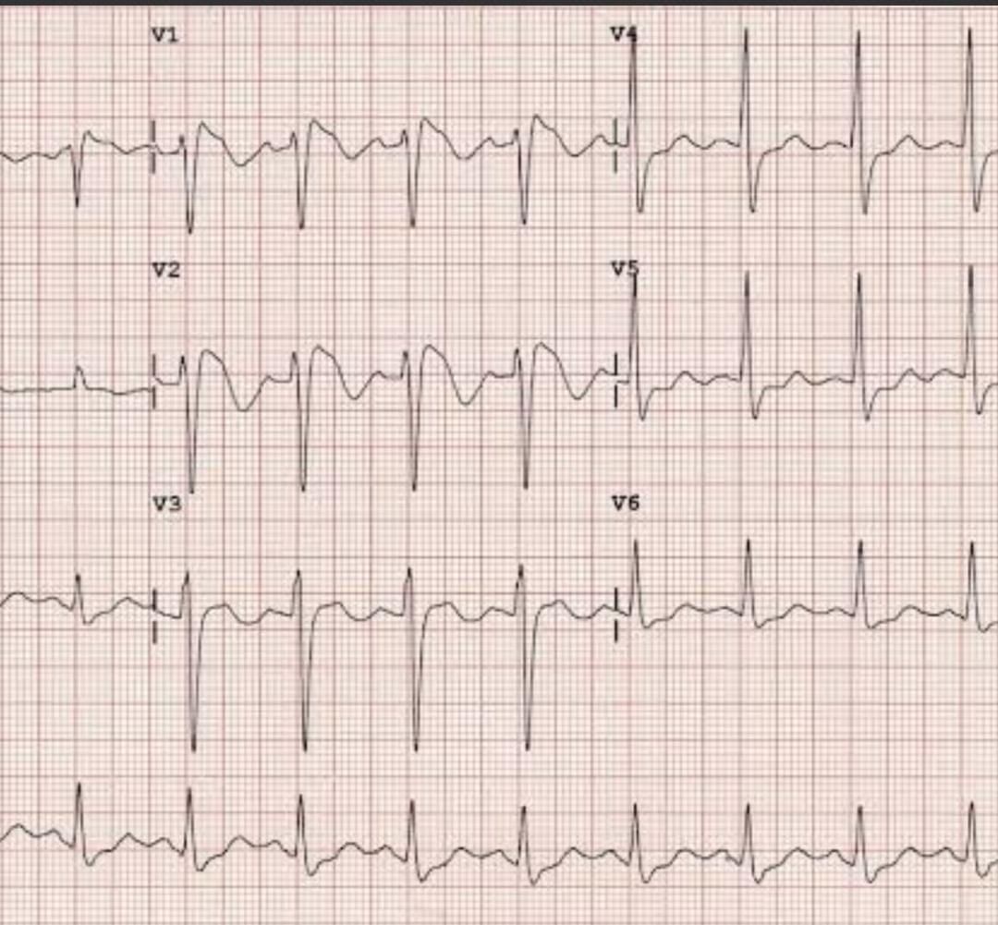
2.BRUGADA SYNDROME
Rare syndrome characterized by > 0.2 mv of ST segment elevation with coved ST segment and negative T wave in more than one precordial leads.
Cardiac arrest may occur during sleep or provoked by febrile illness
Male> female
ST elevation wax
and wane over time.

Slide 24
Na channel blocking drugs –
Flecainide, ajmaline,procainamide augment/unmask ST elevation
TREATMENT – ICD -unexplained syncope
resuscitated from cardiac arrest
To suppress frequent episode of VT
quinidine , catheter ablation

Slide 25
3.Catecholaminergic pmvt
AD Form – Mutation in Cardiac Ryanodine receptors
AR Form – Mutation in Calsequestrin 2
[ sarcoplasmic calcium binding protein ]
MECHANISM ;
Intracellular calcium overload due to improper handling
Resembles
.
CLINICAL FEATURES ;
Polymorphic or Bidirectional VT .
Present during childhood with exercise or emotion induced
palpitation , sweating , syncope , cardiac arrest .

Slide 26
TREATMENT
Beta blockers [ nadolol , propranolol ]
To prevent recurrence ;
verapamil , flecainide / surgical left cardiac sympathetic
denervation .

Slide 27
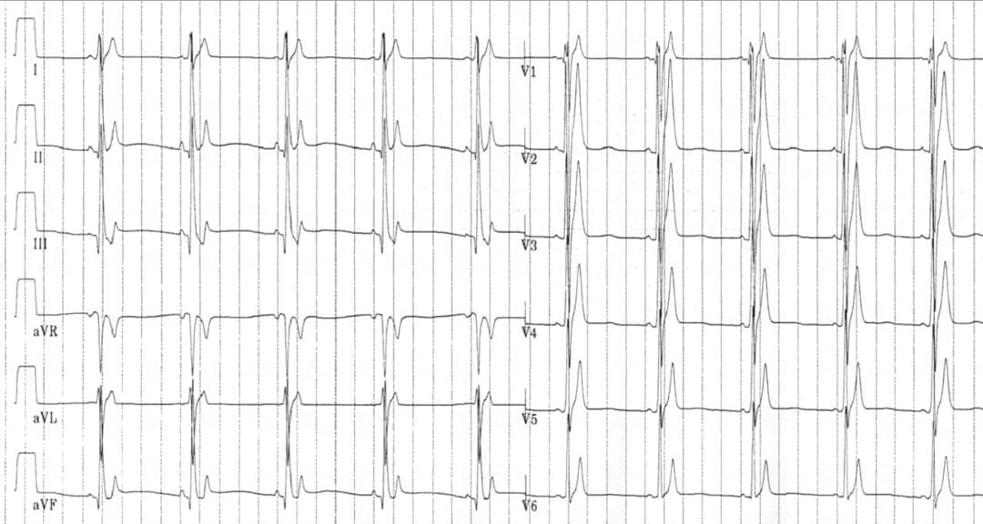
4.SHORT QT SYNDROME :
CAUSE
Due to gain of function mutation in Potassium channel .
Reduced inward depolarization currents
QTc is < 360 ms and usually< 300 ms

Slide 28
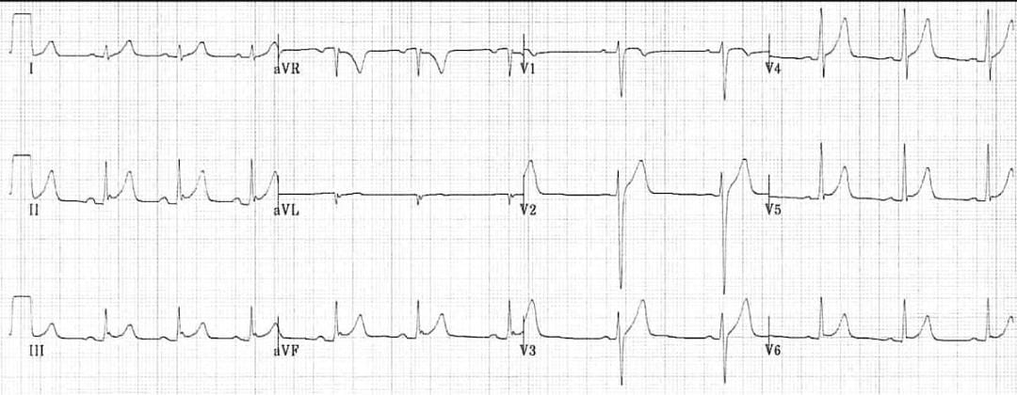
5.EARLY REPOLARIZATION SYNDROME
Patient resuscitated from VF with no structural heart disease or other abnormalities have higher prevalence of J POIINT elevation with notching in terminal QRS .
TREATMENT ;
ICD – Patient with h/o Cardiac arrest .

Slide 29
IDIOPATHIC VT WITHOUT STRUCTURAL HEART DISEASE
Negative family history and Normal ECG and ECHO anad Cardiac imaging shows normal LV function without any evidence of scar .
PRESENTATION ;
Palpitation , lightheadedness and rarely syncope.
Episode provoked by either Sympathetic stimulation or Withdrawal of sympathetic tone [ e.g, Immediate post exercise period ]
Sudden cardiac death rare – ICD not recommended .

Slide 30
TYPES OF IDIOPATHIC MONOMORPHIC VT ;
1. Outflow tract VTs .
2.LV Fascicular VT / Belhassen’s VT
3. Other site – Papillary muscles , Mitral and Tricuspid valve annuli , Moderator band
[ VT from unusual site need careful assessment for SHD ]
1.OUTFLOW TRACT VTs :
site ; Focus near pulmonic or aortic valve annuli
Mechanism ; Automaticity
Presentation ; Sustained VT , Non sustained VT or PVCs
[ Exclude - ARVC before diagnosing Idiopathic VT ]

Slide 31
RVOT LVOT
LBBB Pattern in V1 Prominent R wave in V1 or V2
Axis – Directed inferiorly with
Tall R wave in II,III, a VF
TREATMENT ;
Indicated when symptoms or frequent or incessant arrhythmia depress ventricular funftion
DOC – Beta blockers , Calcium and Sodium channel blockers
1 st – Flecainide in Tachyacardia induced cardiomyopathy
2 nd – Catheter Ablation

Slide 32
2. LV FASCICULAR VT ;
Referred as Belhassen’s VT or Verapamil sensitive VT
Site ; Septal ramification of LV Purkinje system
Mechanism ; Small reentry circuit .
PRESENTATION ;
Sustained VT has RBBB configuration and negative in inferior leads
Exercise induced
TREATMENT ;
IV Verapamil

