Slide 1
AN INTERESTING CASE OF HEMOPTYSIS
By MU -6
CHIEF PROF.DR.S.PEER MOHAMED M.D
ASST PROF DR.M.SATHEESHKUMAR M.D
DR.C.VIGNESH M.D
DR.V.P.PRIYA M.D

Slide 2
CHIEF COMPLAINTS
A 40 years old female pt who is a daily wages worker from Usilampatti, came to GRH with
chief c/o Cough with expectoration ×7 days
Breathlessness for 3 days
Blood tinged sputum for 3 days
HISTORY OF PRESENTING ILLNESS
Pt was apparently normal 7 days back,then she developed
Cough with expectoration ×7 days
White, mucoid sputum initially,
Blood tinged for the past 3 days,
No diurnal/postural variation

Slide 3
C/o Breathlessness for 3 days,
Acute onset,MMRC Gr 4
H/o Easy fatiguability +
No h/o chest pain/palpitation
No h/o fever
No h/o Trauma
No h/o Rash
No h/o Joint pain/swelling
No h/o Oral ulcers/hair loss
No h/o Hematuria/Hemetemesis/Hematochezia
No h/o Nausea/vomiting/Abdominal pain
No h/o burning micturition/urgency/frequency
No h/o Altered bowel habits
No h/o Altered sensorium/Loc/seizures
No h/o visual disturbances
No h/o Loss of weight/loss of appetite

Slide 4
PAST HISTORY
Pt had similar complaints 6 months back ,treated in a private hospital with IV antibiotics, nebulisation and Steroids. Patient was advised for further evaluation but patient has lost follow up for the past 5 months.
Not a k/c/o TB/ DM/HTN/BA/CAD/CKD/Epilepsy/Bleeding diathesis.
No h/o drug intake for the past 5 months
PERSONAL HISTORY
Mixed diet
Bladder and bowel habits normal
No h/o Substance abuse
MENSTRUAL AND OBSTETRIC HISTORY
P2L2A0
LCB 15 years back
Normal Regular menstrual cycles 3/30
LMP 6/5/2024

Slide 5
GENERAL EXAMINATION
Pt conscious
Oriented
Afebrile
Dyspneic/tachypneic
Pallor +
No Icterus/cyanosis/clubbing
No generalised lympahdenopathy/Pedal edema
No external markers of TB/HIV
No bony deformities/skin rash/purpura/ecchymosis
HT 160 cms
WT 65 kg
VITALS
BP 110/70 mmHg
PR 90 / min
SP02 90% RA
96% @4L O2
RR 25/ min

Slide 6
EXAMINATION OF RS
EXAMINATION OF NASAL CAVITY AND ORAL CAVITY – Normal
INSPECTION
Shape of the chest wall – Elliptical
B/L symmetrical
Trachea seems to be in midline
Type of respiration Thoracoabdominal
Apical impulse not seen
No chest wall/spinal deformities
No scars/sinuses/dilated veins

Slide 7
AUSCULTATION
BAE +
AE decreased in b/l infraaxillary,infrascapular and interscapular areas
Fine Crackles + in b/l infra axillary,infrascapular and interscapular areas
PALPATION
Trachea in midline
Apical impulse –Lt 5th ICS half an inch medial to MCL
Chest wall expansion 3 cm
AP diameter 18 cm, Transverse diameter 24 cm
VF decreased in B/L mammary,infra axillary,infrascapular and interscapular areas

Slide 8
OTHER SYSTEMS EXAMINATION
CVS :S1S2 +
No murmur
P/A:Soft,BS+
No organomegaly
CNS: Pt conscious,oriented
NFND
L/E of Both Breast and Axilla -normal

Slide 9
INVESTIGATIONS
CHG with PS
TC 13700, DC- N 84%,L 13%,E 2%,M 1%
HB 8.9
HCT 27.5
PLATELET 3.71L
RBC-Normochromic normocytes
Retic.count 4% ,RPI – 1.2 %
Neutrophilic leucocytosis +
Platelets Normal in number and morphology
CBC | 26/5 | 4/6
TC | 12200 | 13700
DC | 64/32/4 | 71/21/7
HB | 8.8 | 9.4
MCV | 85.6 fl
MCH | 27.6 pg
MCHC | 32.2
PCV | 27.3 | 27
PLT | 5.35 L | 5.03L

Slide 10
RBS | 86 mg/dl
UREA | 43 mg/dl
CREATININE | 1.0 mg/dl
T.BILIRUBIN | 0.8 mg/dl
Direct | 0.3
Indirect | 0.5
SGOT | 32 U
SGPT | 24 U
ALP | 39
Sodium | 137
Potassium | 3.7
Calcium | 9.1
TOTAL PROTEINS | 6.0 gms
ALBUMIN | 4.3 gms
GLOBULIN | 1.7 gms
PT | 15
INR | 1.1
APTT | 23

Slide 11
CHEST X-RAY
Diffuse heterogenous airspace opacities + in B/L mid, lower zones

Slide 12
ABG
PH | 7.35
PO2 | 55
PCO2 | 35
Lact | 1.0
HCO3 | 22

Slide 13
URINE ANALYSIS
ALBUMIN -NIL
SUGAR -NIL
DEPOSITS - 0 to 2 pus cells
No Cast/Dysmorphic RBC’s

Slide 14
ESR 22mm/hr
qCRP 12.7
CPK 27
VCTC Non -Reactive
Viral markers –Negative
Rheumatoid factor –Negative
SPUTUM CULTURE –No growth
SPUTUM AFB –Negative
SPUTUM CBNAAT-MTB not detected
URINE CULTURE – No growth

Slide 15
ECG
HR 100/min
Normal axis
Normal sinus rhythm
PR interval 160 ms
No st-t changes
ECHO
EF 60%
NO RWMA at rest
Normal study
USG ABD &PELVIS
RK 9*5 CM Normal echoes CMD +
LK 9.3*5 CM Normal echoes CMD +
NIL SIGNIFICANT ABNORMALITY DETECTED

Slide 16
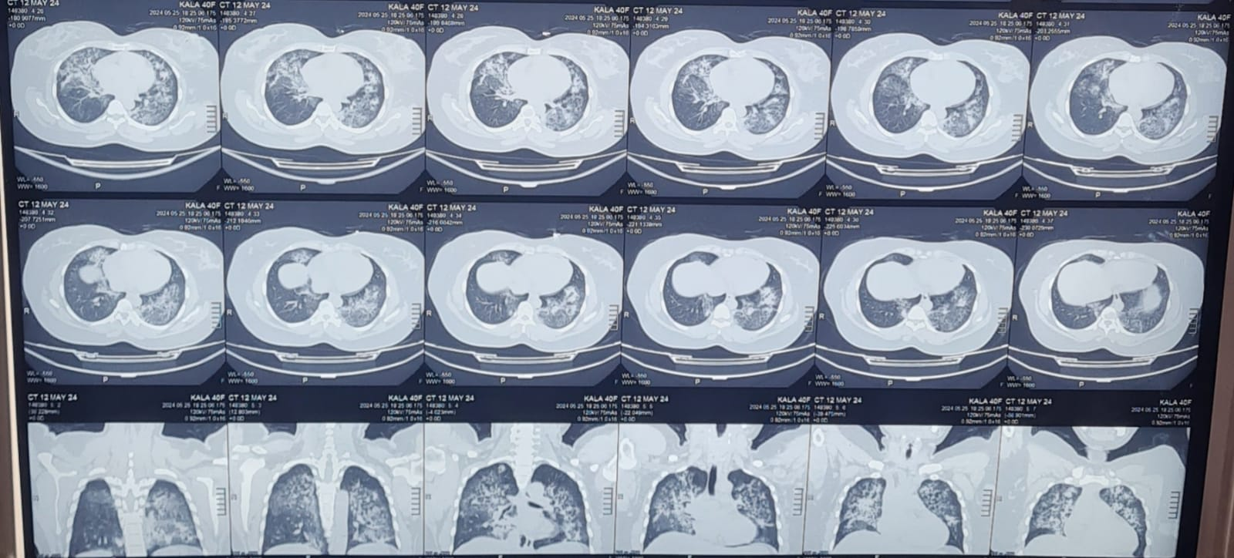
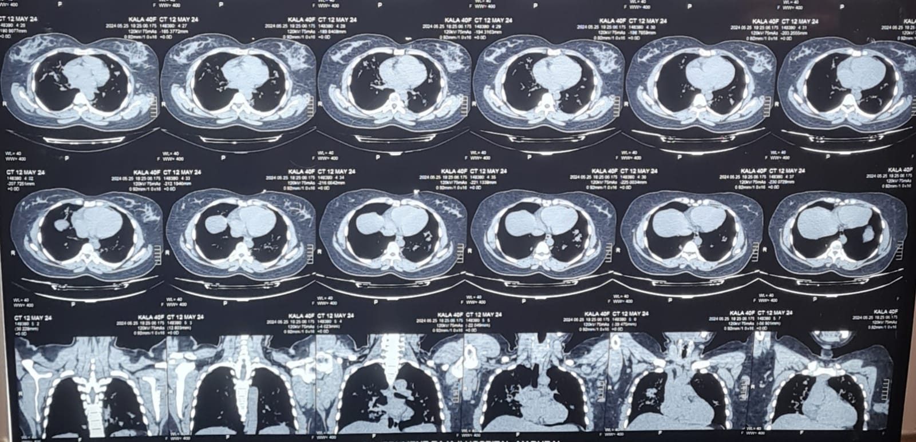
CT Chest

Slide 17
Ill defined GGO’s and centrilobular nodules noted in B/L lung fields in perihilar and peribronchiolar region with peripheral sparing

