Slide 1
INFECTIVE ENDOCARDITIS
BY 6th medical unit
CHIEF:
DR.R.SUNDARAM MD
ASSISTANT PROFESSORS: DR.P.SUDHA MD
DR.M.J.SENTHILKUMAR MD
DR.S.SUGADEV MD
PRESENTOR: DR.N.S.SRIKANTAN
( 1st year Post Graduate)

Slide 2
Definition:
Infective Endocarditis is the infection of inner lining of the heart including the heart valves, chordae tendinae, interventricular septum, mural endocardium or intracardiac device
It is characterized by the formation of vegetations
A vegetation is a mass of platelets, fibrin, microorganisms and inflammatory cells.

Slide 3
History of IE
Lazare Rivière in 1646 described a patient who presented with palpitations and irregular pulse and died after a short course. At autopsy, he found “round carbuncles” in the left ventricles
Jean-Nicolas Corvisart introduced the term “vegetation,” and pointed their resemblance to syphilitic warts
Byrom bramwell noted the presence of microbes in both the vegetations and in the embolized material. Bramwell was one of the first to emphasize that left-sided valves were more often involved than right
In 1924 Libman, along with Benjamin Sacks described a form of vegetative endocarditis from which organisms could not be isolated in patients with SLE.

Slide 4
Some other Terminologies
NBTE / MARANTIC ENDOCARDITIS
Characterised by the presence of vegetations on cardiac valves, which consist of fibrin and platelet aggregates alone without any microbes. These are small(1 to 5 mm) verrucous non destructive.
Libman–Sacks endocarditis is a form of non-bacterial endocarditis that is seen in association with systemic lupus erythematosus, antiphospholipid syndrome. Vegetation of libman sack’s endocarditis can be seen on both sides of AV valve
INFECTIVE ENDARTERITIS A process that is similar to IE occuring in arteriovenous / arterioarterial shunts or coarctation of aorta

Slide 5
Predisposing factors
Congenital heart defects
Rheumatic / degenerative valvular disease
Bicuspid aortic valves
Mitral valve prolapse
Hypertrophic cardiomyopathy
Prior endocarditis
Prosthetic valves, cardiac implantable electrical devices, indwelling catheters
IV drug abusers
Immunosuppressed
Recent dental or surgical procedures

Slide 6
CLASSIFICATION OF INFECTIVE ENDOCARDITIS
Infective Endocarditis can be acute / subacute
Acute IE :
Develops abruptly and progresses rapidly (ie, over days)
Acute IE affects native valves
It is usually caused by highly virulent organisms Staphylococcus aureus, group A beta hemolytic streptococci, pneumococci, gonococci
A source of infection or portal of entry can often be identified in acute IE

Slide 7
Subacute IE :
Develops insidiously and progresses slowly (ie, over weeks to months) Subacute IE is caused most commonly by low virulence organisms like viridans streptococci, CoNS, HACEK group, and enterococci) Subacute IE often develops on abnormal valves after asymptomatic bacteremia due to periodontal, gastrointestinal, or genitourinary infections.

Slide 8
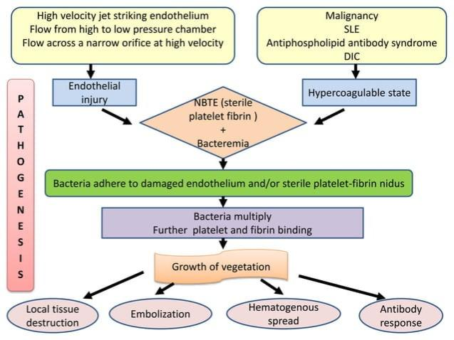
Pathogenesis

Slide 9
Causative organisms
Viridans group / Alpha hemolytic streptococcus (S.gallolyticus, S.mutans, S.sanguinis, Abiotrophia, granulicatella)
Staphylococcus aureus (most common causative organism)
Enterococci
Coagulase negative staphylococcus
Other rare organisms causing IE include HACEK group, pseudomonas, enterobacteriaceae , Coxiella burnetti ,Bartonella, Brucella
Fungal – Aspergillus, Candida

Slide 10
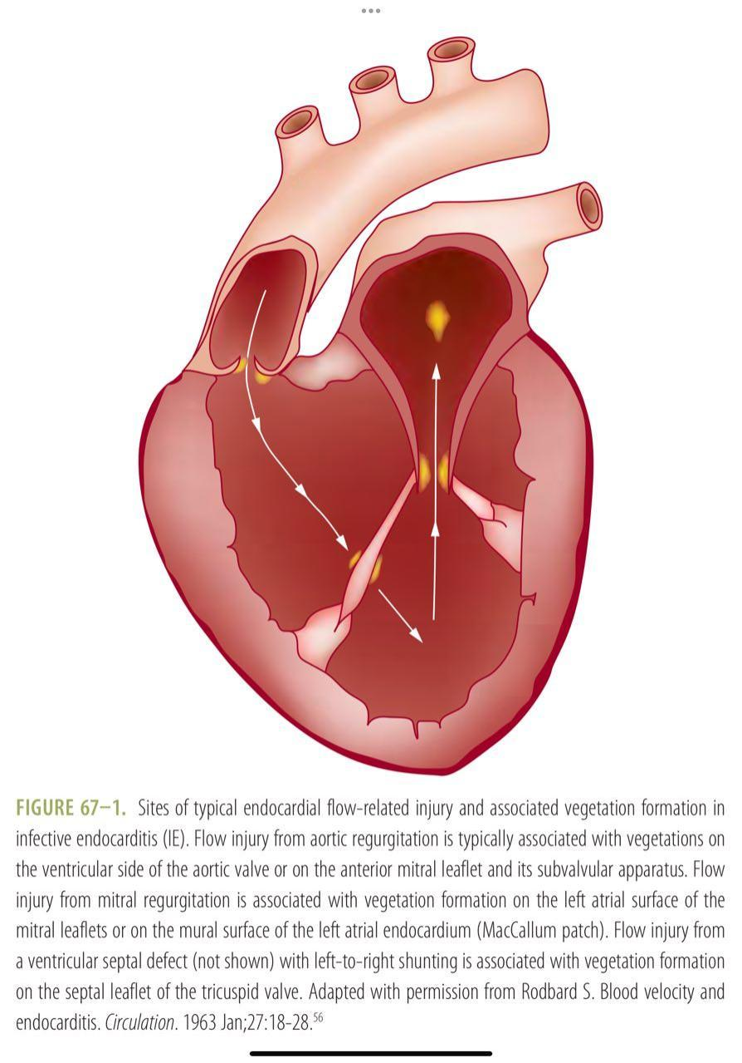
Site of Vegetation in Infective Endocarditis
Vegetations mostly form in areas where blood flow injury is likely to occur or on the low pressure side of a cardiac structural lesion– on the ventricular side of Semilunar valves and the atrial side of Av valves
Endothelium damaged by regurgitant jets / intracardiac shunts are also sites for formation of vegetations
Aortic regurgitation – mitral chordae
Mitral regurgitation – mural left atrial endocardium
Septal leaflet of tricuspid valve in VSD

Slide 11
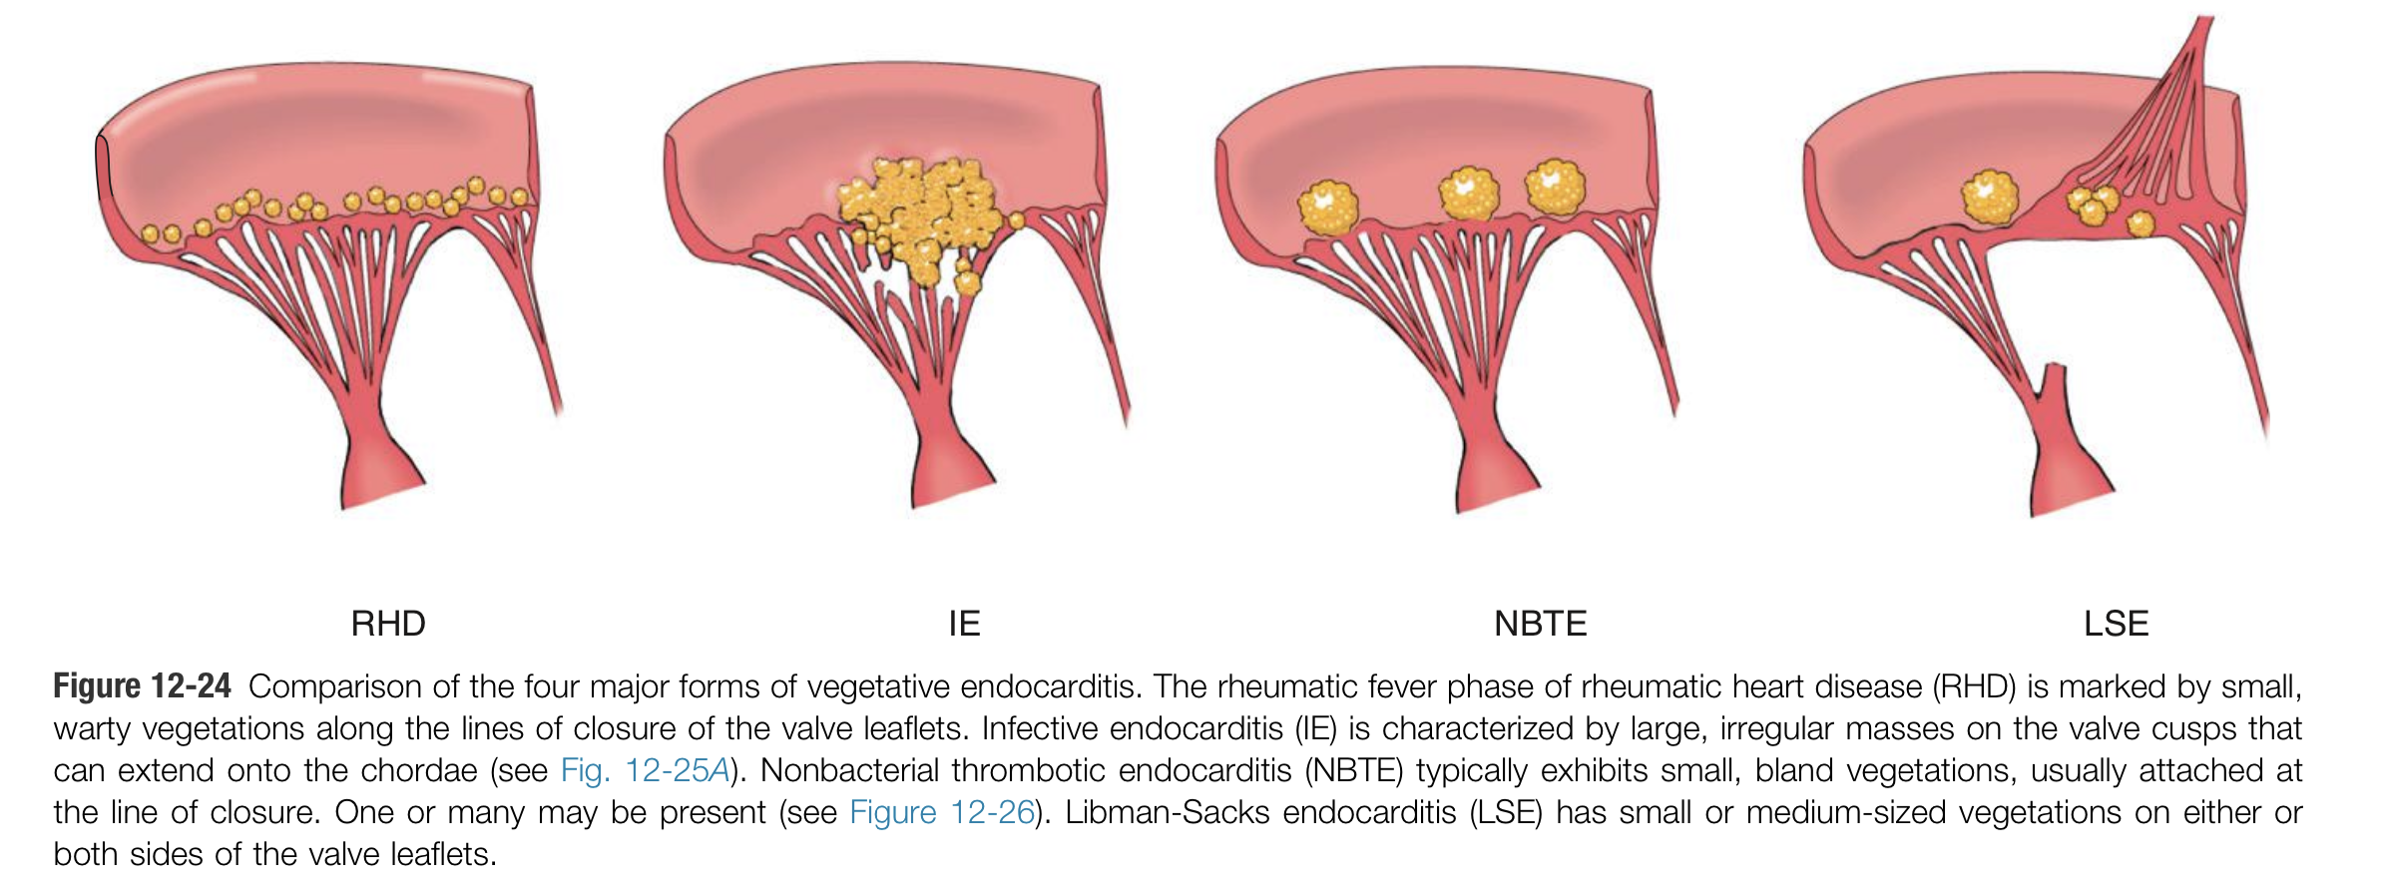
Pic from Robbins pathology

Slide 12
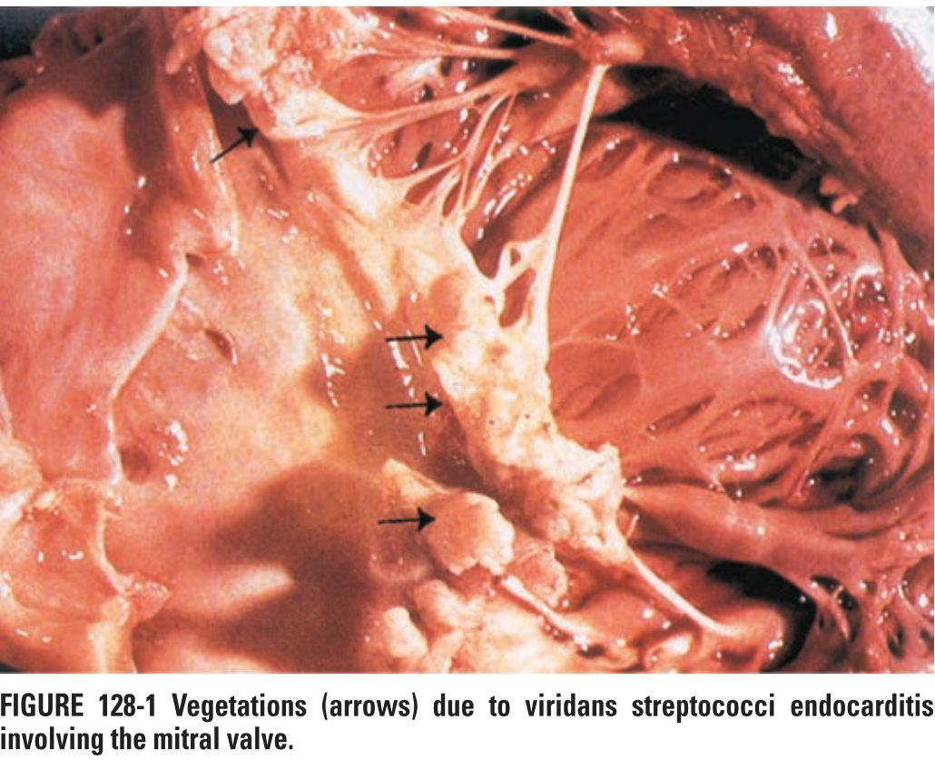
Vegetation at risk for embolisation
Vegetation >10mm diameter
Vegetation involving anterior mitral leaflet
Pic obtained from Harrison

Slide 13
Infective Endocarditis can be
Native valve infective Endocarditis
Prosthetic valve infective Endocarditis – early (<6 months) or late (>6 months)
IE in people who inject drugs – Right sided (Tricuspid > pulmonary)
Nosocomial

Slide 14
Prosthetic valve Endocarditis
Incidence is 1 to 3 percent at 1 year and 3 to 6 percent at 5 years
Risk is greater for bioprosthetic valves > mechanical valves
It can be early ( within 2 months to 1 yr of valve surgery ) or late PVE
Early PVE is predominantly caused by coagulase negative staphylococcus , gram negative bacilli , diphtheroids and fungal species.
Prosthetic valve Endocarditis occuring after 1 year of surgery is late PVE
Late PVE is predominantly caused by Streptococci , Enterococci

Slide 15
Nosocomial endocarditis
Nosocomial endocarditis is the IE that occurs more than 48- 72 hours after admission in patients with no evidence of IE on admission or IE that develops within 60 days of a previous hospital admission during which there was risk for bacteremia or IE

Slide 16
Right sided vs Left sided IE
Right sided
Involves tricuspid valve > pulmonic
Risk factors include injection drug use(90%), presence of CIED(9%), right sided cardiac anomaly(1%)
Most commonly caused by staphylococcus aureus
Septic pulmonary emboli may cause cough, pleuritic chest pain, and sometimes hemoptysis.
Left Sided
Most commonly involves mitral > aortic valves
Risk factors include congenital heart disease , RHD , prior IE
Higher rates of local invasion and systemic embolisation
Embolism will cause splenic, renal and brain infarcts

Slide 17
Clinical features
Fever is the most common presenting symptom (90%) with or without chills, night sweats
Malaise, fatigue and anorexia
Weight loss
Musculoskeletal pain, headache, abdominal pain, dyspnea
Loin pain / hematuria
Stroke / seizures
Skin rashes

Slide 18
Signs
Pallor
clubbing
New or changing murmurs (85%)
Petechiae (20-40%)
Splenomegaly
Subungual ( splinter ) hemorrhages
Sub-conjunctival hemorrhages
Janeway lesions
Osler’s node
Roth spots (2%)

Slide 19
Janeway lesions
Painless erythematous blanching maculopapular rash In palms and soles
It is a vascular phenomenon (septic emboli)

Slide 20
Splinter hemorrhages
Non blanching linear reddish brown lesions found under the nail bed and do not extend upto entire length of the nail.
It is a vascular phenomenon (septic emboli)

Slide 21
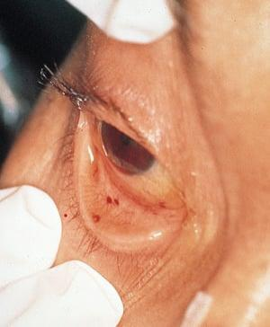
Subconjunctival hemorrhages

Slide 22
Oslers node
Painful erythematous nodules seen in pulp of fingers and toes.
It is an immunological phenomenon

Slide 23
Roth spots
Oval retinal hemorrhages with pale Centre located near optic disc
It is an immune phenomenon

Slide 24
Complications of IE
Cardiac complications (50 percent )
Heart failure – due to acute severe valvular dysfunction/ rupture of chordae/ obstruction by large vegetations / prosthetic valve dehiscence/ intracardiac shunts.
Embolism into coronary arteries leading to acute MI (2%)
Peri-annular extension of infection – more common with prosthetic valve
Peri-valvular extension may further lead to formation of abscess, perforation, intracardiac fistula formation and conduction abnormalities.
Neurological complications (40 percent)
Embolic stroke
Intracerebral hemorrhage due to ruptured mycotic aneurysms
Brain abscess
Purulent meningitis

Slide 25
Complications contd.
Pulmonary complications - bacterial pneumonialung abscess, pyothorax
Septic Emboli to brain, spleen, Liver, kidneys and extremities in left sided IE and pulmonary emboli in right sided IE
Metastatic infection - vertebral osteomyelitis, septic arthritis and splenic abscess
Mycotic aneurysms – they result from septic embolism to arterial Vasa vasorum leading to weakening of vessel Wall. They more frequently occur in intracranial arteries at arterial branch points
Glomerulonephritis

Slide 26
References:
Harrison’s principles of Internal Medicine
Hurst’s the heart
UpToDate
Robbins and Cotran pathologic basis of disease

