Slide 1
APPROACH TO LFT
VII MEDICINE UNIT
CHIEF - DR.ALAGAVENKATESAN MD.,
ASSISTANT PROFESSORS - DR.ARUL PRAKASH MD.,DA
DR.VINOTH KANNAN MD.,
DR.NABIL FAYAZ MD.,

Slide 2
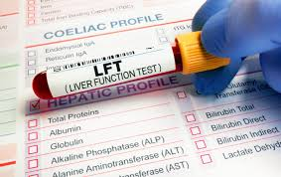
Liver function tests (LFTs) or liver biochemical tests can be used to screen for liver disease, direct diagnostic work-up, and assess severity, prognosis and response to treatment.
LFT abnormalities may be classified into the following categories:
HEPATOCELLULAR (elevations predominantly in aspartate aminotransferase (AST) and alanine aminotransferase (ALT));
CHOLESTATIC (increases predominantly in alkaline phosphatase (ALP), γ-glutamyl transpeptidase ( γ-GT) and bilirubin)
INFILTRATIVE (increases in ALP, γ-GT and occasionally bilirubin).

Slide 3
HEPATOCELLULAR | CHOLESTATIC | INFILTRATIVE
VIRAL HEPATITIS HEPATITS A,B,C,D,E EBV CYTOMEGALOVIRUS HSV | INTRAHEPATIC VIRAL HEPATITIS FIBROSING CHOLESTATIC HEPATITIS-HEP B, C | CANCER
ALCOHOLIC HEPATITIS | ALCOHOLIC HEPATITIS | GRANULOMATOUS DISEASE
CHRONIC LIVER DISEASE | DRUG TOXICITY ANBOLIC STEROIDS,OCPS | AMYLOIDOSIS
DRUG TOXICITY (paracetomol,isoniazid) | PRIMARY BILIARY CHIRROSIS | HODGKIN’S DISEASE
WILSONS DISEASE | PRIMARY SCLEROSING CHOLANGITIS
AUTOIMMUNE HEPATITIS | CONGESTIVE HEPATOPATHY,ISCHEMIC HEPATITIS
 | CHOLESTASIS OF PREGNANCY
 | INFECTIONS –MALARIA,LEPTOSPIRPOSIS
 | 2.EXTRAHEPATIC
 | MALIGNANT 1.cholangiocarcinoma 2.pancreatic carcinoma 3.gall bladder ca 4.Amupullry carcinoma
 | BENIGN Choledocolithiasis psc Chronic pancreatitis Aids cholangiopathy Parasitic disease

Slide 4
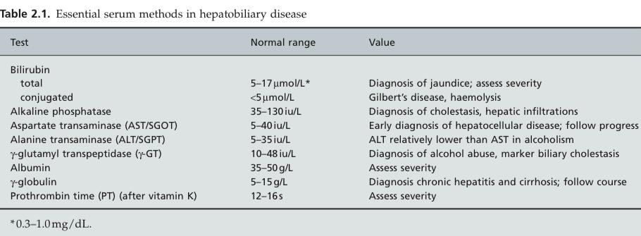

Slide 5
BILIRUBIN
Source of heme: RBC, Cytochromes, myoglobin
Total production : 4mg/kg/day
SITE: Reticuloendothelial system
Hepatocytes
Only conjugated or direct bilirubin excreted in urine
VAN DEN BERGH REACTION /DIAZO REACTION
Blood +diazotized sulfalinic acid – colour change – direct bilirubin
After 1 hour of accelerator ( Alcohol or caffeine ) – Total bilirubin
Total – direct = indirect
MEASUREMENT

Slide 6
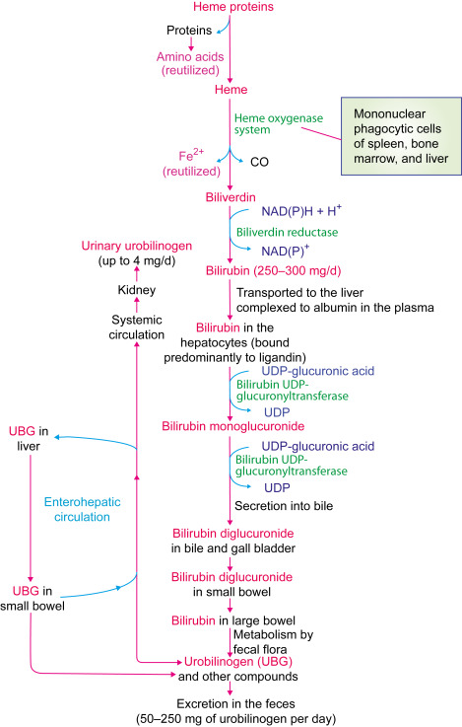
DELTA BILIRUBIN/BILIPROTEIN
It is the bilirubin that is covalently bound to albumin
Clearance rate of delta bilirubin is half life of albumin ( 12 to 14 days ) rather than short half life of bilirubin ( 4 hours )
Conjugated hyperbilirubinemia but no bilirubinuria ( since albumin cannot cross glomerular membrane)
BILIRUBIN METABOLISM

Slide 7
APPROACH TO HYPERBILIRUBINEMIA

Slide 8
AMINOTRANSFERASES
ASPARTATE AMINOTRANSFERASE
AST (Aspartate Aminotransferase) /SGOT(Serum Glutamic Oxaloacetic Transaminase)
Mitochondria> cytosol
Source: liver>heart> skeletal muscles, kidney, brain, pancreas, lungs
MACRO AST
Rare benign condition, isolated AST elevation due to binding of AST with immunoglobulin
Not reflective of liver disease
LOW AST
Chronic hemodialysis due to pyridoxine deficiency
Calculous biliary obstruction with cholangitis : AST elevation greater than 10 times

Slide 9
ALANINE AMINOTRANSFERSE
ALT(Alanine Aminotransferase) /SGPT(Serum Glutamic Pyruvic Transaminase)
Cytosolic Enzyme
More specific for liver damage than AST

Slide 10
ALCOHOLIC HEPATITIS
AST/ALT>2 : Alcoholic liver disease
AST/ALT>3 : Highly suggestive of alcoholic liver disease
Alcoholics have pyridoxal ( Vitamin B6 ) deficiency
Both enzymes require pyridoxal 5 phosphate cofactor(ALT>AST) for their production
This is because damages primarily mitochondria and thus more AST synthesized systemically.

Slide 11
ALT>AST
CHRONIC MILD ELEVATION OF ALT>AST
<150U/L or 5x upper limit of normal
HEPATIC CAUSE
Chronic viral hepatitis(B,C,D)
Hemochromatosis
Wilson Disease Alpha antitrypsin deficiency
Autoimmune Hepatitis
NON HEPATIC CAUSE
Celiac disease
Hyperthyroidism
SEVERE ACUTE ELEVATION OF ALT >AST
>1000U/L or > 20 -25x upper limit of normal
Acute viral hepatitis
Autoimmune hepatitis
Drugs and toxins
Hepatic artery ligation
Ischemic hepatitis
Acute Budd Chiari Syndrome
Wilson Disease

Slide 12
AST>ALT
CHRONIC MILD ELEVATION OF AST>ALT
<150 U/L or < 5x upper limit of normal
HEPATIC
Alcohol associated liver injury
Cirrhosis
NON HEPATIC
Hypothyroidism
Macro AST
Myopathy
SEVERE ACUTE ELEVATION OF AST>ALT
>1000U/L or >20 to 25x upper limit of normal
HEPATIC
Medications or toxins in a patient with underlying alcohol induced liver injury
NON HEPATIC
Acute rhabdomyolysis

Slide 13
ALKALINE PHOSPHATASE
Site of synthesis: Canalicular membrane of hepatocytes, bone, placenta, kidney and intestines
Half life : 3 days
Hepatic ALP differentiated from bone ALP by isoenzyme fractionation and by concominant rise in GGT
RAISED ALP
Cholestasis
Primary or secondary hepatic tumours
Amyloid, abscess, lymphoma or granulomas, hodgkins
heart failure or hyperthyroidism
Isolated rise can also be from intestinal cause
LOW ALP
Hypothyroidism
Wilson with hemolysis
Congenital Hypophosphatasia
Pernicious Anemia
Zinc Deficiency
Children recovering from enteritis

Slide 14
GAMMA GLUTAMYL TRANSPEPTIDASE OR TRANSFERASE
Primarily from Liver (Highest concentration in epithelium lining of bile duct)
Decreasing order from proximal renal tubule, pancreas and intestine
Significance: To confirm hepatic origin of ALP
ISOLATED RISE IN GGT
Alcoholics even without liver disease due to microsomal enzyme induction and impaired clearance
OTHER CAUSES
COPD, Hyperthyroidism, diabetes mellitus
DRUGS: Antiepileptics , NNRTI, Abacavir, Isotretinoin, methotrexate, cemitidine ,furosemide, heparin and OCPS

Slide 15
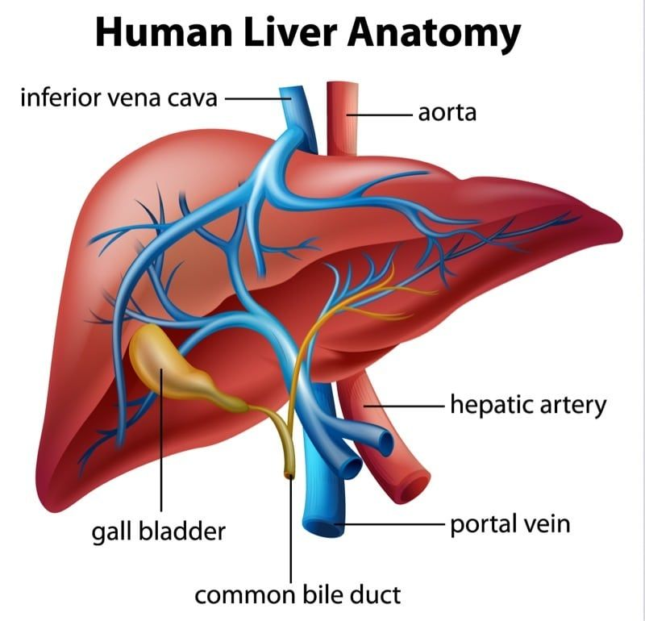

Slide 16
5” nucleosidase
SITE: Canalicular and sinusoidal plasma membranes
Other Organs: Intestine, brain, heart, blood vessels, and endocrine pancreas
USE: To identify organ source of isolated serum ALP
LACTIC DEHYDROGENASE (LDH)
Cytoplasmic enzyme with 5 isoenzymes in serum
Rise in neoplasm and ischemic hepatitis
ALT/LDH ratio
> 1.5 - acute viral hepatitis
<1.5 - Ischemic hepatitis and paracetamol toxicity

Slide 17
ALBUMIN
Exclusive production from liver
Normal Production 15gm/ day
Cirrhotic patient synthesize only 4gm
Half life 14 to 21 days
Responsible for 75% oncotic pressure

Slide 18
R RATIO
CALCULATION
Hepatocellular vs mixed vs cholestasis
ALT/ UNL for ALT divided by ALP / UNL for ALP

Slide 19
LIPIDS
The liver is central to lipid (cholesterol, phospholipid, triglyceride) and lipoprotein metabolism.
Cholesterol derived from intestinal absorption reaches the liver in chylomicron remnants. Cholesterol synthesis takes place mainly from acetyl coenzyme A(CoA) in the microsomal fraction and in cytosol
Synthesis is increased in biliary duct obstruction, terminal ileal resection, biliary or intestinal lymph fistula and medications such as cholestyramine, corti-costeroids and thyroid hormones.
Cholesterol synthesis inhibited by bile acids, cholesterol feeding, fasting and medications such as clofibrate, nicotinic acid and statins.

Slide 20
BILE ACIDS
Tight recirculation
Serum concentration reflects extent to which bile acids in intestine have escaped extraction during first pass metabolism
Radioimmunoassay can measure individual bile acids
Not sensitive
Levels increased in cholestasis of pregnancy
PT INR
Assess extrinsic pathway
All clotting factors from liver except 8 ( from endothelium )
Half life of factor vii – 6 hours
Sensitive for acute fulminant liver failure
Liver secretes both coagulant and anticoagulant factors ( protein C, S, antithrombin 3)
In Chronic liver disease ( Thrombosis>Bleeding)

Slide 21
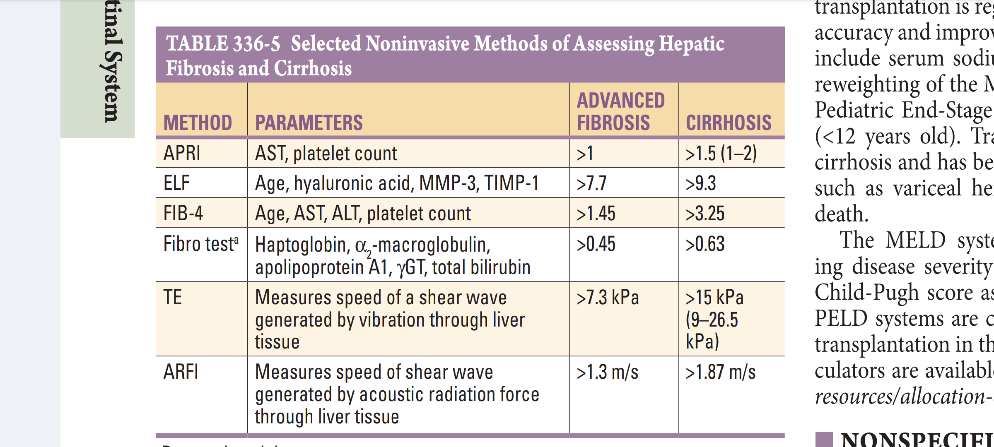
FIBROSIS
Fibrosis may be assessed by serum markers,
hyaluronate,
procollagen type III peptide,
matrixmetalloproteins and their inhibitors,
transient liver elastography

Slide 22
Thank you

