Slide 1
ECG
IMCU- 1
HOD: Dr. M. Natarajan M.D.
Chief: Dr. Alagu venkatesan M. D
Assistant: Dr. Vasantha kalyani M. D
Presentor: Dr. Subbiah

Slide 2
Case summary
A 59 year old male, reformed smoker, admitted in IMCU with acute ischemic stroke / multi infarct state/ aspiration pneumonia/ sepsis / respiratory failure and he was on mechanical ventilatory support..
During course in hospital( 3rd day), he went for sudden cardiac arrest and revived with 1 cycle of CPR...
Blood urea- 199mg/dl
Serum Creatinine- 5.7mg/dl
Serum potassium- 4.4 Meq/L
Tropnin I - Negative

Slide 3
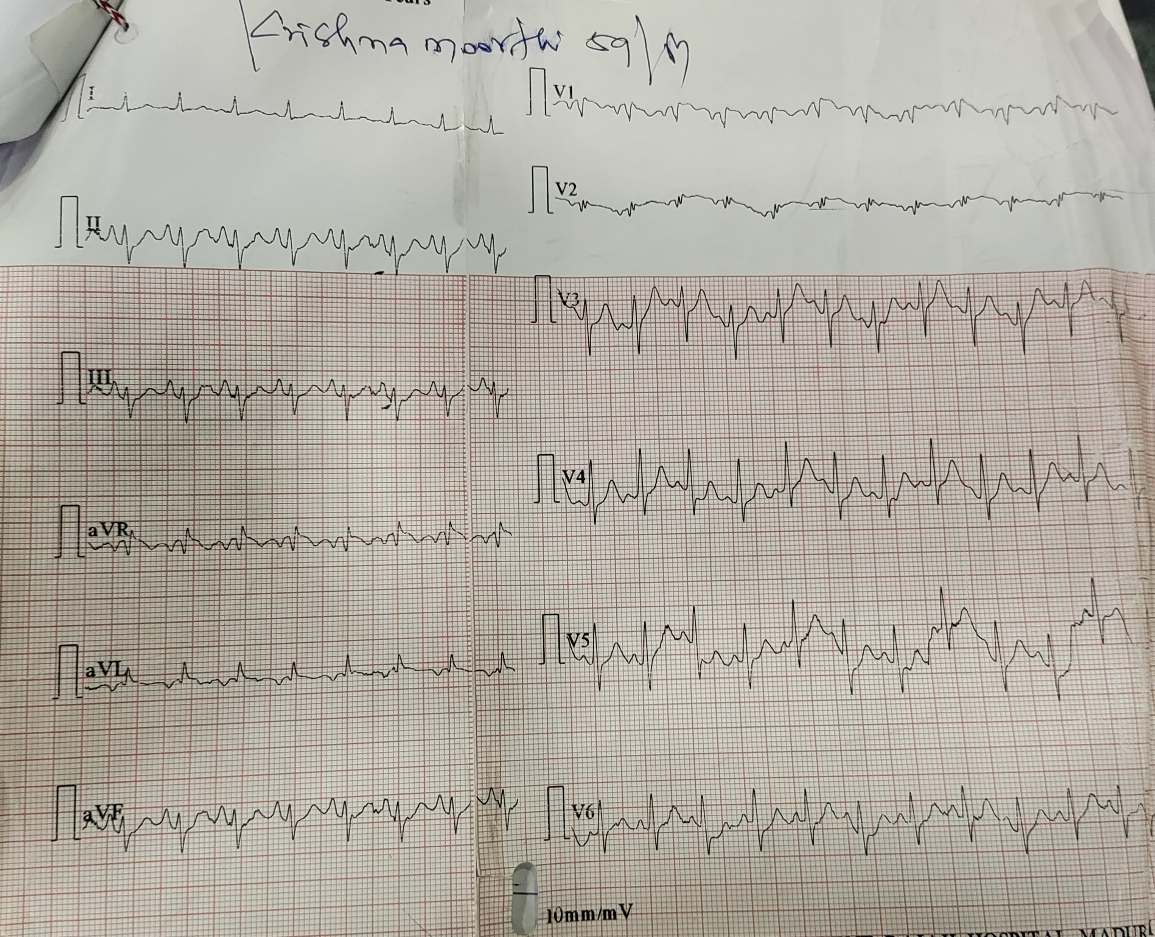
Admission ECG

Slide 4
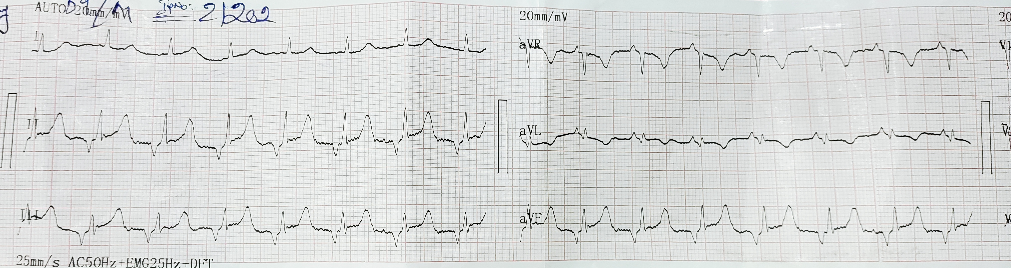
Post Cpr ecg

Slide 5
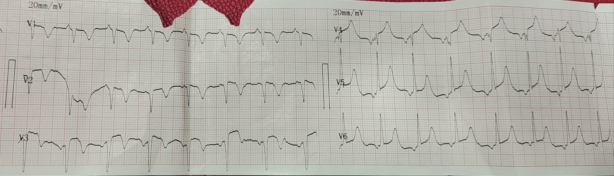

Slide 6
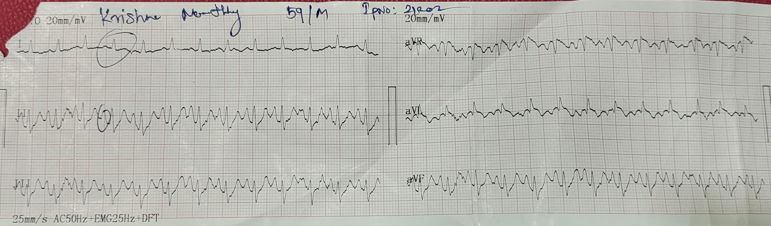
After 1 hour post cpr

Slide 7
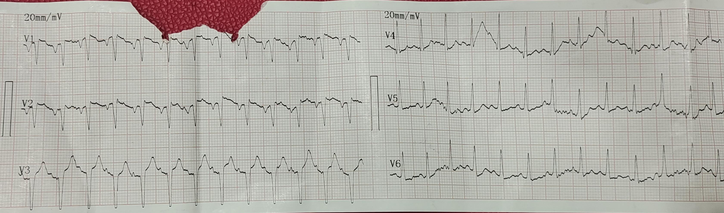

Slide 8
Discussion

