Slide 1
Effects of Semaglutide on Chronic Kidney
Disease in Patients with Type 2 Diabetes
By VIth medical unit,
CHIEF.PROF.DR.S.PEER MOHAMED M.D,
ASST PROF DR.M.SATHEESHKUMAR M.D,
DR.C.VIGNESH M.D,
DR.V.P.PRIYA M.D.

Slide 2
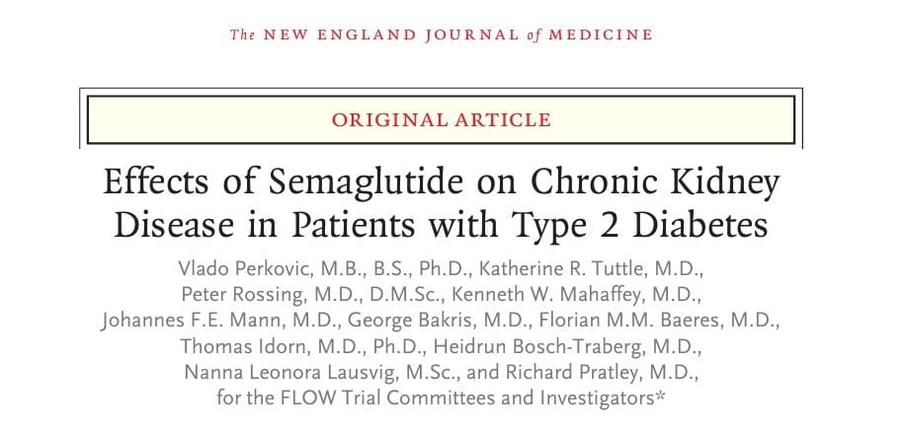
PUBLISHED ON – MAY 24, 2024.

Slide 3
BACKGROUND :-
Patients with type 2 diabetes and chronic kidney disease are at high risk for kidney failure, cardiovascular events, and death.
Semaglutide is a glucagon like receptor -1 (GLP-1) Agonist, Whether treatment with semaglutide would mitigate these risks is the background of the study.

Slide 4
METHOD OF STUDY :-
International (28 countries at 387 sites )
Double blind
Randomized , placebo controlled trial.
Total participants – 3533
Participants in semaglutide group – 1767
Participants in placebo group – 1766
Follow up – 3.4 yrs.
Mean age – 66.6 yrs
Mean eGFR – 47ml / minute / 1.73 m2 of BSA.

Slide 5
INCLUSION CRITERIA :-
TYPE II DM patient with glycated hemoglobin less than 10%.
estimated glomerular filtration rate [eGFR] of 25 to 75 ml / minute / 1.73 m2 of BSA.
with a urinary albumin-to-creatinine ratio (with albumin measured In milligrams and creatinine measured in grams) of greater than 300 and less than 5000 if the eGFR was 50 – 75 ml /minute/ 1.73 m2.
OR with a urinary albumin-to-creatinine ratio (with albumin measured In milligrams and creatinine measured in grams) of greater than 100 and less than 5000 if the eGFR was 25 – 50 ml /minute/ 1.73 m2.
Irrespective of RAS inhibitor medication.
The use of SGLT2 inhibitors and mineralocorticoid-receptor antagonists (MRAs) was permitted.

Slide 6
EXCLUSION CRITERIA :-
TYPE II DM patient with glycated hemoglobin more than 10%.
estimated glomerular filtration rate [eGFR] of less than 25 or more than 75 ml / minute / 1.73 m2 of BSA.

Slide 7
TRIAL PROCEDURES :-
Eligible patients were randomly assigned in a 1:1 ratio to receive semaglutide or placebo.
An 8-week dose-escalation regimen was used, with dose escalation (as long as unacceptable side effects did not occur).
Semaglutide dose -from 0.25 mg per week for 4 weeks and 0.5 mg per week for another 4 weeks, followed by a maintenance dose of 1.0 mg per week,
If unacceptable adverse effects occurred, dose-escalation intervals could be extended, treatment could be paused.

Slide 8
Primary outcome :-
Persistent ≥50% reduction from baseline in eGFR
Persistent eGFR <15 ml/min/1.73 m2
Initiation of kidney-replacement therapy
Death from kidney-related causes
Death from CVS related causes

Slide 9
Secondary outcome :-
Mean annual rate of change in eGFR — ml/min/1.73 m2
Nonfatal myocardial infarction
Nonfatal stroke
Mean change in glycated hemoglobin level from baseline to week 104.
Ratio of urinary albumin-to-creatinine ratio from baseline to week 104.
Mean change in systolic & diastolic blood pressure from baseline to week 104.
Mean change in body weight from baseline to week 104.

Slide 10
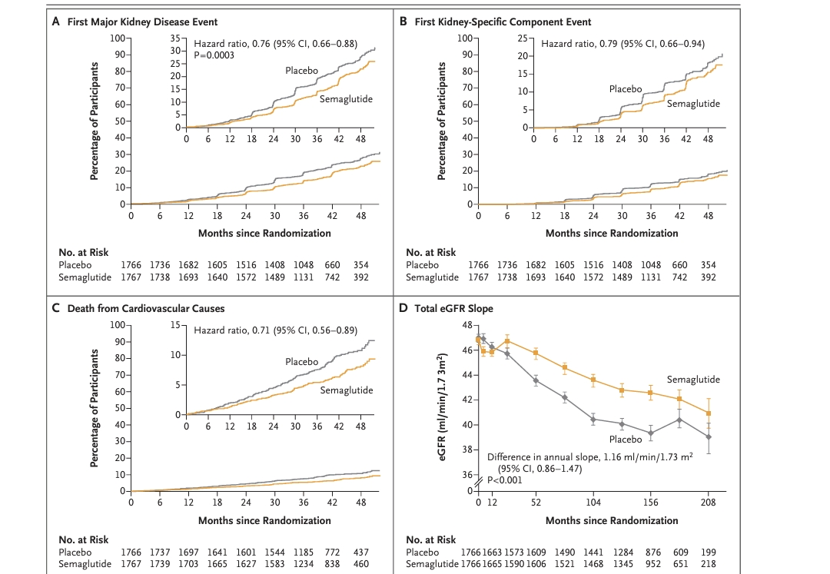

Slide 11
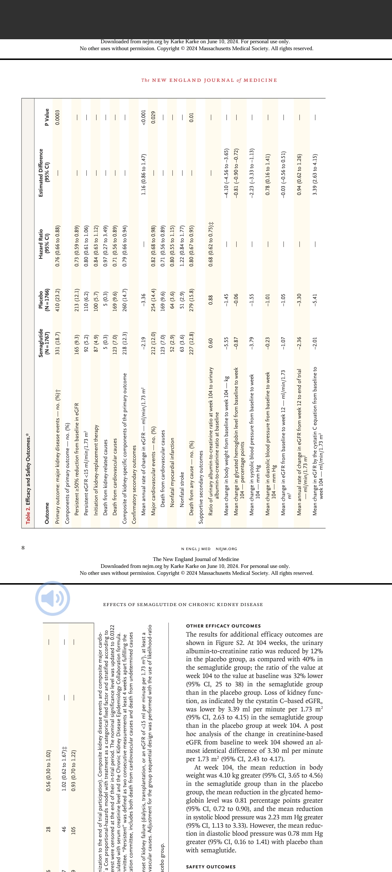

Slide 12
OUTCOME COMPARISON :-
S.NO | outcome | semaglutide | placebo
1 | More than 50% reduction in eGFR from baseline | 165 patients | 213 patients
2 | Need for renal replacement therapy | 87 patients | 100 patients
3 | Death from CVS cause | 123 deaths | 169 deaths
4 | Non fatal MI | 52 patients | 64 patients
5 | Mean fall in eGFR per year (ml/min/1.73m2) | 2.19 | 3.36
6 | Mean reduction in body weight | 5.55 kg | 1.45kg
7 | Mean reduction in glycated hemoglobin | 0.8% | 0.06%

Slide 13
Conclusion :-
In this trial, semaglutide reduced the risk of clinically important kidney outcomes, major cardiovascular events, and death from any cause in participants with type 2 diabetes and chronic kidney disease.

Slide 14
Safety :-
Fewer participants in Semaglutide group reported to have
eye disorders
blurring of vision,
worsening of diabetic retinopathy and
macular complication.
Permanent discontinuation of semaglutide mainly due to GIT disorders:-
abdomen pain,
Nausea & vomiting.
Pancreatitis
Gall bladder disease.

Slide 15
Limitation :-
Semaglutide or placebo was permanently discontinued by 26% of participants during the trial, with adherence to the trial regimen averaging 89% of the planned time during the trial period.
Adverse events leading to permanent discontinuation were more common in the semaglutide group than in the placebo group, mainly because of GIT disorders (79 [4.5%] vs 20 [1.1%]).

Slide 16
THANK YOU.

