Slide 1
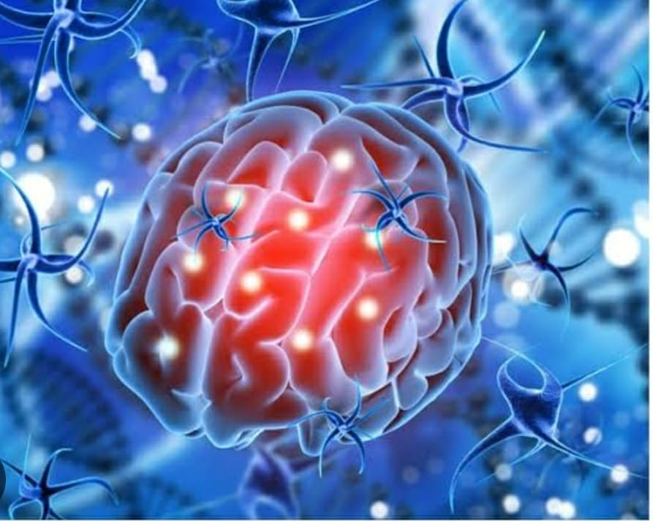
BY IMCU hod & CHIEF prof: DR. M.NATARAJAN MD
chief prof: DR. ALAGUVENKATESAN MD
ASST PROF : DR. V.PALANiKUMARan MD D.DIAB
PRESENTOR: DR.t.m.JEYaLAKSHMI (2nd yr pg )
ZOSTER’S BAD TOUCH

Slide 2
CHIEF COMPLAINTS
A 16 year old male patient was referred from kariapatti PHC with complaints of altered sensorium for 1 day
HOPI
Patient was apparently normal before 10 days, then he developed vesicles over right side of upper chest, axilla and medial aspect of arm on 18/8/24 ,for which he went to private hospital on 21/8/24 where he was treated with T. Valacyclovir 1g TDS for 5 days
then he had irrelevant talk for 4 days
h/o hesitational suicidal cut over left wrist
h/o altered sensorium for 1 day
Then he was taken to kariapatti PHC, from where he was referred to GRH Madurai for further management

Slide 3
H/o sleep disturbances
H/o visual hallucination at presentation
No h/o fever
No h/o seizure before hospitalisation
No h/o abnormal movement like hand picking, lip smacking, frequent blinking , crying and laughing, oro facial twitching
No h/o aerophobia, hydrophobia
No h/o dog bite
No h/o recent vaccination

Slide 4
No h/o any speech disturbance
no H/O difficulty in turning head side to side
No H/O difficulty in head rising
No H/O sensory disturbance
No H/O loss of sense of smell
No H/O double vision, difficulty in eye movements
No H/O sensory loss over the face, difficulty in chewing
No H/O hard of hearing, vertigo and tinnitus
No H/O difficulty in tongue movements

Slide 5
PAST H/O
H/o viral exanthem developed at 3 years of age
H/o recurrent upper RTI present since 8 years of age, for which he was treated at local hospital symptomatically at op basis
H/o nasal polyp diagnosed at 9 years of age for which he was treated at local hospital symptomatically,
Not k/c/o DM/SHTN/TB/BA/Epilepsy/Thyroid disorder
No h/o Mumps in his childhood

Slide 6
PERSONAL H/0
mixed diet
bowel and bladder habits normal
no addictive habits
FAMILY H/o
no h/o any similar illness in his family members
BIRTH H/O
Term, Normal vaginal delivery, postnatal period uneventful.
CHILDHOOD VACCINATION H/O: he received routine vaccination till his 5 years of age
VZV vaccination status not known

Slide 7
General examination
Patient is irritable
partially obeying oral commands
responding to pain
afebrile
moderately built and nourished
elongated face, high arched palate, open mouth appearance
No pallor/pedal odema/cyanosis/clubbing/generalised lymphadenopathy
No neurocutaneous markers
No external markers of TB/HIV

Slide 8
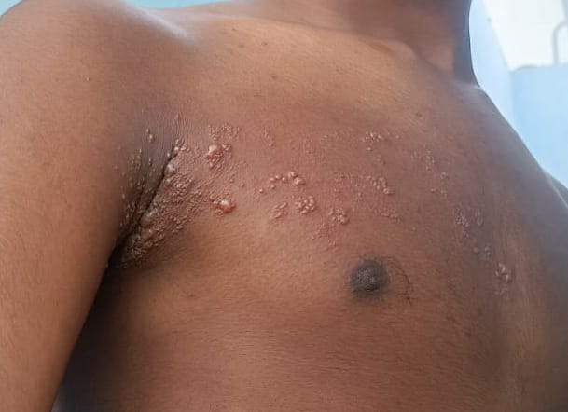
General examination
Multiple group of vesicles seen over right side of upper chest, axilla and medial aspect of arm
few crusted vesicles seen over right side of upper chest

Slide 9
VITALS
BP 110/70 mmhg
PR 88/min
SPO2: 98 % RA
temp 97* F

Slide 10
SYSTEMIC EXAMINATION
CNS: Patient is irritable, partially obeying oral commands
responds to painful stimuli
bilateral pupil 2.5mmRTL, B/L EOM – normal
no nystagmus
No neck stiffness
B/L corneal reflex present
B/L fundus examination – normal

Slide 11
Cns
Motor system: power could not be elicted
Bilateral plantar flexor
Kernig and Brudzinski sign negative
Tone | right | left
Upper limb | normal | normal
Lower limb | normal | normal
DTR | RIGHT | LEFT
Upper limb | + | +
Lower limb | + | +

Slide 12
Other system examination
CVS – s1, s2 heard. Apical impulse felt at right 5th ICS, No murmur heard
RS- bilateral AE present, No added sound
P/A - soft, non tender, BS heard, lower edge of liver palpable in left hypochondrial region

Slide 13
investigationS
 | 29/8/24 | 30/8/24
TC | 18,100 | 11,000
DC | 90.9/5.3/3.8 | 89.9/6.7/3.4
HB | 11.8 | 12.4
PLATELET | 2,47,000 | 2,48,000
UREA/CR | 22/1.0 | 17/1.0
TB/DB/IB | 0.8/0.3/0.5
OT/PT | 13/16/60
RBS | 109
NA/K | 130/3.5 | 135/3.5
ESR | 30mmhr
QCRP | 40mg/dl
S.Protein | 6.4g/dl
Albumin | 3.6g/dl
Globulin | 2.8g/dl
VCTC | NONREACTIVE
VM | NEGATIVE
VDRL | NONREACTIVE
TSH | EUTHYROID

Slide 14
Neuromedicine opinion

Slide 15
Dermatology opinion
IMP: Herpes zoster (T2-T3 dermatome)
Adv – to contiune Inj.ACYClOVIR
2%Muprocin ointment L/A BD

Slide 16
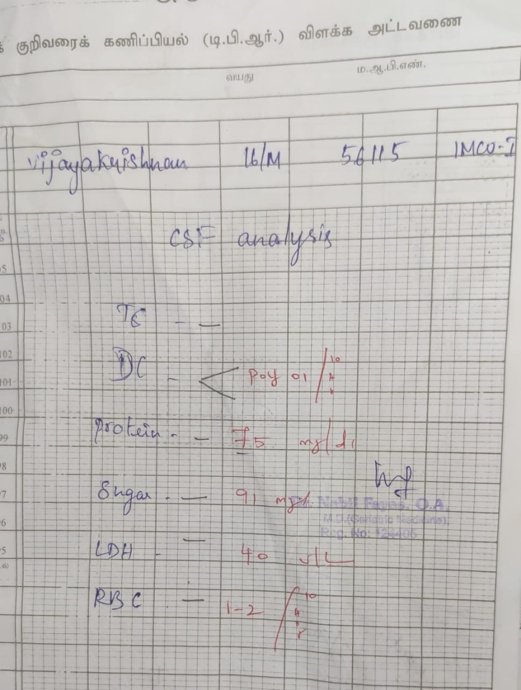
INVESTIGATION
CSF ANALYSIS: CBG – 110MG/DL

Slide 17
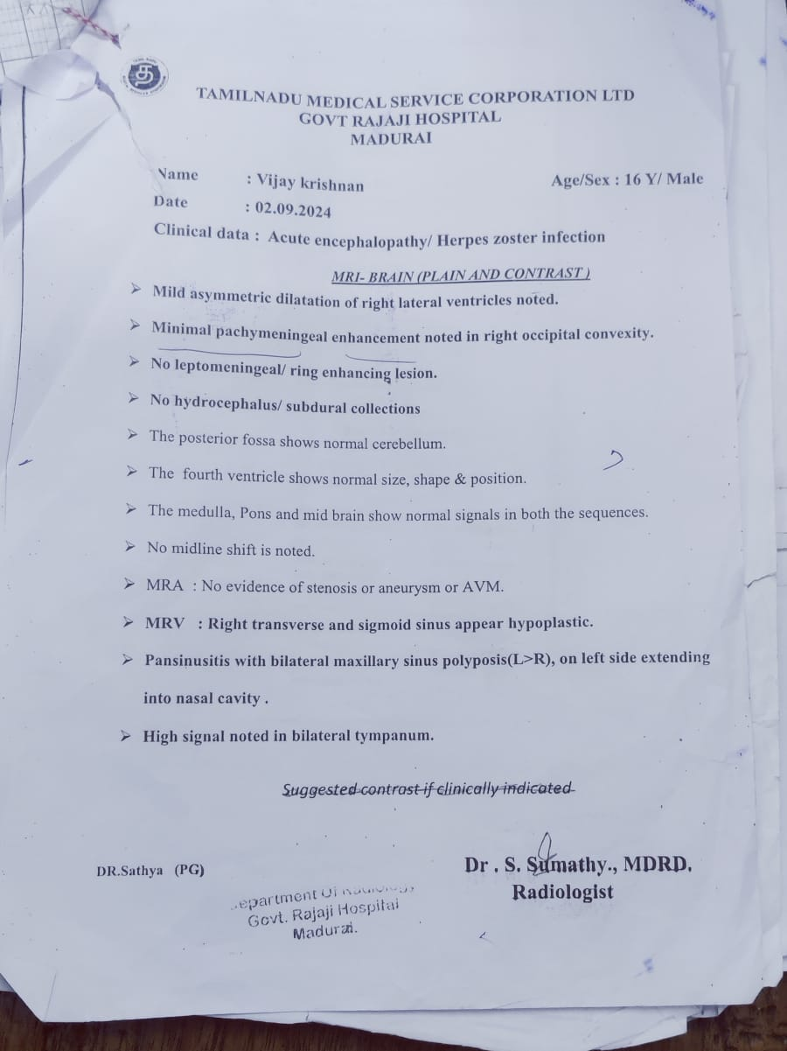
MRI BRAIN PLAIN AND CONTRAST

Slide 18
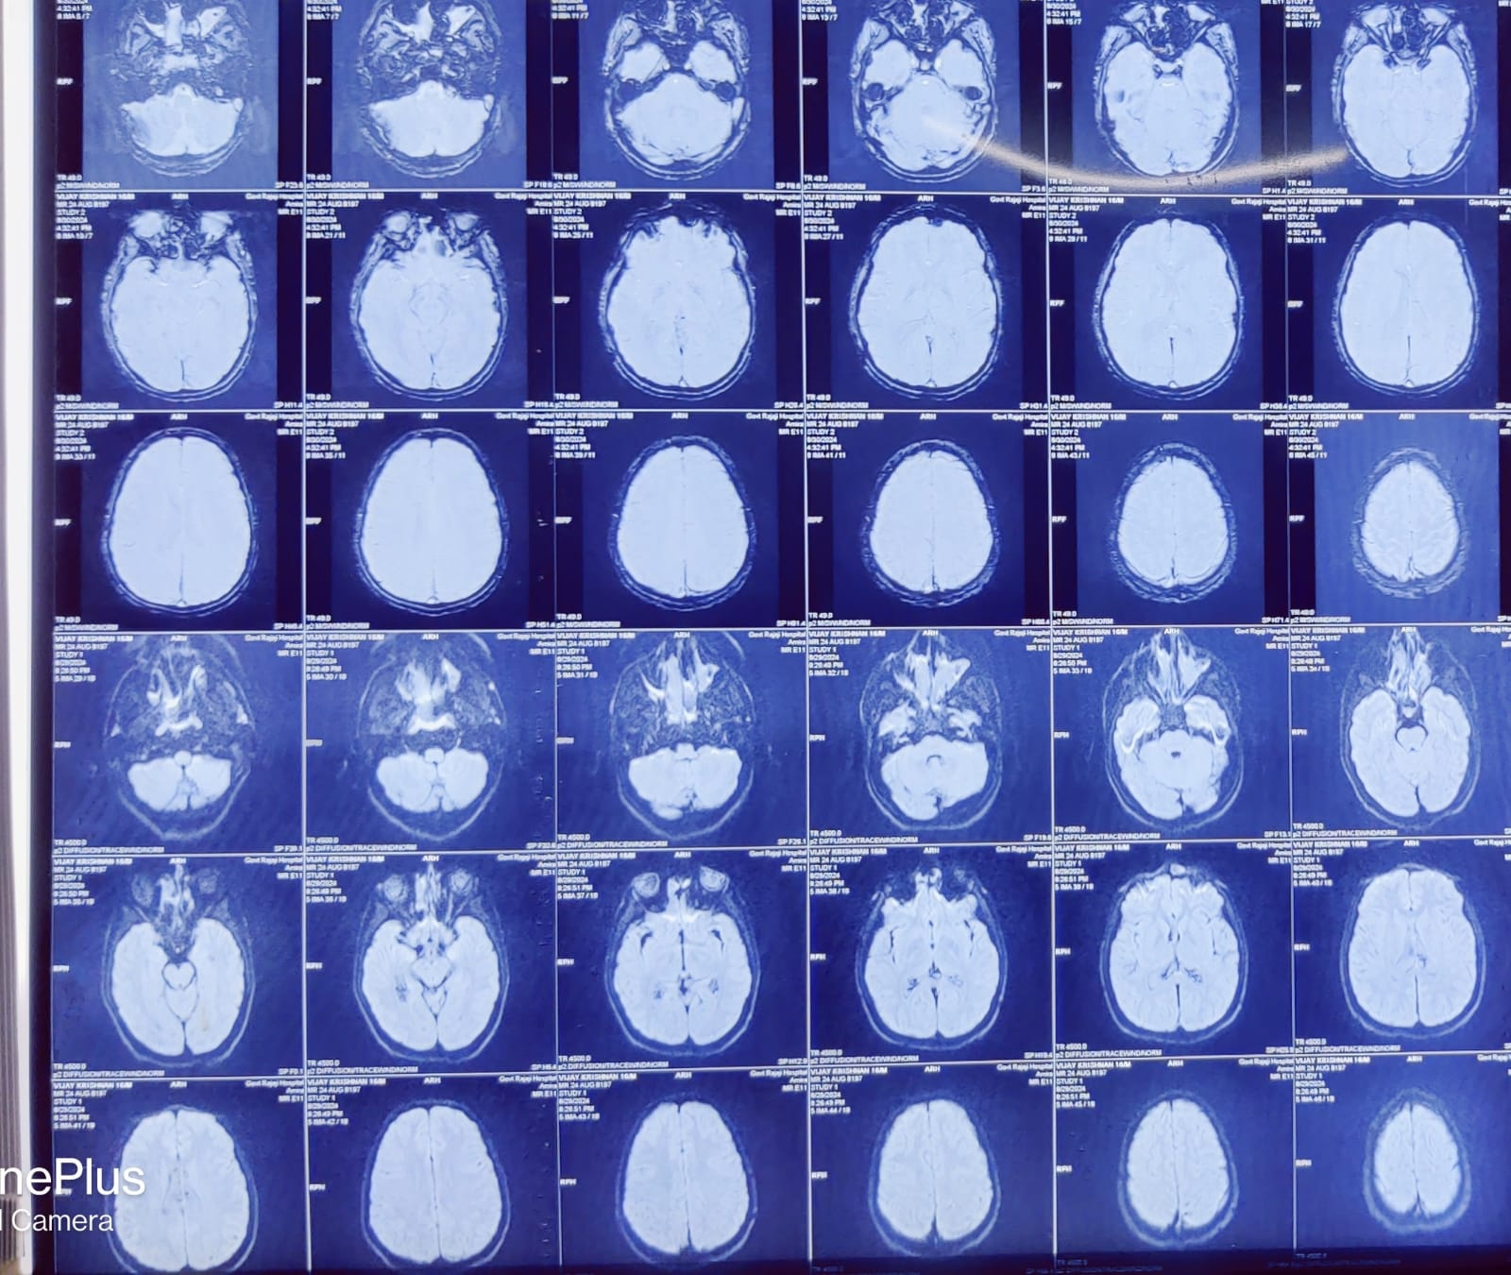

Slide 19
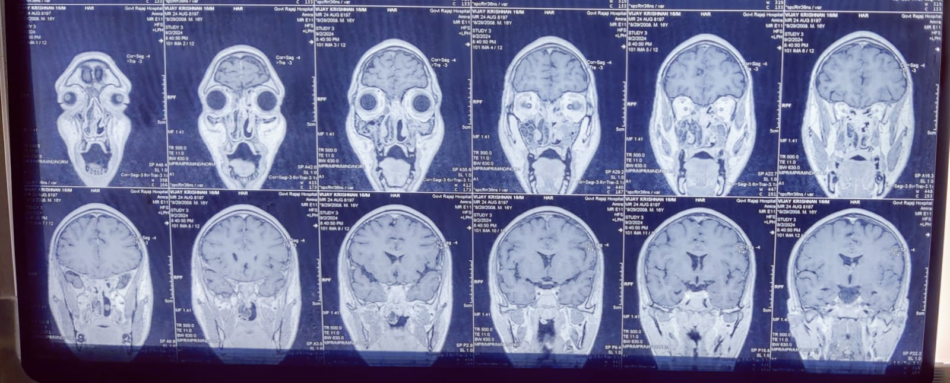

Slide 20
Csf vzv pcr

Slide 21
CSF culture – no growth
CSF HSV 1 &2 PCR – negative
CSF JE PCR – Negative
Tzanck smear – showed Acantholytic cells and Multinucleated Giant cells seen

Slide 22
Course in the imcu
In view of poor GCS , patient was intubated in IMCU on29/8/24, 0n 31/8/24 patient was self extubated
Post Extubation
patient was drowsy, responds to painful stimuli,
RS- crepts heard in left infra axillary area infra scapular area, decreased AE in left infra axillary and infra scapular area

Slide 23
Course In the imcu
Patient had visual hallucinations .
Patient had frequent staring episodes

Slide 24
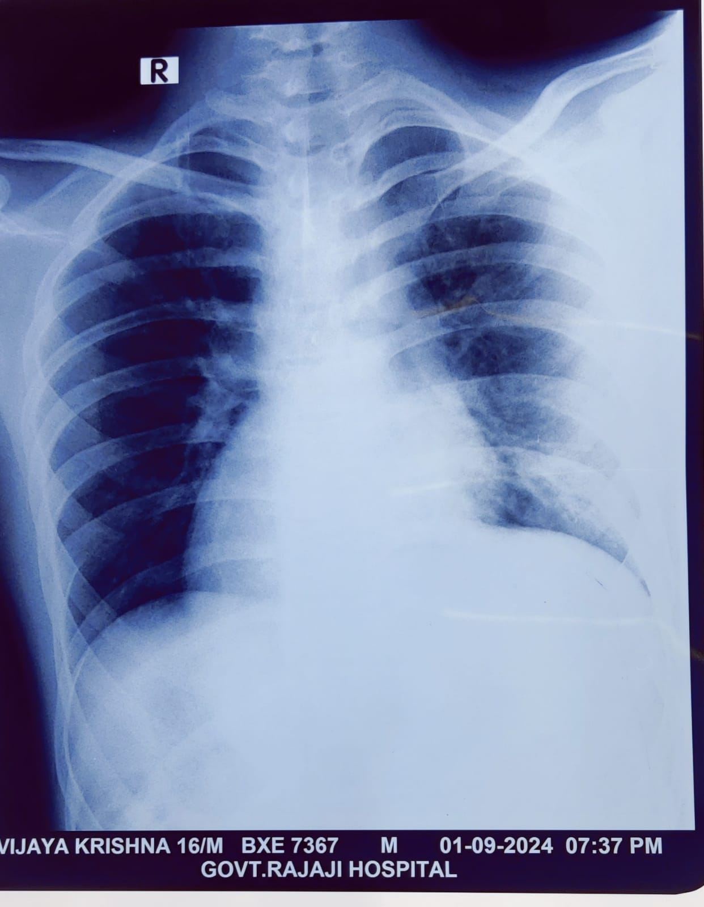

Slide 25
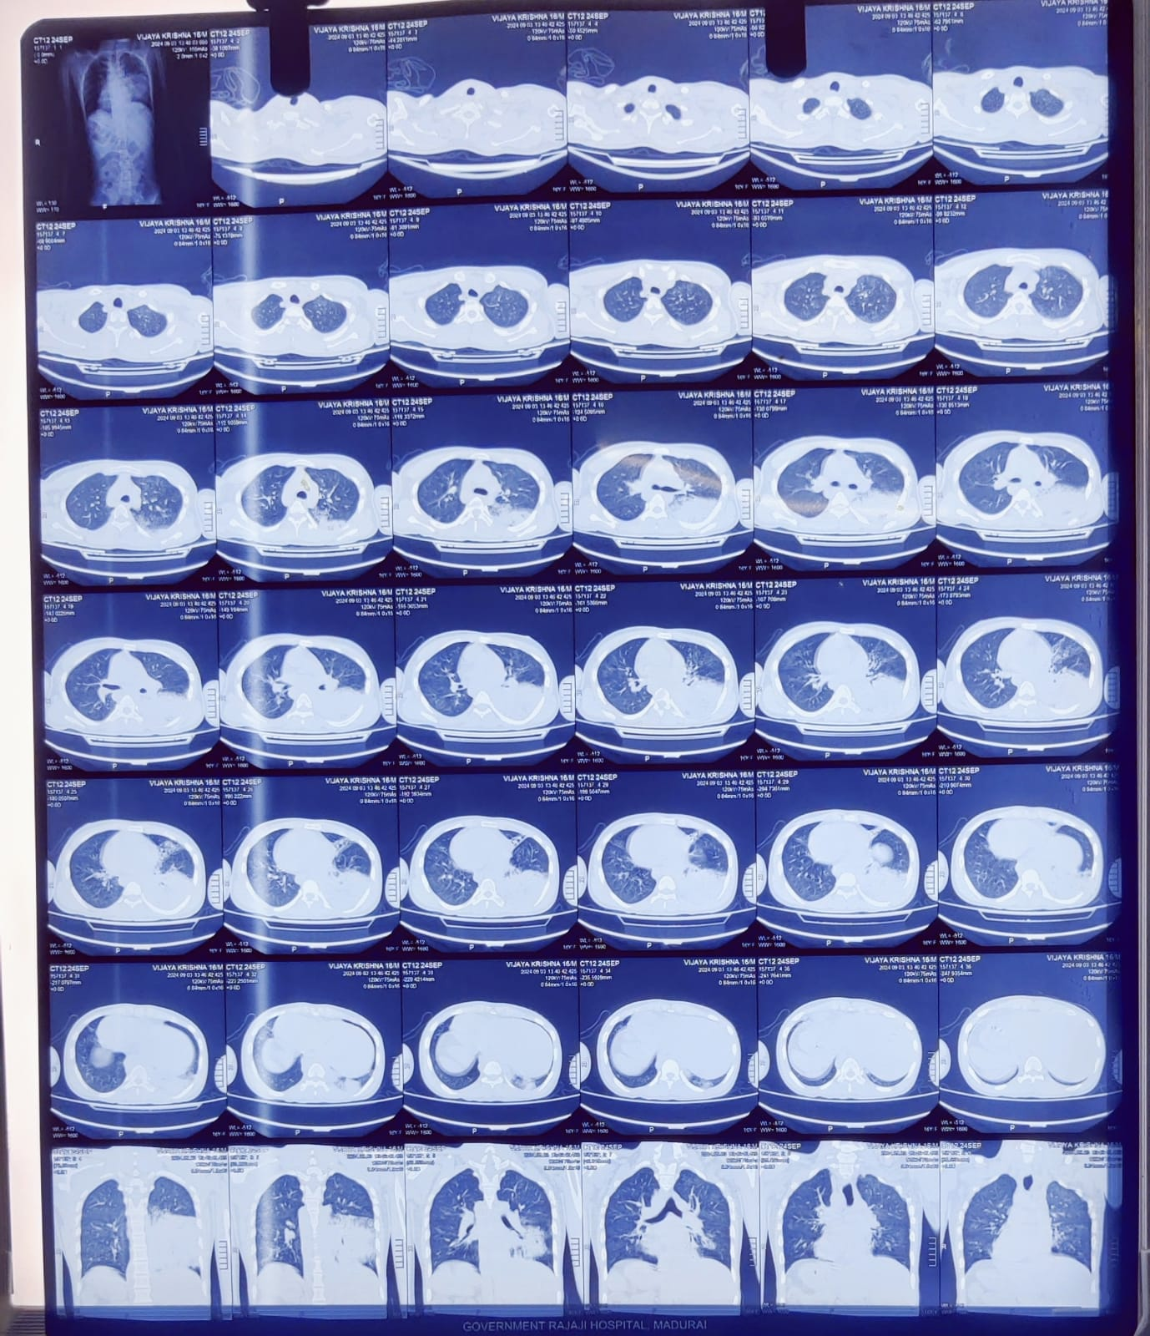
Ct chest
IMP- left LL Pneumonia
left middle lobe bronchiectatic changes
Dextrocardia
Situs inversus Totalis

Slide 26
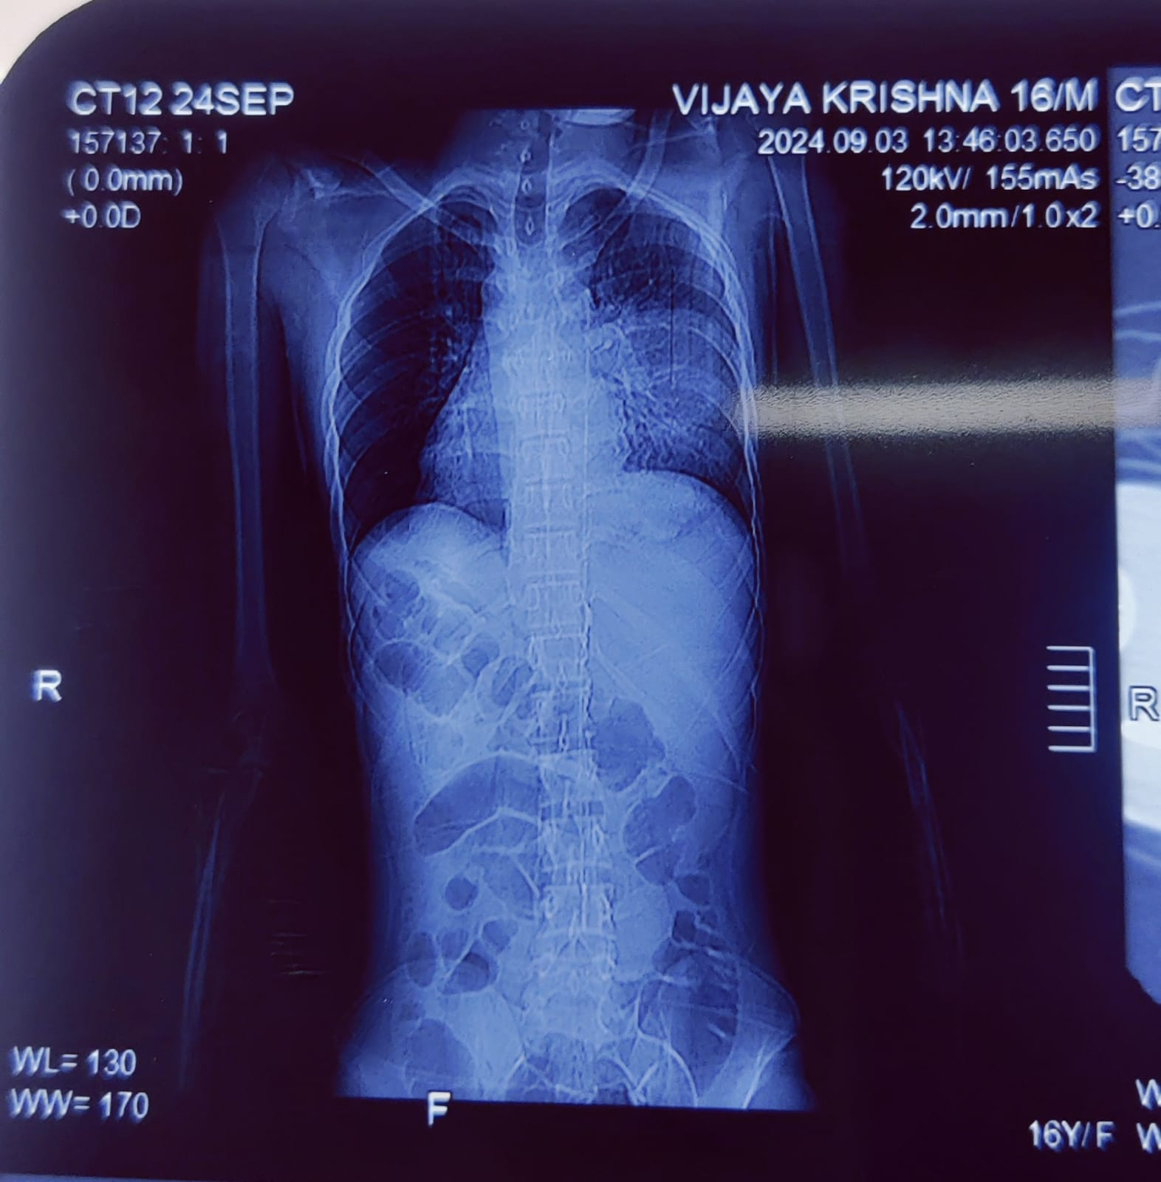

Slide 27
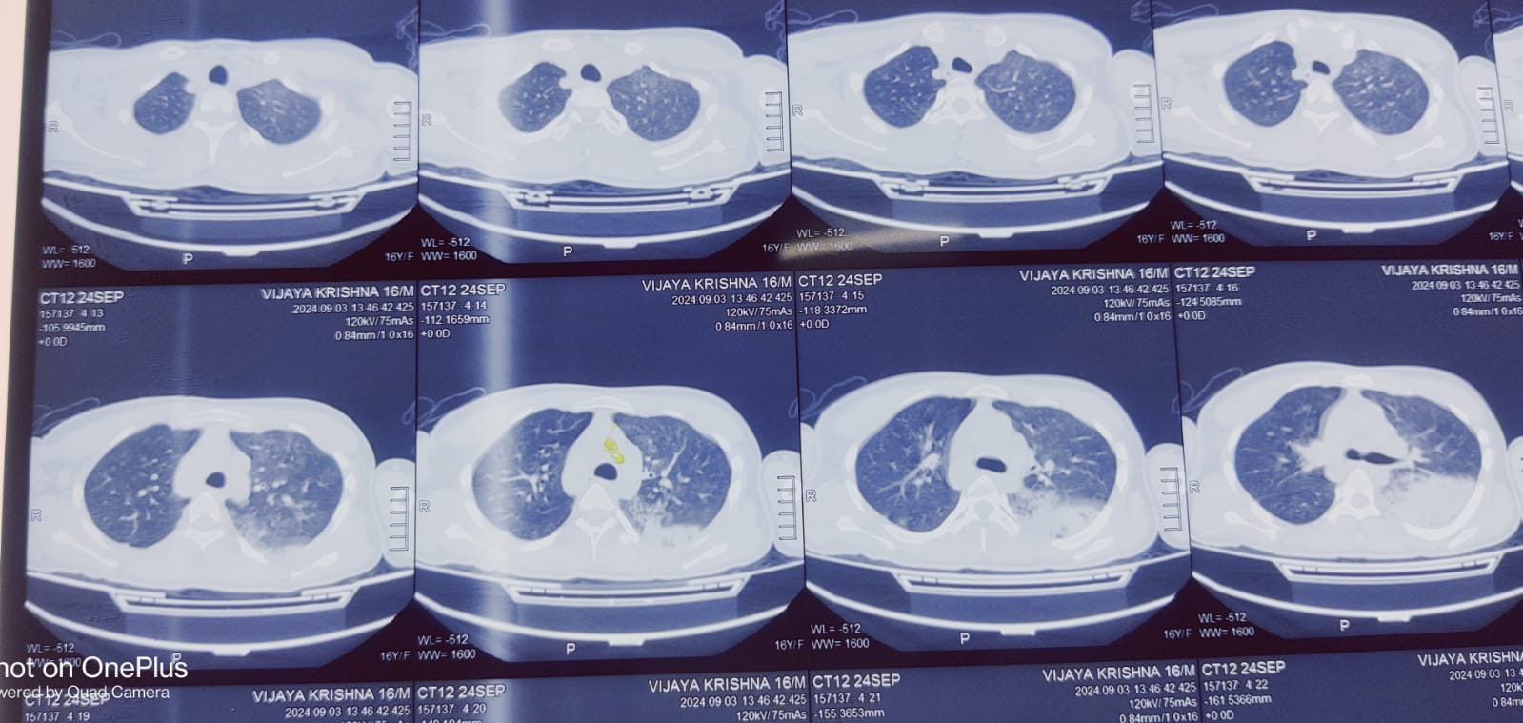

Slide 28
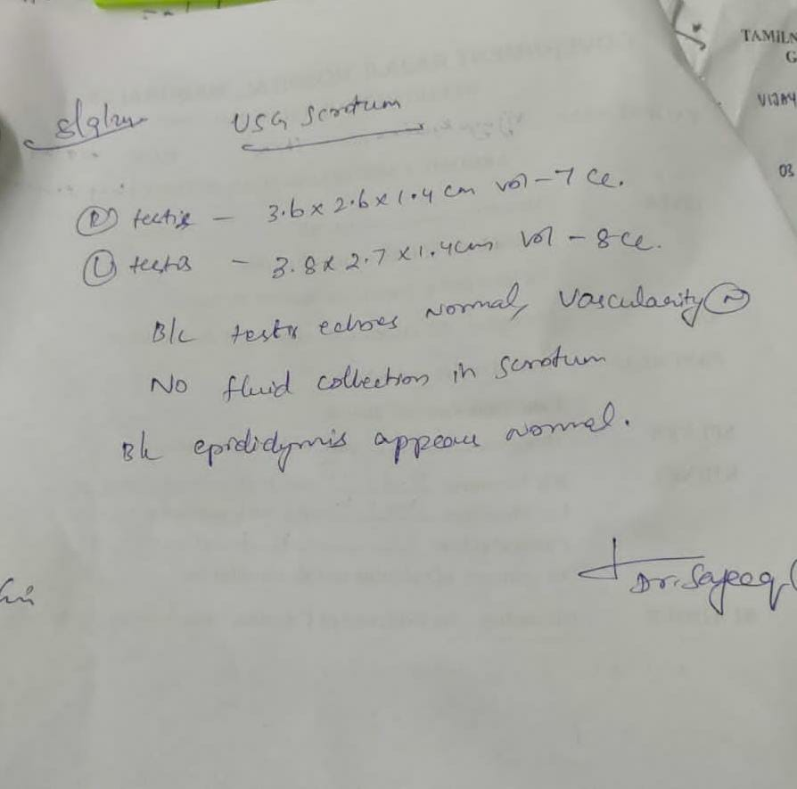
Usg abdomen and scrotum

Slide 29
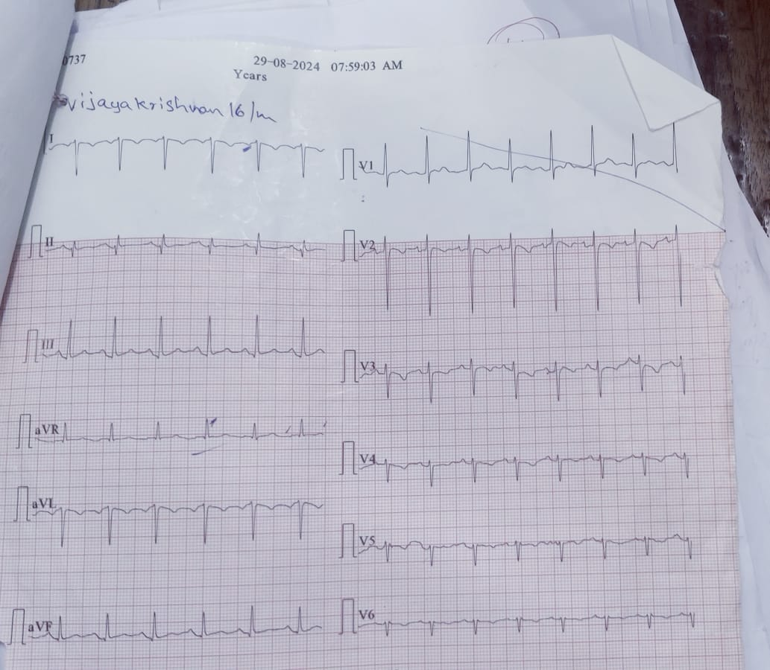
ecg

Slide 30
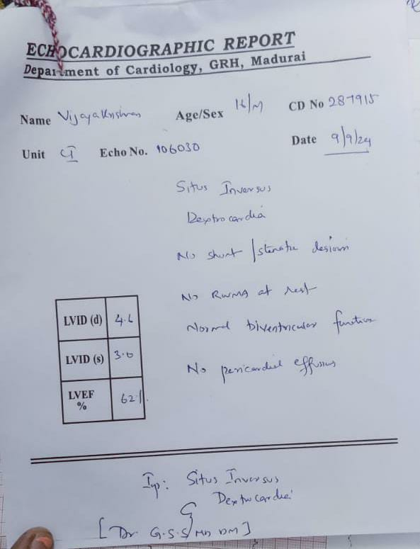
echo

Slide 31
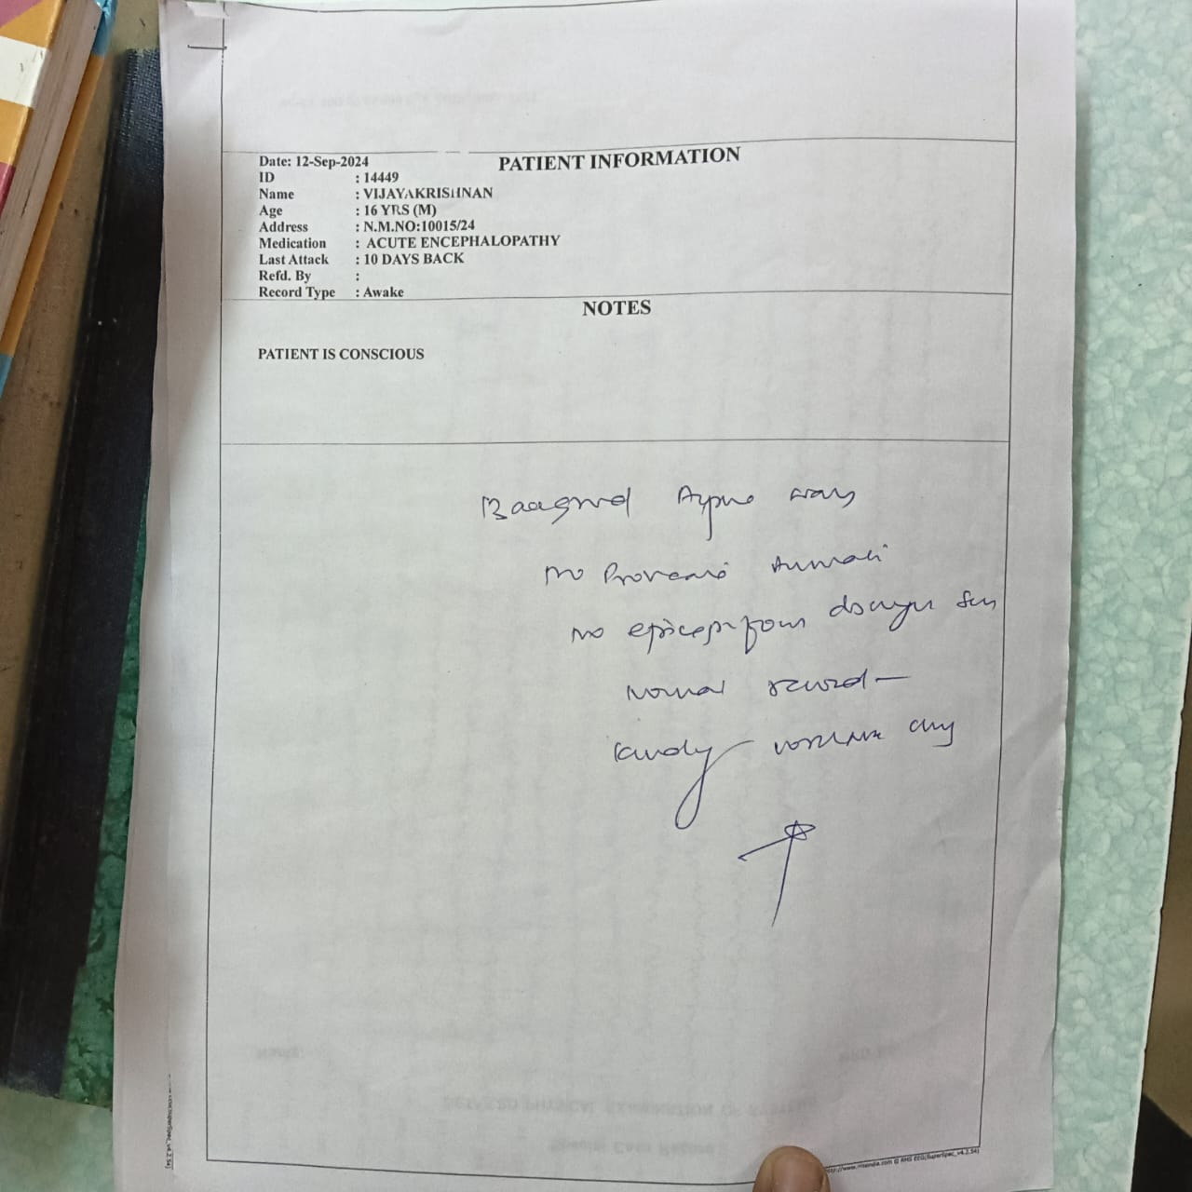
EEG

Slide 32
Psychiatry opinion
IMP : Acute confusional state (?ACUTE CNS INFECTION)
Adv – Inj.haloperiodol 0.5ml im sos
Inj.Lorazepam 2ml im sos

Slide 33
Thoracic opinion
Imp : left LL consolidation (?bacterial ?Aspiration)
Adv: To continue antibiotics
Neb. Salbutamol TDS,
Neb.NAC TDS

Slide 34
Patient was treated with
Inj.Ceftriaxone 2gm iv BD, then esclated to
Inj.Piperacillin Tazobactam 4.5g iv TDS
Inj.Acyclovir 600mg iv tds
inj.Levitiracetam 500mg iv tds
Inj.Dexamethasone 8mg iv tds
Neb. salbutamol TDS
Neb. NAC TDS

Slide 35
After 14 days of antiviral coverage, patient had persistant staring episodes and visual hallucination.
O/E :Awake ,
partially obeys oral commands
bilateral pupil2.5mmRTL,afebrile
vitals BP-110/80mmhg
PR -80/min
spo2 -99%in RA

Slide 36
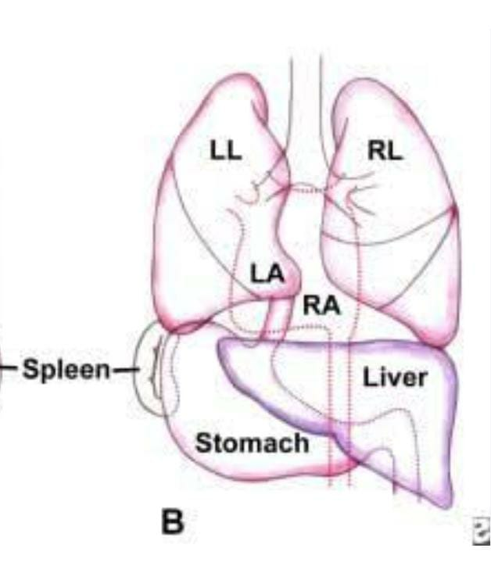
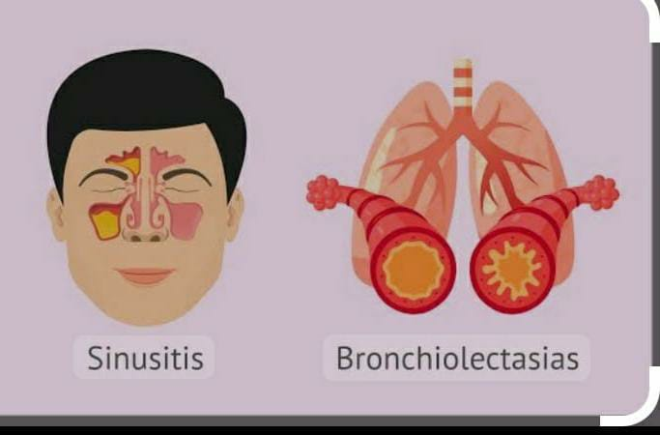
FINAL IMPRESSION
KARTAGENER SYNDROME
T2-T3 DERMATOMAL HERPES ZOSTER
ACUTE ENCEPHALITIS
LEFT LL PNEUMONIA (aspiration)

