Slide 1
EATING DISORDER
By 4TH MEDICAL UNIT
CHIEF PROF.DR.S.PEER MOHAMED M.D
ASST PROF DR.M.SATHEESHKUMAR M.D
DR.C.VIGNESH M.D
DR.V.P.PRIYA M.D

Slide 2
ANOREXIA NERVOSA :-
Characterized by three essential criteria.
Self induced Restriction of energy intake (low body weight)
Fear of gaining weight
Disturbance in the way, in which one’s body weight or shape is experienced.
Occurs
Most commonly – adolescent girls and young women (10:1)
Rarely – adolescent and young men, older women up to menopause

Slide 3
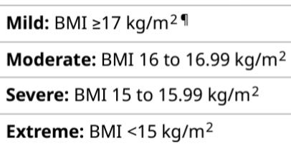

Slide 4
Restricting type: During the last 3 months, the individual has not engaged in recurrent episodes of binge eating or purging behavior ie. weight loss is accomplished through
dieting,
fasting, and
excessive exercise.
Binge-eating/ purging type: During the last 3 months, the individual has engaged in recurrent episodes of binge eating or purging behavior
self-induced vomiting or
the misuse of laxatives, diuretics, or enemas.

Slide 6
Course and Prognosis
Range of mortality rates - 5 to 18 percent.
Suicide risk - 12 per 1,00,000 per year
Indicators of a favourable outcome are
admission of hunger,
lessening of denial and immaturity, and
improved self-esteem.
Associated with
depression - 65 percent ,
social phobia - 35 percent , and
obsessive-compulsive disorder - 25 percent

Slide 7
MEDICAL COMPLICATIONS :-
Vital signs - Bradycardia, hypotension with marked orthostatic changes, hypothermia
General - Muscle atrophy, loss of body fat, carotenemia
Central nervous system - Generalized brain atrophy with enlarged ventricles, decreased cortical mass, seizures, abnormal electroencephalogram
Renal - Prerenal azotemia
Electrolyte - hypokalemia, hyponatremia, hypochloremia and alkalosis

Slide 8
Hematologic - Anemia of starvation, leukopenia, hypocellular bone marrow
Metabolic - hypoglycemia, elevated liver enzymes, decreased bone mineral density
Electrocardiographic (ECG) - T wave :flattening or inversion, ST segment depression, and lengthening of the QT interval in the emaciated stage. ECG changes may also result from potassium loss, which can lead to death.
Aortography may show a superior mesenteric artery syndrome

Slide 9
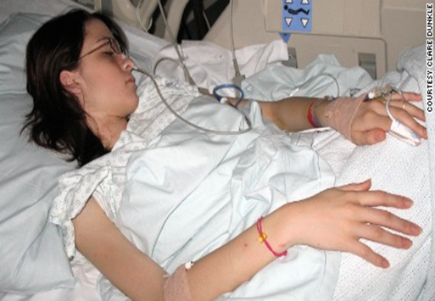
TREATMENT :-
To restore patients' nutritional state; dehydration, starvation, and electrolyte imbalances
20 % below the expected weight - Compulsory admission - only when the risk of death from the complications of malnutrition is likely
Most patient treated on the OPD basis.

Slide 10
Cognitive-Behavioral Therapy
Taught cognitive restructuring to identify automatic thoughts and to challenge their core beliefs.
Problem solving - patients learn to devise strategies to cope with their food-related and interpersonal problems.
Dynamic Psychotherapy
Therapists empathize with patients' points of view and take active interest in what their patients think and convey to patients that their autonomy is respected
Family Therapy
Maudsley method – parents take responsibility of refeeding their eating disordered child with the therapist’s support

Slide 11
PHARMACOTHERAPY :-
SSRIs
Atypical antipsychotics – Olanzapine
Cyproheptadine - antihistaminic and antiserotonergic properties -restricting type of anorexia nervosa.
Amitriptyline - some benefit.
Other medications that have been tried with variable results include
Clomipramine
Pimozide
Chlorpromazine

Slide 12
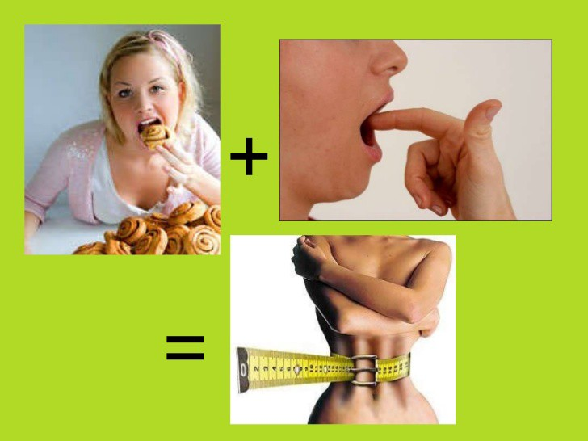
BULIMIA NERVOSA :-
Episodes of binge eating → physical discomfort such as abdominal pain or nausea → terminates binge eating → feelings of guilt, depression, or self-disgust → compensatory behaviours, such as purging or excessive exercise.
Unlike patients with anorexia nervosa, those with bulimia nervosa typically maintain a normal body weight.
Prevalence - 1 to 4 percent of young women
More common in women than in men (10:1)

Slide 13
DSM -5 BULIMIA NERVOSA :-
a) Recurrent episodes of binge eating characterized by both of the following:
1. Eating (e.g., within any 2-hour time period), an amount of food that is definitely larger than what most individuals would eat in a similar period of time under similar circumstances.
2. A sense of lack of control over eating during episode.
b) Recurrent inappropriate compensatory behaviours in order to prevent weight gain, such as self-induced vomiting; misuse of laxatives, diuretics, or other medications; fasting; or excessive exercise.
c) Occur at least once a week for 3 months.
d) Self-evaluation is unduly influenced by body shape and weight.
e) The disturbance does not occur exclusively during episodes of anorexia nervosa.

Slide 14
COMPLICATIONS :-
Dehydration and electrolyte disturbances - who purge regularly.
Hypomagnesemia, hypokalemia,hyponatrmia, hyperamylasemia.
Myocardial toxicity – from emetine
Russell sign - calluses on knuckles from teeth scraping, “moth-eaten” look of teeth, loss of dental enamel
Menstrual disturbances.
Hypotension and bradycardia

Slide 15
TREATMENT :-
Hospitalization
When associated with suicidality and substance abuse
electrolyte and metabolic disturbances resulting from severe purging
Psychotherapy
CBT - 18 to 20 sessions over 5 to 6 months.
(1) interrupt the self-maintaining behavioral cycle of binging and dieting and
(2) alter the individual's dysfunctional cognitions
Dynamic Psychotherapy - limited success.
Integrative Cognitive-Affective therapy
Pharmacotherapy
SSRI, TCA, MAOI, Topiramate in comorbid depression
Carbamazepine and lithium in comorbid bipolar I disorder
Bupropion is contraindicated – risk of seizures

Slide 16
BINGE EATING DISORDER :-
Occurs in
50 to 75 percent of those with severe obesity (BMI > 40).
More common in females - 4 % than in males - 2 %. (1.75:1)
DSM 5
Recurrent episodes of binge eating. An episode of binge eating is characterized by both of the following:
1. Eating within any 2-hour period, an amount of food that is definitely larger than what most people would eat in a similar period of time under similar circumstances.
2. A sense of lack of control over eating during the episode

Slide 17
b) The binge-eating episodes are associated with
1. Eating much more rapidly than normal.
2. Eating until feeling uncomfortably full.
3. Eating large amounts of food when not feeling physically hungry.
4. Eating alone because of feeling embarrassed by how much one is eating.
5. Feeling disgusted with oneself, depressed, or very guilty afterward.
Marked distress regarding binge eating is present.
The binge eating occurs, on average, at least once a week for 3 months.
The binge eating is not associated with the recurrent use of inappropriate compensatory behaviour as in bulimia nervosa and does not occur exclusively during the course of bulimia nervosa or anorexia nervosa.

Slide 18
TREATMENT :-
Psychotherapy
CBT, DBT
Interpersonal psychotherapy
Self help groups
Overeaters Anonymous (OA) and Weight Watchers can be extremely helpful
Pharmacotherapy
SSRI,
TCAs,
Topiramate
Sibutramine
Lisdexamfetamine – FDA approved

Slide 19
THANK YOU

